Slide 1
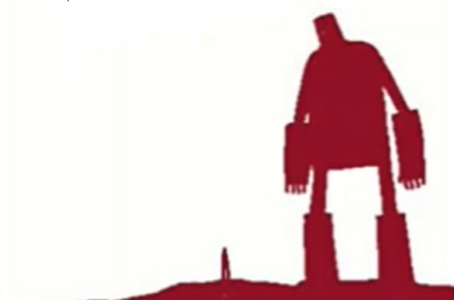
The Iron Man
Lesson 19

Slide 2
LO: To write my extension to the story.
YR2
Success criteria:
I can use my plan to help with my writing.
I can use expanded noun phrases.
I can use inverted commas to show speech.

Slide 3
LO: To write my alternative ending to the story.
YR3 core
Success criteria:
I can use my plan to help with my writing.
I can use fronted adverbial phrases.
I can use inverted commas to show speech.

Slide 4
LO: To write a story based on the structure of another.
YR3 challenge
Success criteria:
I can write coherently using my plan as support.
I can use inverted commas to show speech.
A climax is reached relating to the problem.

Slide 5
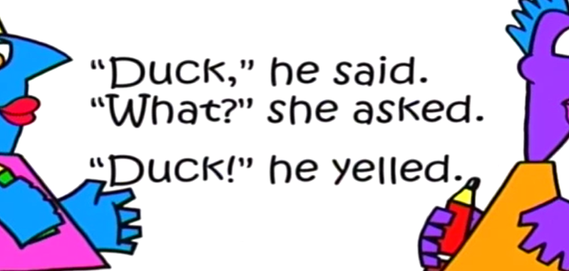
Using Speech Marks
Speech marks - KS2 English - BBC Bitesize

Slide 6
Starter
Can you write these sentences correctly using the right punctuation. (Speech marks, commas, full stops)
Happy birthday she said
What is that lucy asked
The woman exclaimed hello
Notes:
Remind chn that punctuation needs to go inside of speech marks e.g. “Happy birthday,” she said.

Slide 7
Expanded noun phrases
Using two adjectives and a noun to describe something.
The large, square sandwich.
A red, rusty lorry.
Can you write your own expanded noun phrases.

Slide 8
Fronted adverbial phrases
A phrase at the start of a sentence that gives us more information about the verb (doing word). This clause is separated by a comma. e.g.
Quietly and quickly, he dusted off the crumbs on his lap before his mum saw!
With all the air in his lungs, he let out a huge roar.
Can you write your own fronted adverbial sentence.

Slide 9
Extension to story:
After the space-bat-angel-dragon was banished from planet Earth, the whole world cheered. The people no longer fought each other and instead they sang peaceful songs. As for the Iron Man, he went back to his scrap metal yard. He was greeted with all the metal he could imagine. All the scraps from the bombs and missiles were gifted to him like candy, wrapped with pretty bows and decorative ribbons. The Iron Man was overjoyed.
“You can talk!” Hogarth exclaimed. “But why didn’t you speak to me before?” he asked.
“Well,” said the Iron Man, “I was afraid.”
“Afraid of what?” asked Hogarth. “We said we were sorry for trapping you. I came to visit you and you never said a word.”
The Iron Man paused for a moment before answering.
“We can be friends now if you like, and I can tell you the story of how I came to Earth.”
Notes:
Examples of extension to read through.

Slide 10
Alternative ending:
The space-bat-angel-dragon and the Iron Man stood face to face.
“Well,” said monster, “what test of strength do you have for me?” The Iron Man thought hard for a moment. He wanted to defeat the monster so badly, but he didn’t want to hurt himself in the process.
“I have a challenge,” he said finally. “We will both sit on a fire, and whoever can stay on the fire for the longest will win.” The Iron Man thought this was a good challenge, but the space-bat-angel-dragon was too clever and had already thought of a way to guarantee his win.
“Sounds easy to me,” said the dragon.
“But to make it a fair test, we can only change one variable, if we change the person sitting on the fire, everything else has to be the same.”
“That seems fair,” the Iron Man agreed. The monster laughed. He had realized that a fire big enough to hurt the Iron Man would do absolutely nothing to him!
Notes:
Example of alternative ending to read.

Slide 11
My own story:
The dragon woke with a startle.
“What was that?” he asked his mother.
“Go back to sleep dear, it’s just the Earthlings again. They’re being noisy. Just ignore them.” But the monster could not just ignore his mother or the Earthlings. As he stared out of the cave entrance, he thought about what life might be like outside of his realm. He wanted to join in with the Earthlings and their fun. It sounded so much better than singing all day. He could hear the excitement in their noisiness.
“I want to be part of that world,” the monster whispered to himself. “I need to go down and see what all of the noise is about.”
The monster thought long and hard about a plan.
“I know,” he said, to himself. “Tonight, I will fly down to Earth to join their fun. I will copy their ways and make friends.”
Notes:
Example of start of own story.

Slide 12
Narrative Writing Tick List
Year 2:
Capital letter and full stops.
Expanded noun phrases.
Characters are described using interesting adjectives.
Text is written chronologically.
Past tense.
Your story needs to follow on from the end of The Iron Man.
Year 3:
Capital letters and full stops.
Fronted adverbial phrases.
Characters are described using interesting adjectives.
Text is written chronologically.
Past tense.
Your story either changes the ending of the story from the battle between the dragon and TIM OR follows a similar structure.
Notes:
Are there any other non-negotiables that you can think of that we can add to our ticklist?

Slide 13
Your task
Year 2:
Your task is to write up the extension of your story. Remember to use your plan to help order events and make it interesting!
Year 3:
CORE: Your task is to write up your alternative ending to the story. Remember to use your plan to order your events and create a new ending.
CHALLENGE: You are going to write up your story about The Iron Man. Remember to include the key features from your hill e.g. a problem and a solution.
Notes:
Are there any other non-negotiables that you can think of that we can add to our ticklist?

Slide 14
The Iron Man: Word Mat
Iron Man space-bat-angel-dragon
Hogarth furnace scrap metal
Earth scorched music iron
wingbeats Australia writhing

