Slide 1

The Iron Man
Lesson 18

Slide 2
LO: To plan or say out loud my extension to the story.
YR2
Success criteria:
I can orally rehearse my plan.
I can plan an extension to the story.
I can use inverted commas to show speech.

Slide 3
LO: To plan or say out loud my alternative ending to the story.
YR3 core
Success criteria:
I can orally rehearse my plan with a partner.
I can plan an alternative ending to the story.
I can use inverted commas to show speech.

Slide 4
LO: To plan a story based on the structure of another.
YR3 challenge
Success criteria:
I can orally rehearse my plan with a partner.
I can plan my own story based on The Iron Man.
I can use inverted commas to show speech.

Slide 5
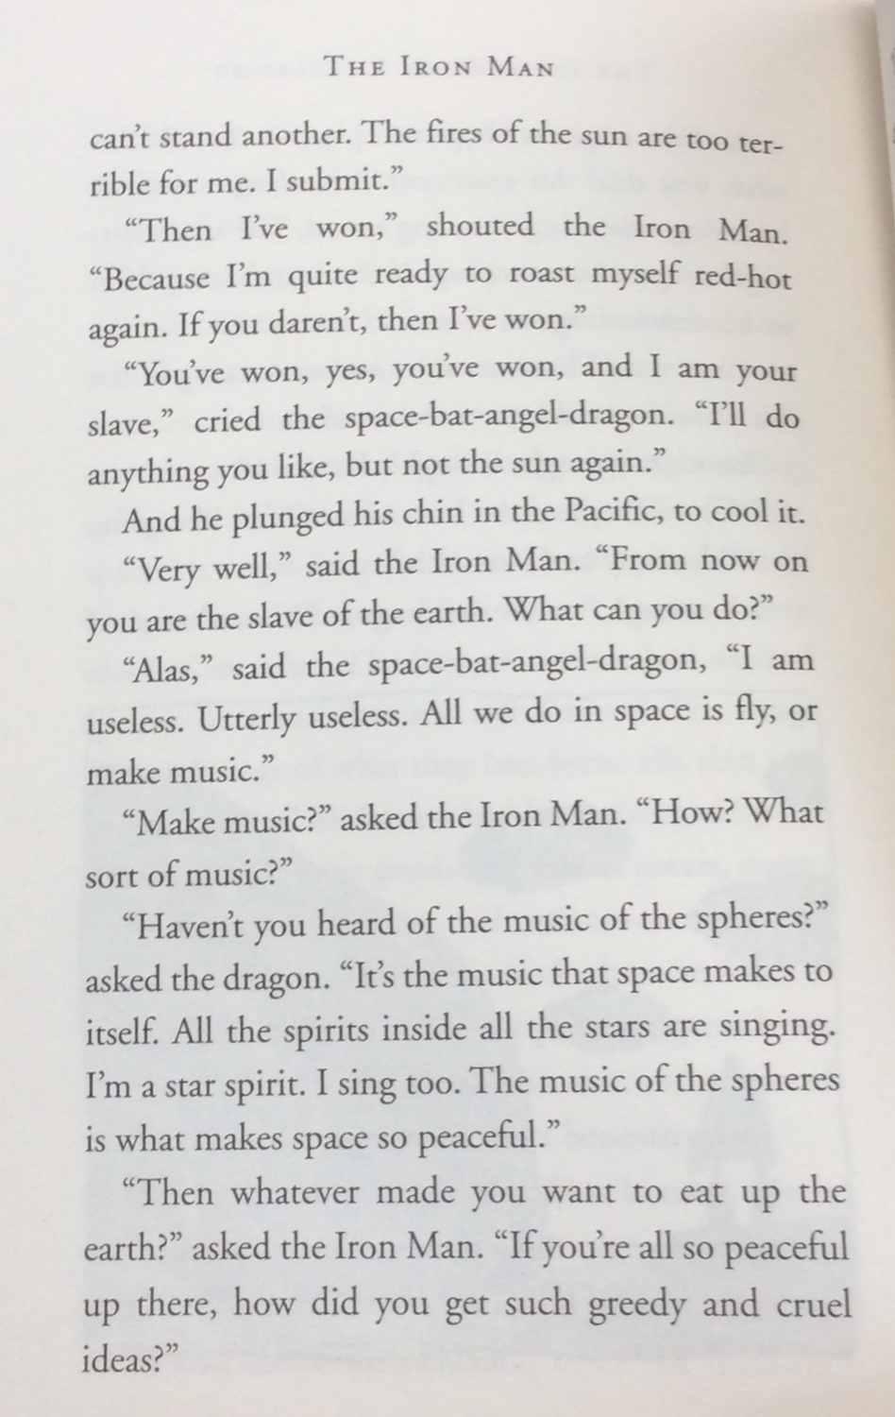
Starter
What do you notice about this extract from Chapter 5?

Slide 6
What do you notice about this extract from Chapter 5?
How can we tell when someone is speaking? What shows us?
What else do you notice about how conversation is written?
Can you write a sentence using speech marks to show direct speech (what is said)?

Slide 8
What happened in Chapter 5?
With a partner, recap what has happened in the last chapter of our book.
Did the ending surprise you?
Was your prediction close?
What do you think will happen next after the story has finished?

Slide 9
What might happen next?

Slide 10
What could have happened differently?

Slide 11
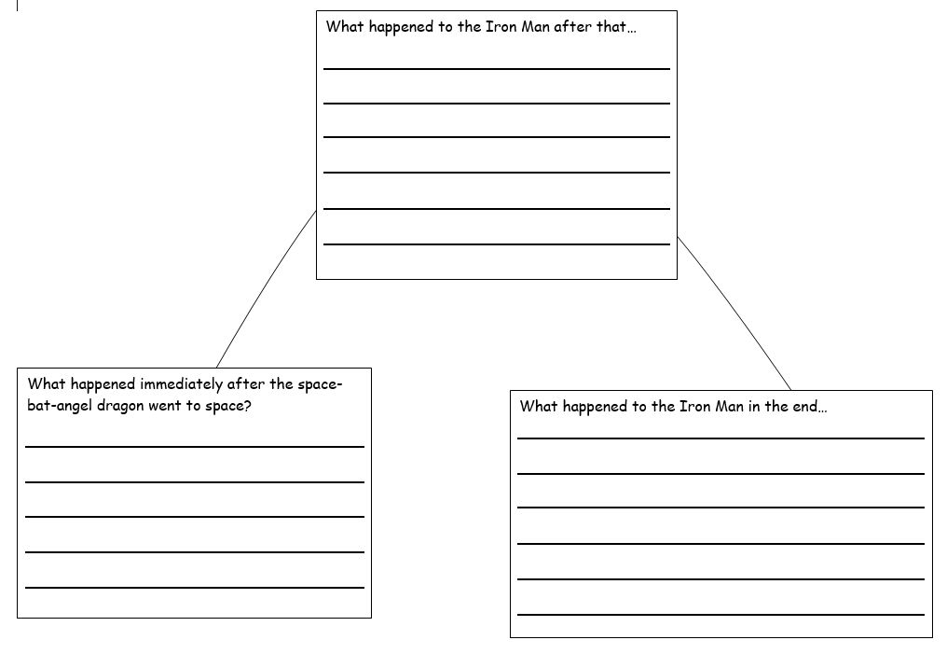
Year 2

Slide 12
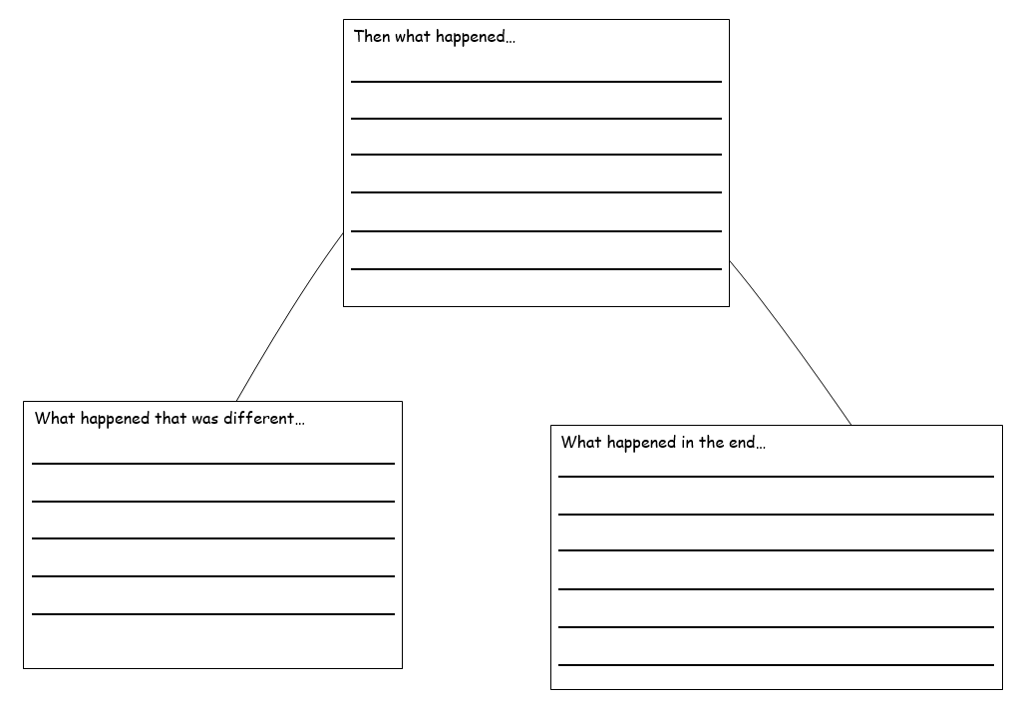
Year 3
Notes:
Y3 MA: Children working individually or with a partner to extend the story or write and alternative ending. Provide word mats/graphic organisers as appropriate to record plan.

Slide 13
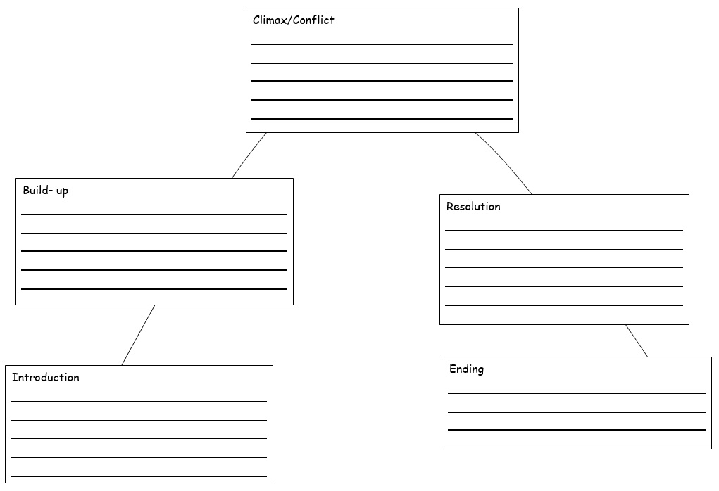
Year 3 challenge:
Notes:
Y3 HA: Encourage pupils to write their own version of this story, changing key details e.g. they may wish to write the story to explain how SBAD decided to come to Earth. Their story must have a clear beginning, middle and end. Provide topic vocabulary mat.

Slide 14
The Iron Man: Word Mat
Iron Man space-bat-angel-dragon
Hogarth furnace scrap metal
furnace scorched music iron
wingbeats Australia writhing
Notes:
Y3 HA: Encourage pupils to write their own version of this story, changing key details e.g. they may wish to write the story to explain how SBAD decided to come to Earth. Their story must have a clear beginning, middle and end. Provide topic vocabulary mat.

