Slide 1
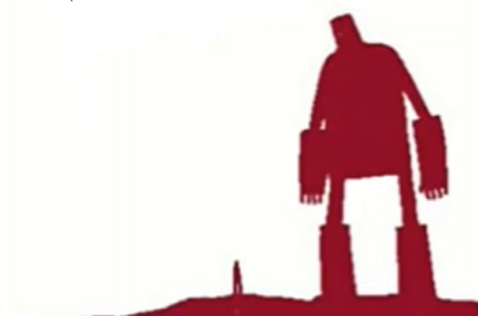
The Iron Man
Lesson 11

Slide 2
LO: To identify the key features of an advertisement poster.
I can label key features of an advert.
I can discuss the purpose of an advert.
I can evaluate what makes an advert effective.

Slide 3
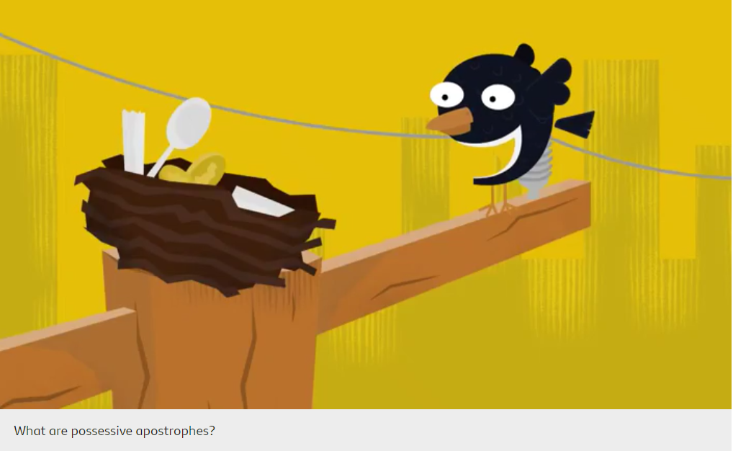
Starter: possessive apostrophes
How to use possessive apostrophes - BBC Bitesize
Notes:
Use activities on page to check understanding.

Slide 4
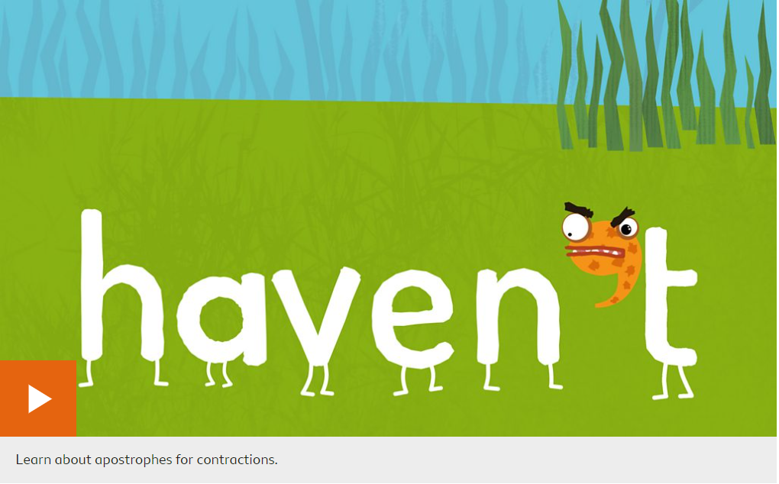
Starter: apostrophes in contractions
How to use apostrophes in contractions - BBC Bitesize
Notes:
Use activities on page to check understanding.

Slide 6
What is the purpose of an advertisement?
Talk to a partner.
What do adverts try to do?
Can you think of any adverts that you have seen?
What different types of adverts are there?

Slide 7
What is the purpose of an advertisement?
Talk to a partner.
What do adverts try to do? To persuade someone to do something or buy something.
Can you think of any adverts that you have seen? Usually adverts for toys/clubs/books/films
What different types of adverts are there? TV adverts, radio adverts, posters.

Slide 8
Key features of a persuasive poster (advert)
Contact information (how can they find you)
Title (what is your product)
Picture (what does your product look like)
Bright colours (catch the reader’s eye)
Rule of 3 (three reasons to buy your product)
Adverts encourage you to buy things. They use memorable words and short descriptions. They can be seen on TV, heard on the radio and printed on posters or within different texts.

Slide 9
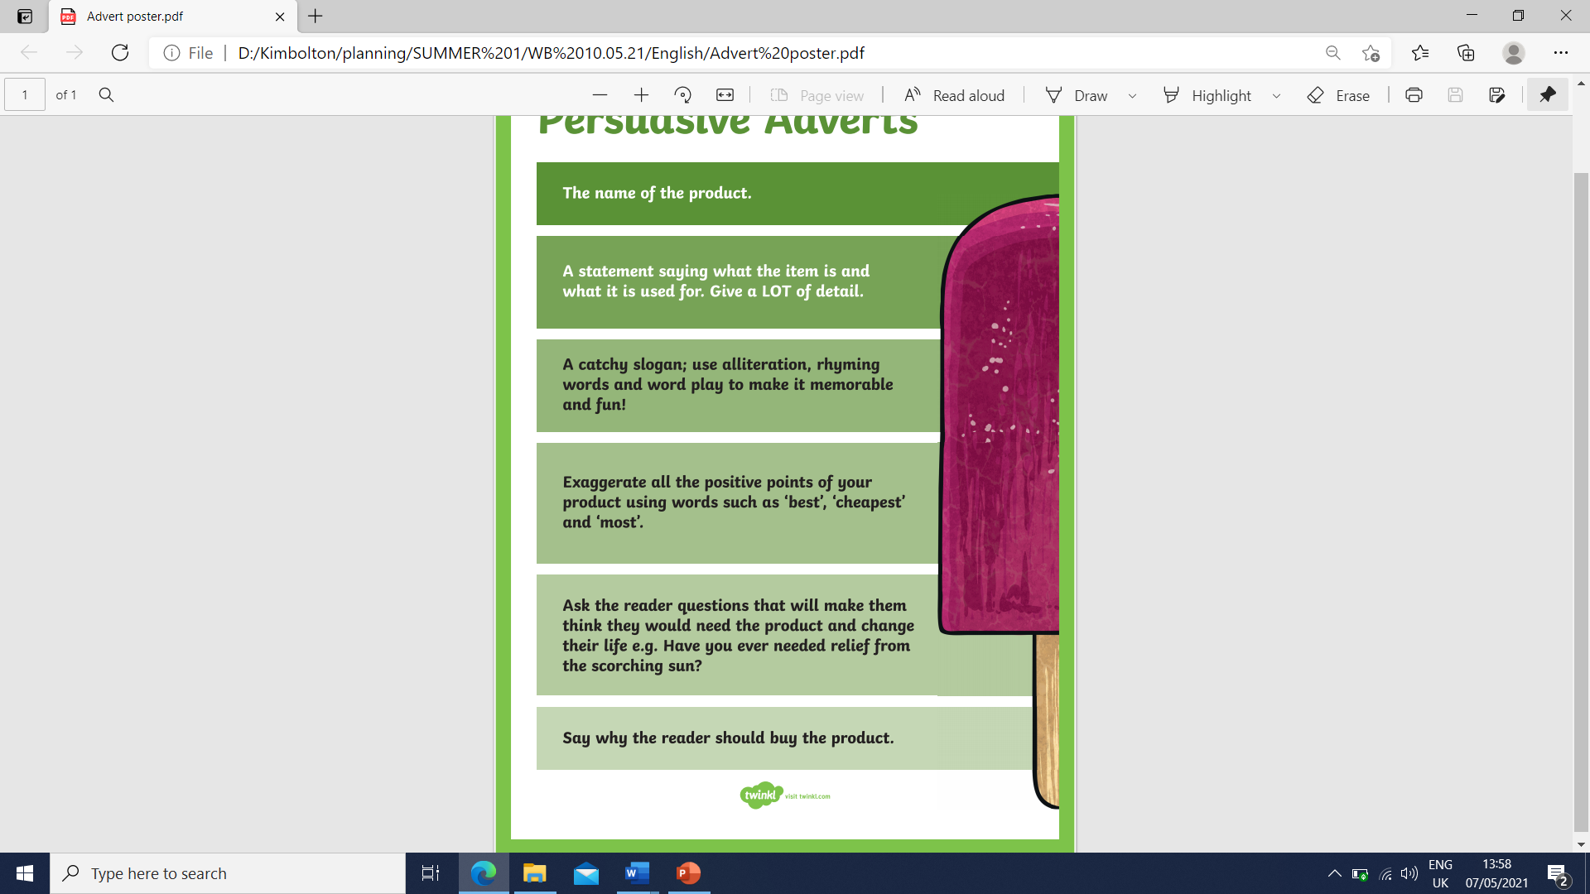
What do I need to include?

Slide 10


Slide 11
Rule of 3 – we know it will include Boxing, Muay Thai and Taekwondo
Title – we know it is a martial arts class for children.
Aimed at parents and children. Parents would like that they don’t have to pay to train or pay extra for their kids to join.
Picture – we can see that the kids are enjoying it.
Contact information

Slide 12
Your task
In pairs, you are going to look at two different advertisement posters. Use post it notes to identify the key features.
Which features do you think are most important and why?
Which advertisement do you like the most and why?
Which advertisement would you be more likely to use and why?
Which advertisement do you think is most effective and why?

