Slide 1
Capacity
LO: To consolidate our understanding of measuring capacity, using ml and l.

Slide 2
Year 2: 47 + 44 =
Year 3: 126 + 147 =
Using a method of your choice, work this calculation out on your whiteboard.
Make sure you are showing your working out.

Slide 3
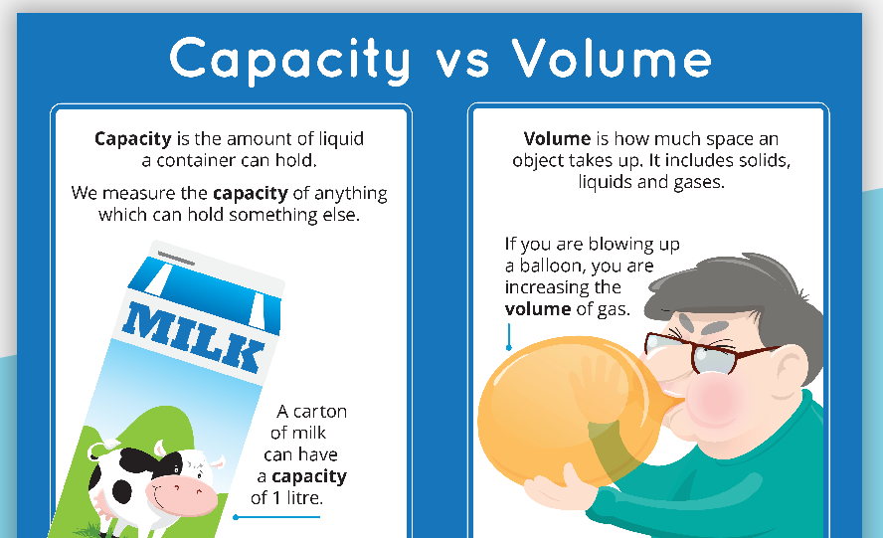
Capacity and Volume
Notes:
Check water bottle –

Slide 4
We use milliliters and liters to measure volume and capacity.
Capacity is the amount of liquid a container can hold.
Volume is how much liquid is in the container.

Slide 5
How many mm are in a cm?
How many cm are in a m?
How many g is in a kilogram?
How many ml do we think is in a l?

Slide 6
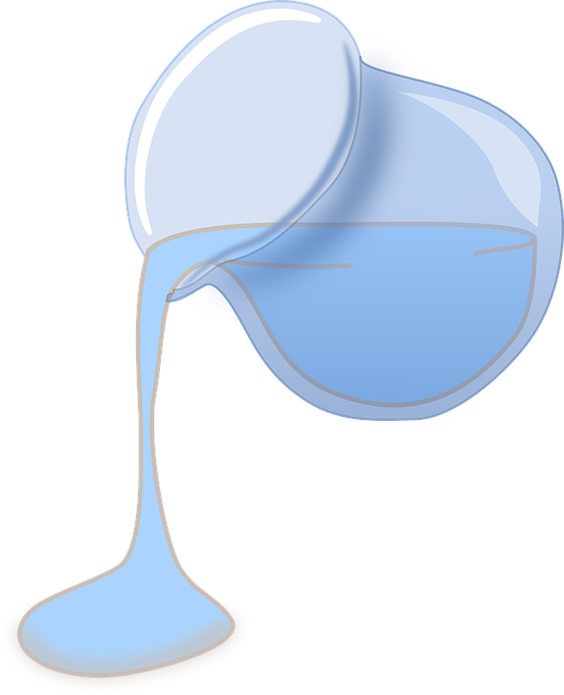
There are 1000milliletres in a liter.
100ml = 1l
How many liters would I have if I had 5000ml?
How many liters would I have if I had 7000ml?
I have 9l, how many ml would this be?

Slide 7
Capacity Vocabulary
Click on the words below to see their meaning.
Full
Half empty
Empty
Nearly full
Half full
Nearly empty

Slide 8
Like yesterdays lesson we need to be able to read scales.
The first thing that you need to do is to work out what each interval of the scale represents.
If there are 5 intervals between 0 and 100, how much is each interval representing?
Notes:
Model on whiteboard.

Slide 9


Introduction
What increments are each of these scales going up in?
0
0
0
35
20
5
70
10
14
8
2
© Classroom Secrets Limited 2018

Slide 10
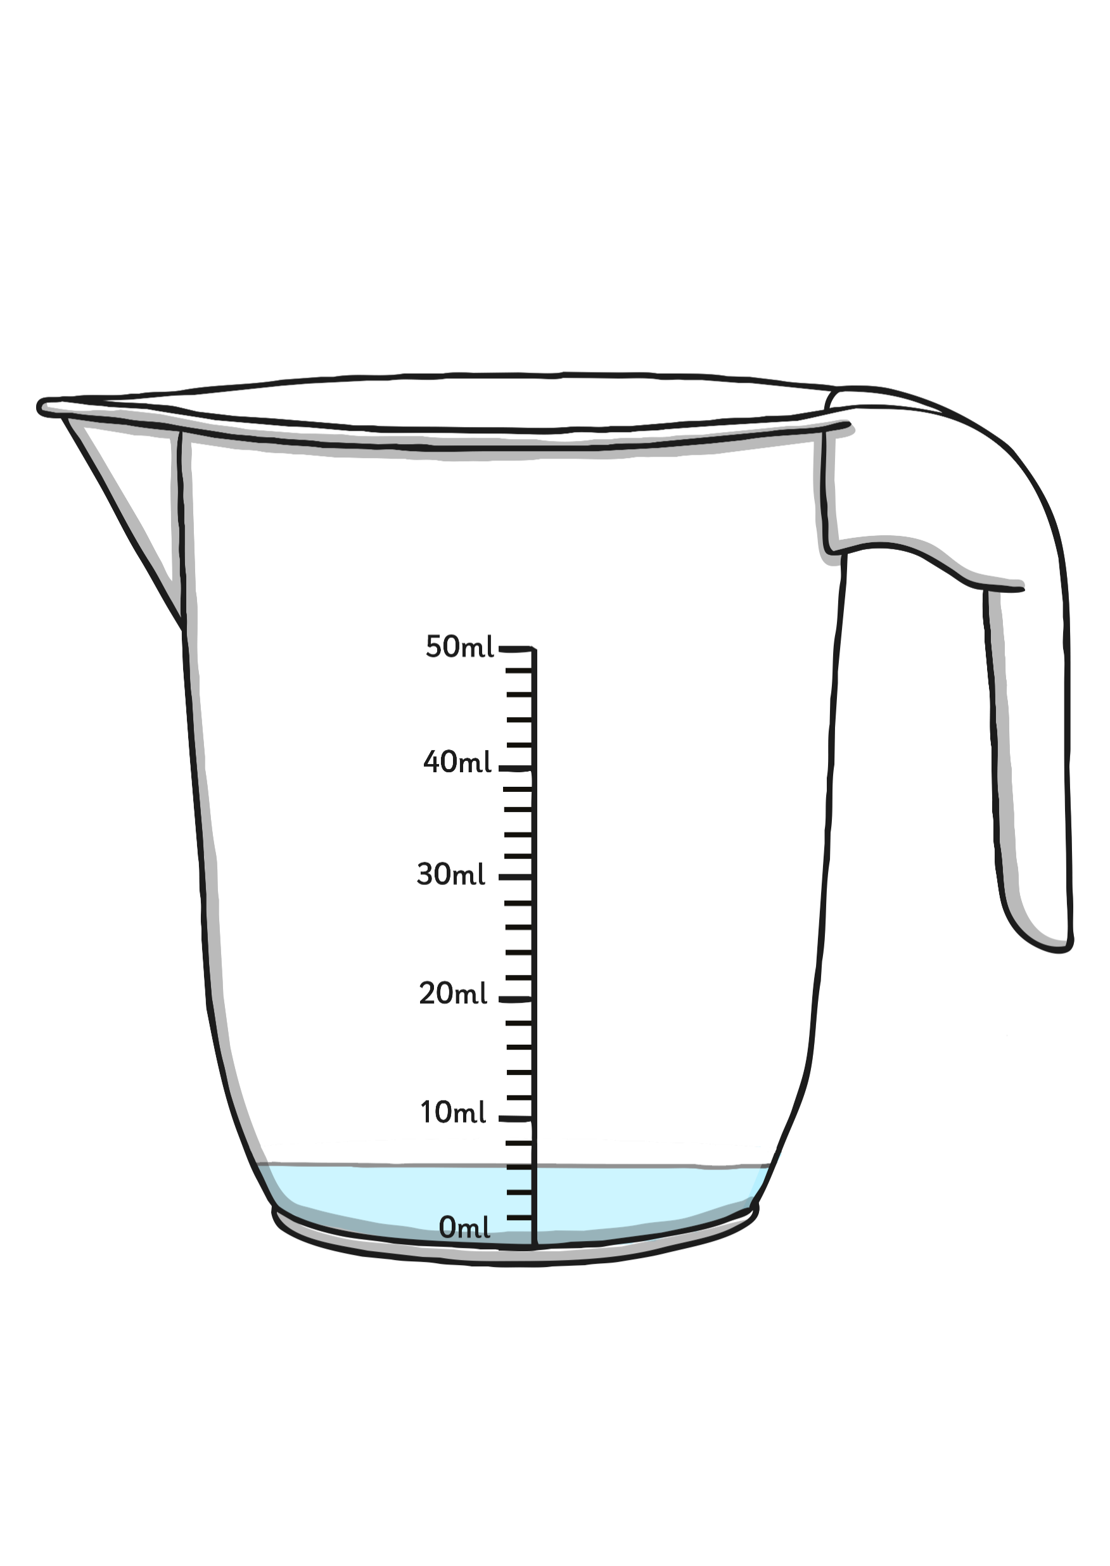
How much liquid is in this jug?
6
ml

Slide 11
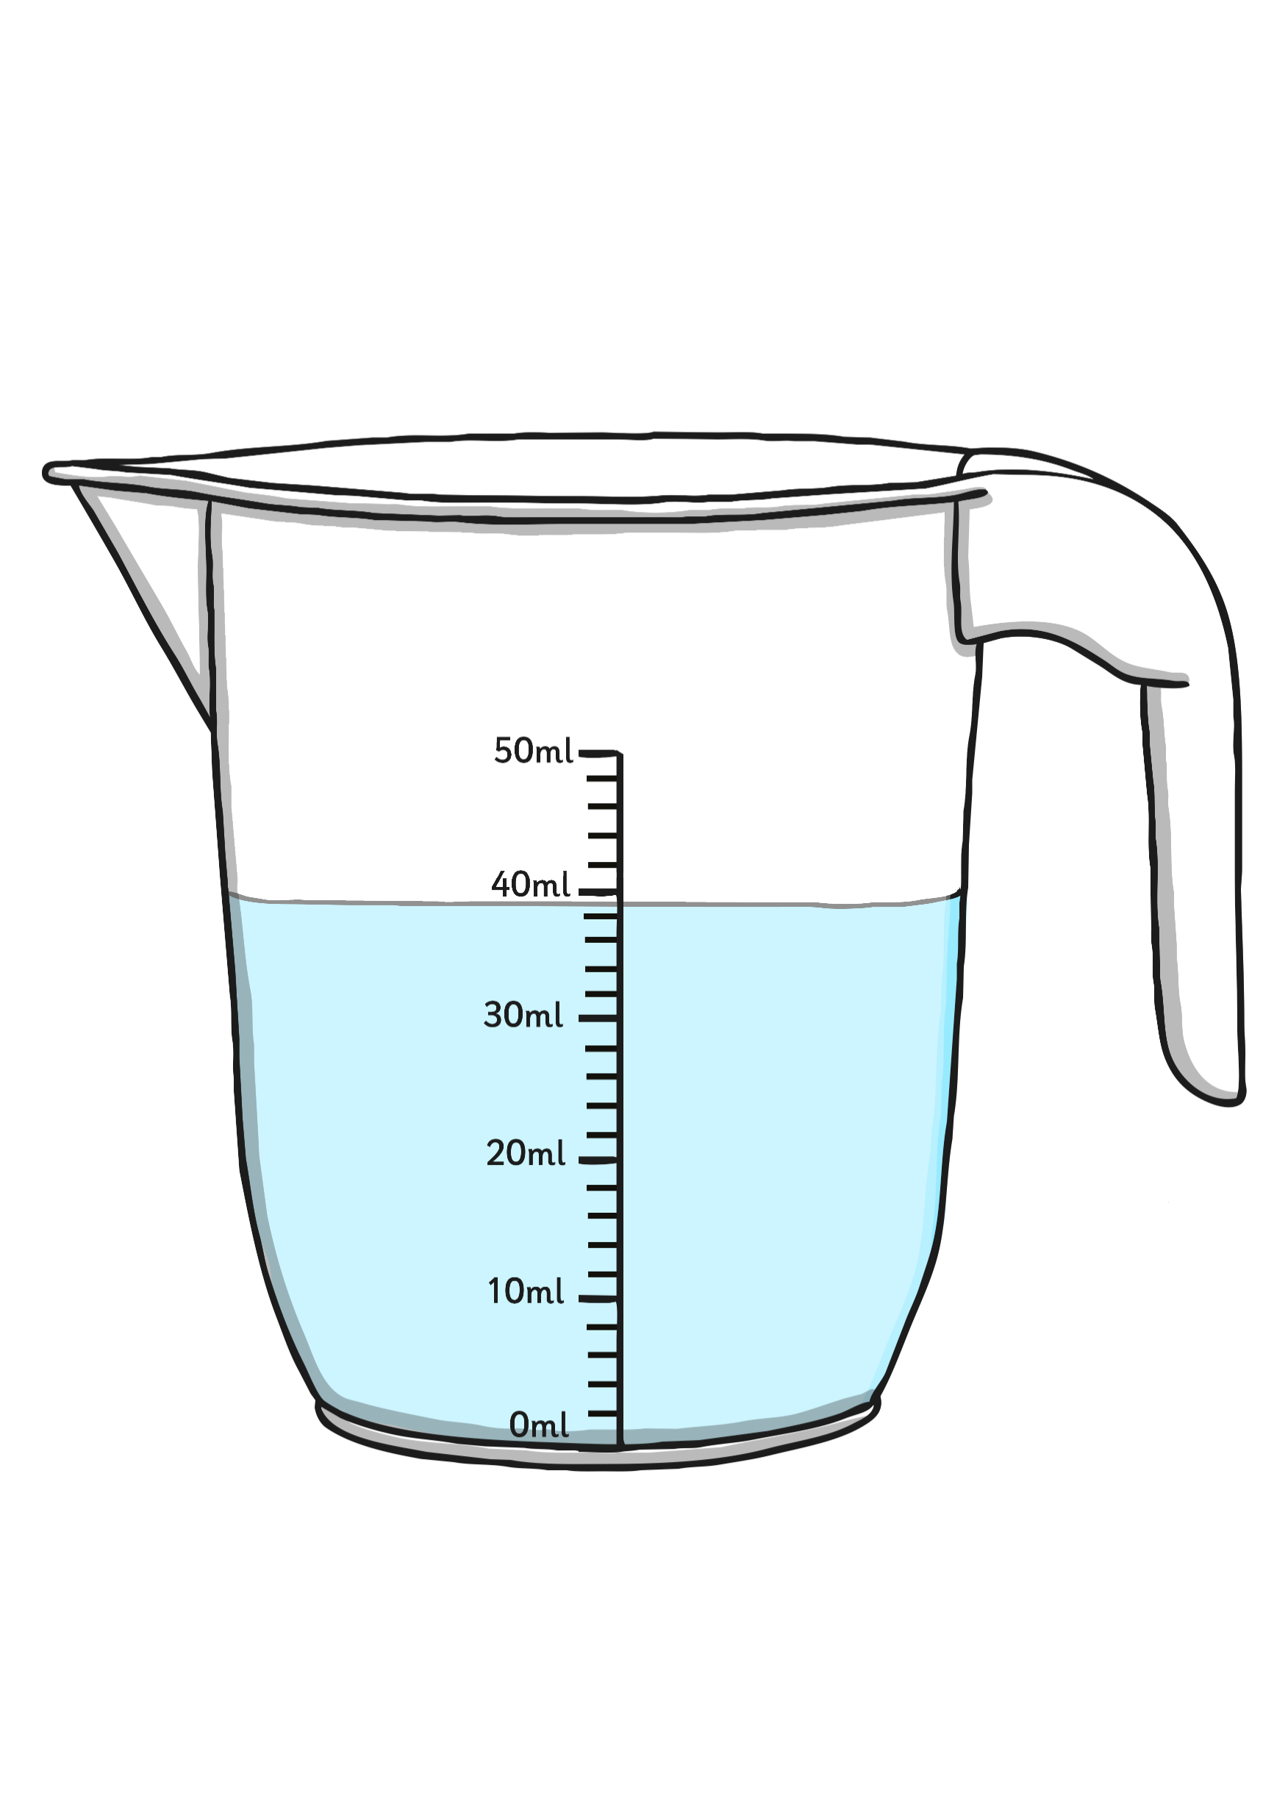
How much liquid is in this jug?
39
ml

Slide 12
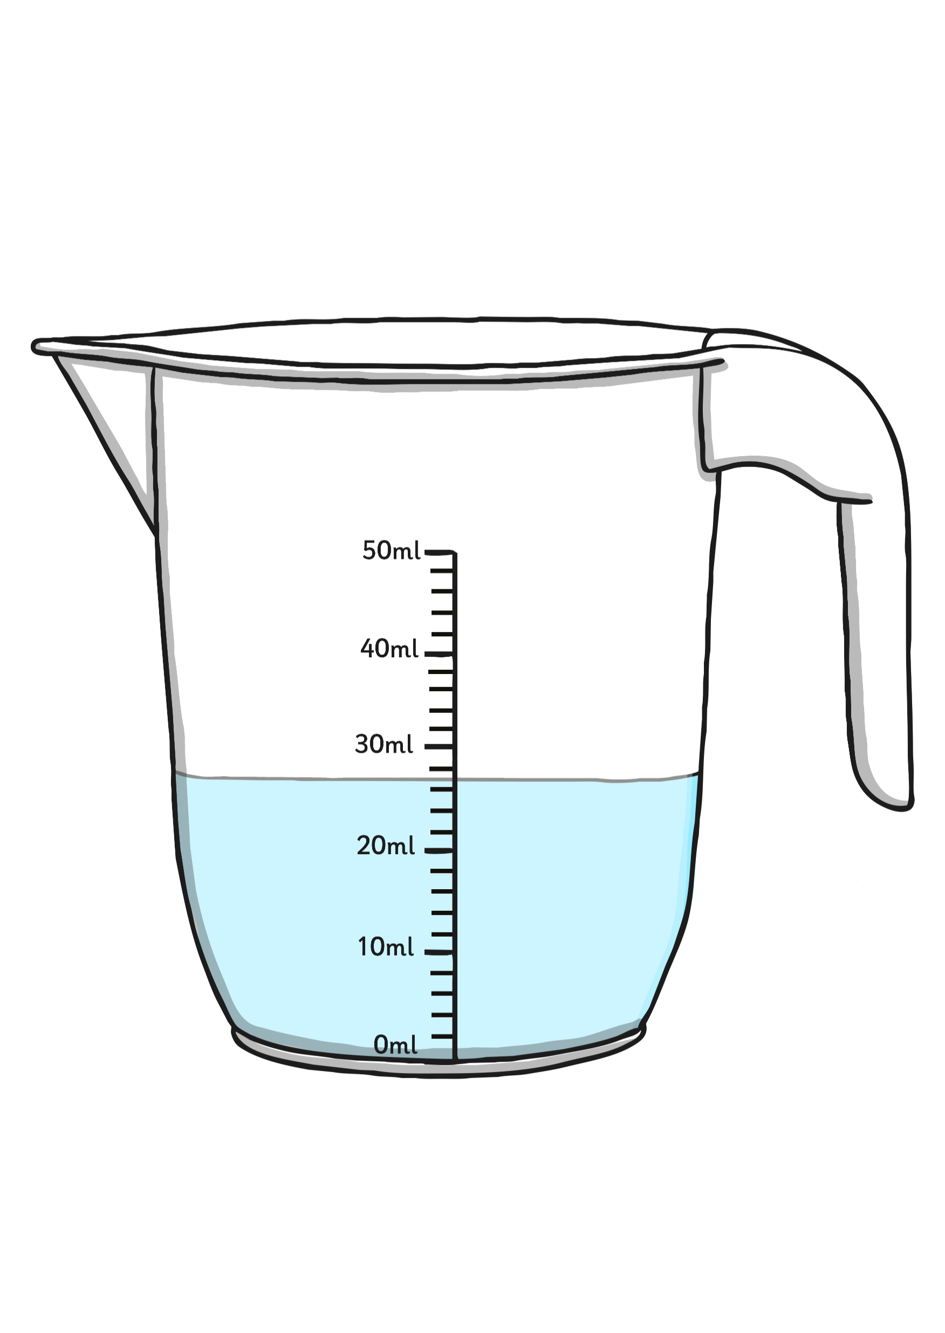
How much liquid is in this jug?
27
ml

Slide 13
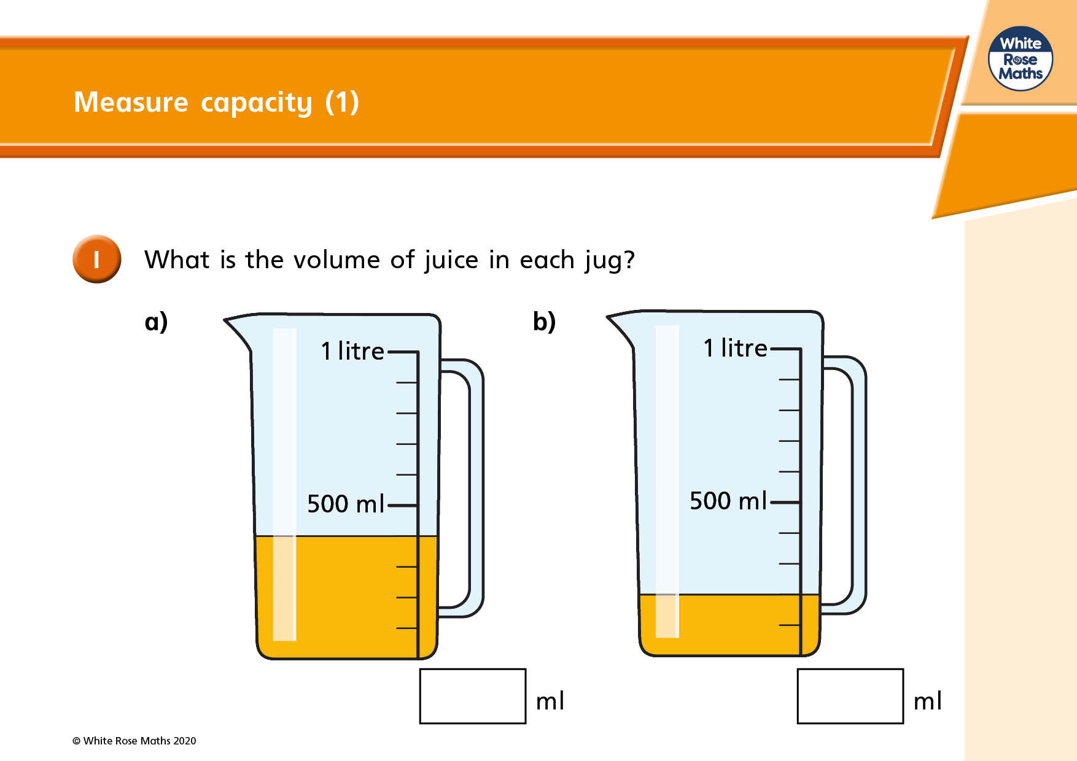

Slide 14
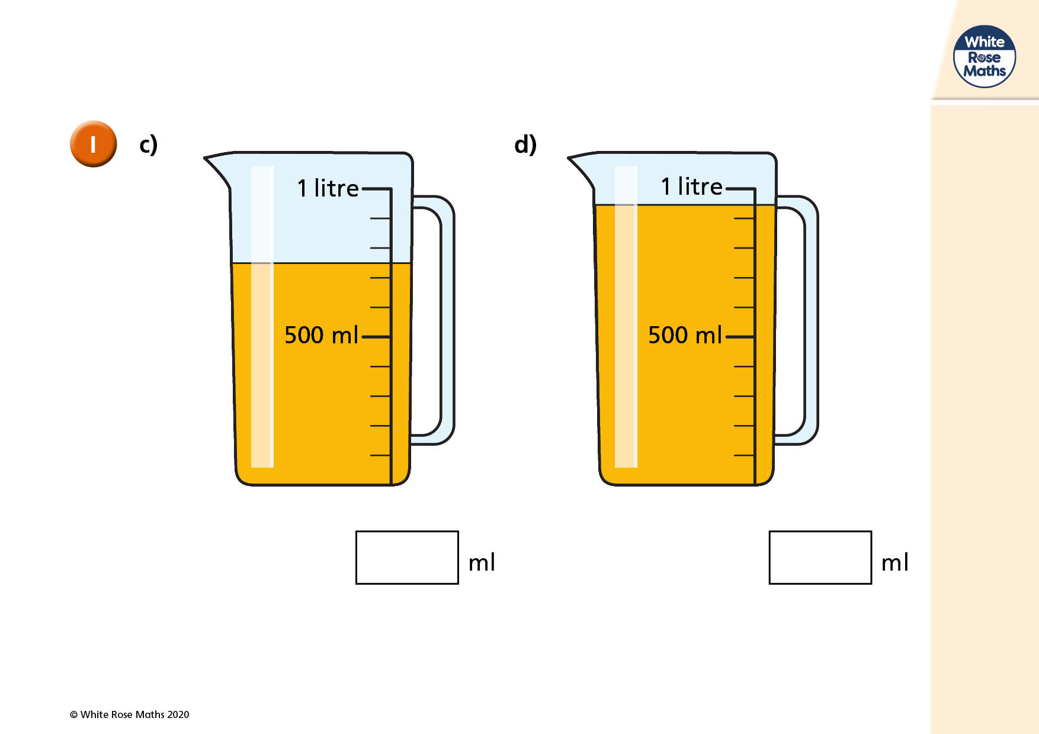

Slide 15
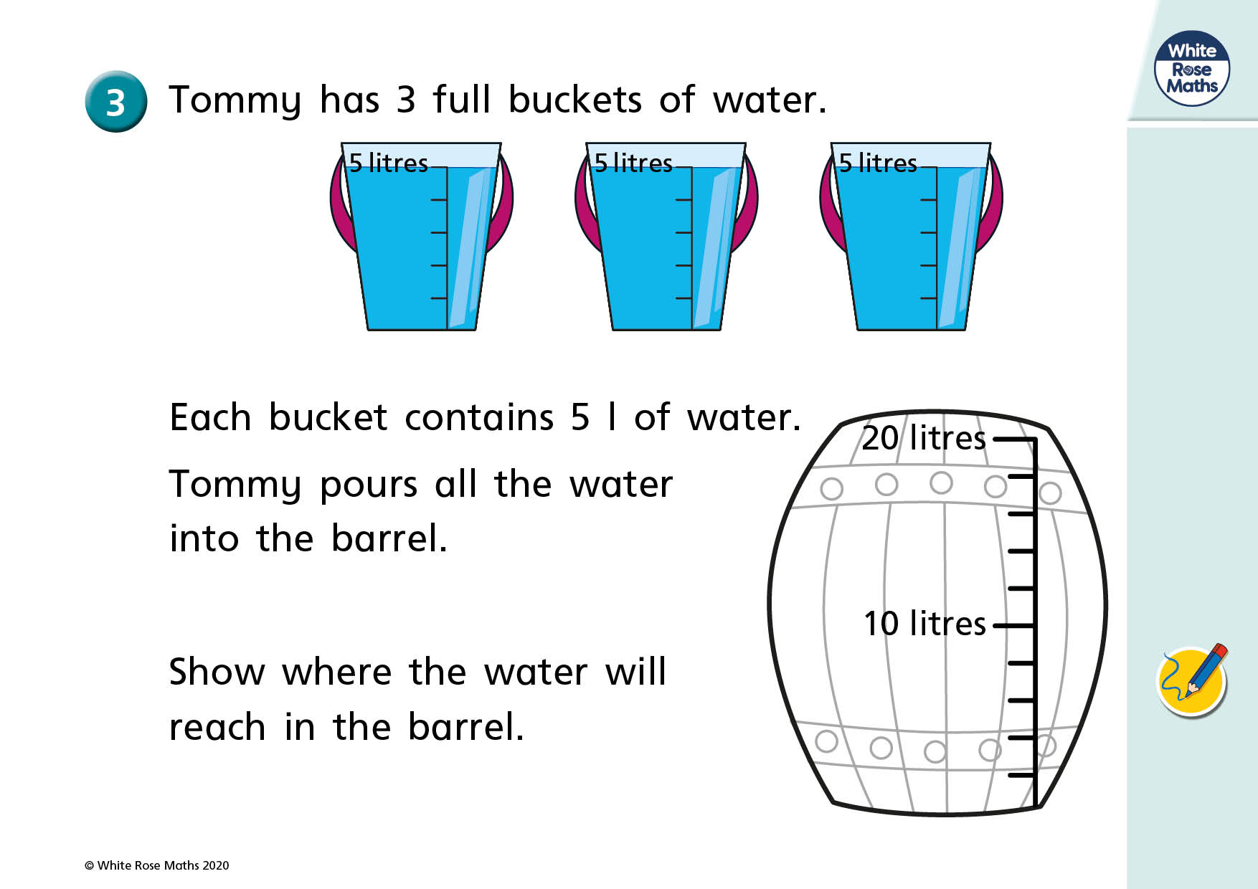

Slide 16
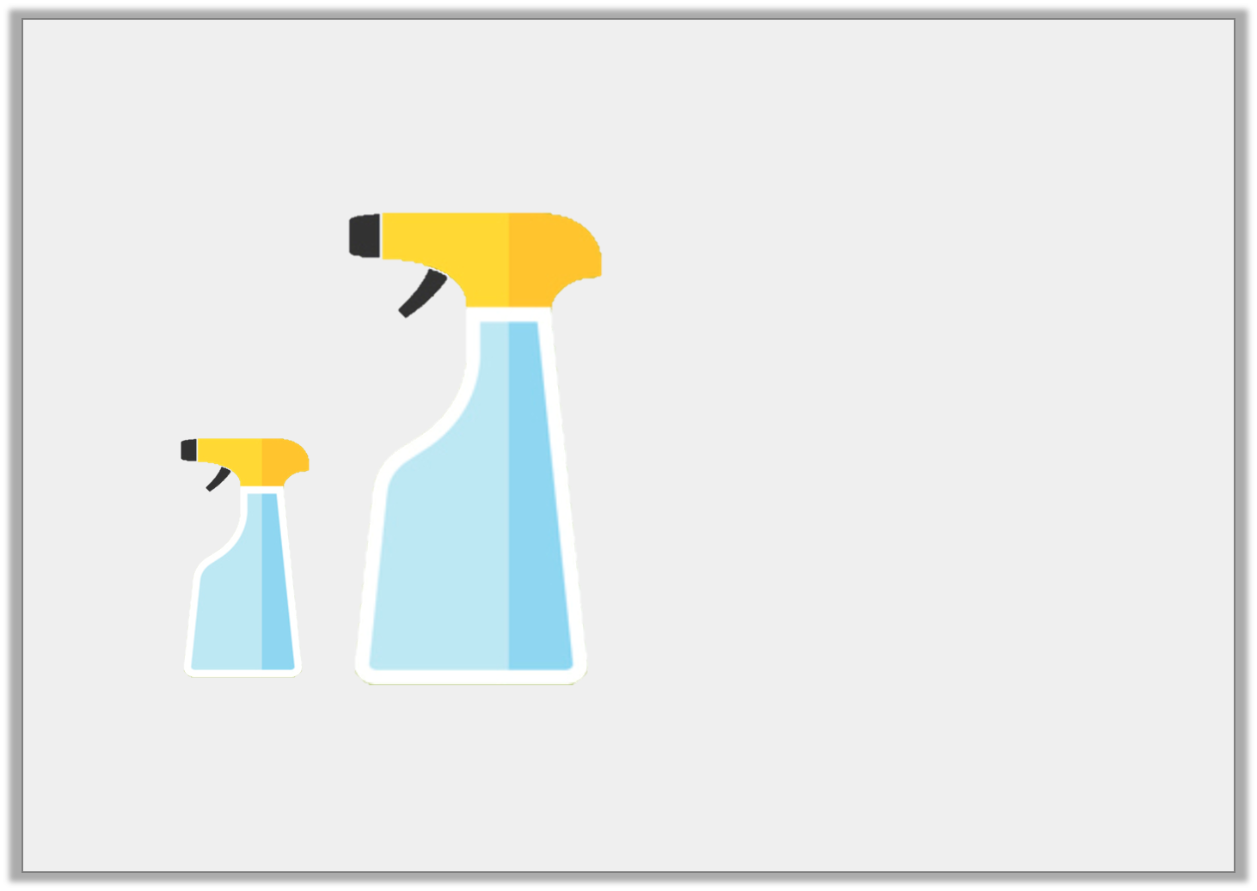
Varied Fluency 3
Estimate how much liquid is in container B.
1L
20L
2L
8L
A
B
© Classroom Secrets Limited 2018

Slide 17
Varied Fluency 4
Colour the containers up to the correct level.
L
10L
8L
6L
4L
2L
L
10L
8L
6L
4L
2L
L
9L
7L
5L
3L
1L
9L
10L
4L
© Classroom Secrets Limited 2018

Slide 18
Task:
Complete the worksheets. There are three levels, choose the one you are most comfortable.

