Slide 1
SPaG week
WB 07.06.21

Slide 2
YR2 LO: To use expanded noun phrases to add description to my sentences.
I can identify nouns and noun phrases.
I can add adjectives to nouns to create expanded noun phrases.
I can use expanded noun phrases in my writing.
YR3 LO: To add more detail to my sentences using adverbs and expanded noun phrases.
I can identify adverbs and noun phrases.
I can add adjectives to nouns to create expanded noun phrases.
I can add adverbs to my sentences to add more detail.

Slide 3
Starter: Can you sort these words into the correct groups?
Noun | Adjective | Verb
run house fluffy hug warm hat sticky brown candle write red pen
Notes:
YR3: could you create a sentence using a noun using a noun, adjective and verb?

Slide 5
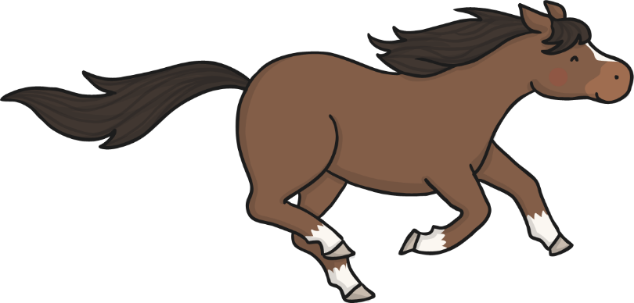
What is a Noun Phrase?
Can you remember what a noun is?
In your pairs, find the noun/nouns in each of these sentences:
The boy loved playing football.
The horses galloped across the field.
The witch was creating a potion.
Notes:
YR3: Can you tell me the verb in these sentences too.

Slide 6

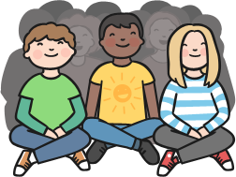
What is a Noun Phrase?
A phrase is a group of words that work together:
my cute puppy
A noun phrase is a group of words that have a noun as a key word:
The year two class

Slide 7

What is a Noun Phrase?
Work with your partner to find the noun phrase in
each of these sentences.
The rain soaked them.
The strong wind nearly blew them over.
The road was long and winding.

Slide 8
Expanded Noun Phrases
Noun phrases can be very short:
a pen the girl
Quite often in our writing we need to add more details so that our readers know exactly what we are writing about.
a purple pen a young girl
When we add more details to our noun phrases they become expanded noun phrases.

Slide 9

Expanded Noun Phrases
One of the easiest ways to expand a noun phrase is to add an adjective before the noun:
a young man the blue butterfly
To expand the noun phrase further, we can add another adjective:
a young, handsome man the beautiful, blue butterfly

Slide 10
Expanded Noun Phrases
Can you expand these noun phrases by adding an adjective?
A _____________________ car.
A _____________________ house.
The ___________________ road.
Can you expand the noun phrases further by adding another adjective to each of them?

Slide 11

Expanded Noun Phrases
You can also expand a noun phrase by adding a preposition (information about where or when something is).
The boy on the ground was crying.
The bird in the tree sang every morning.
The man in the moon looked down at the Earth.

Slide 12
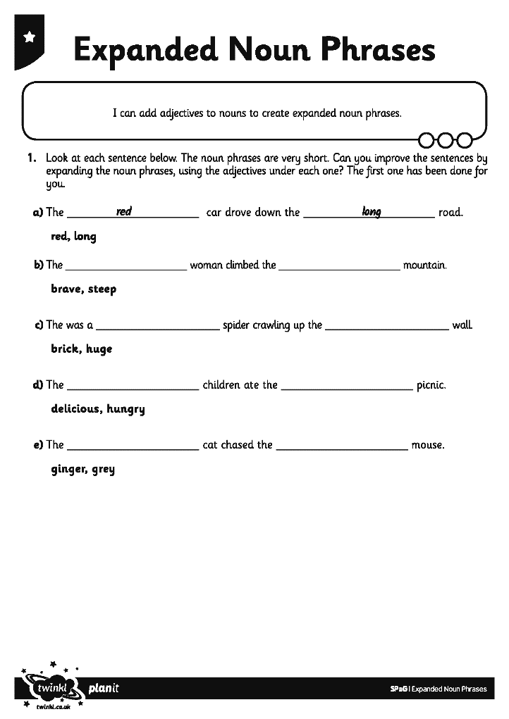
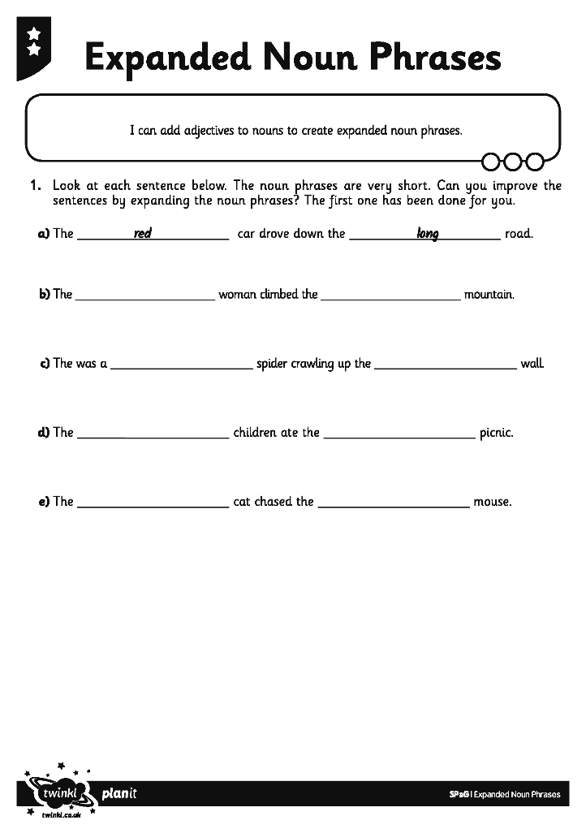
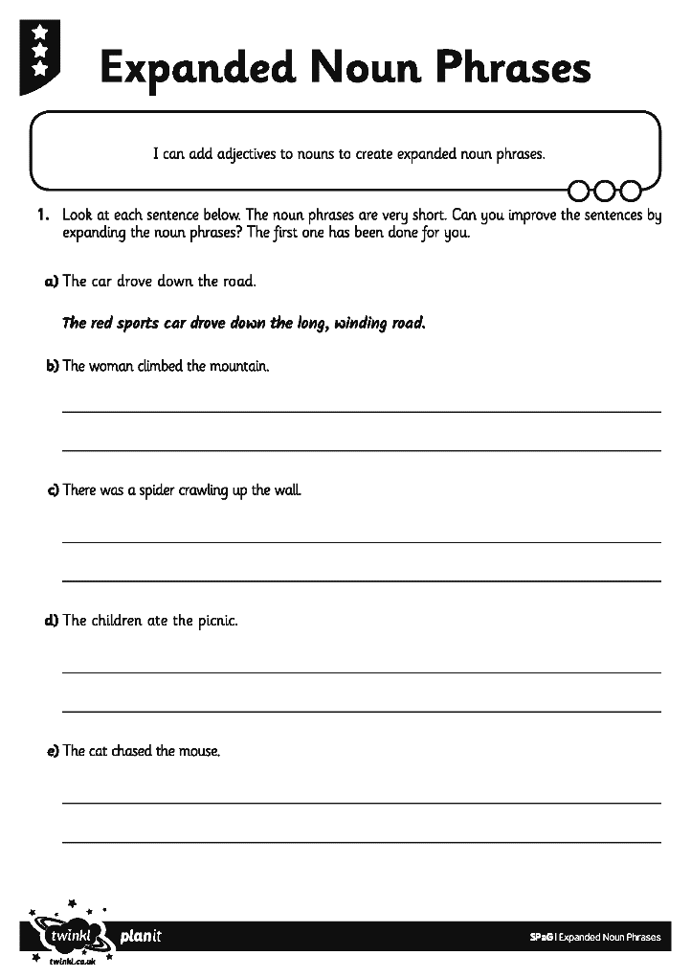
Activity 1 – Year 2
Can you expand the noun phrases on the Expanded Noun Phrase Activity Sheet?
Each sentence has a simple noun phrase. Can you expand each noun phrase so that the sentences are clearer and more interesting?
Notes:
Year 2 to start their first task.

Slide 13
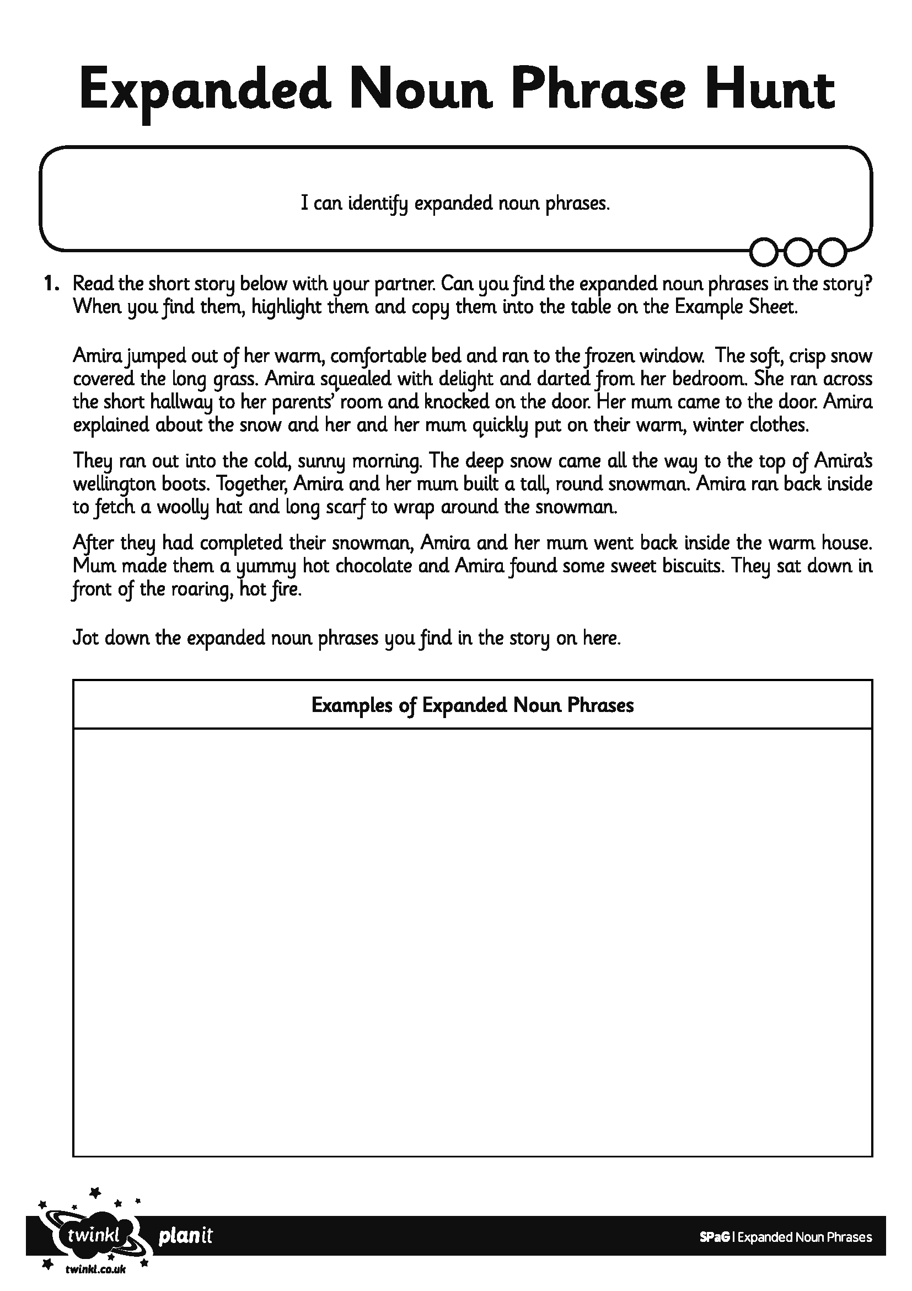
Activity 2 – Year 2
In your pairs, read the story from the Expanded Noun Phrase Hunt Activity and find as many expanded noun phrases as you can.
Write any you find onto the sheet.

Slide 14
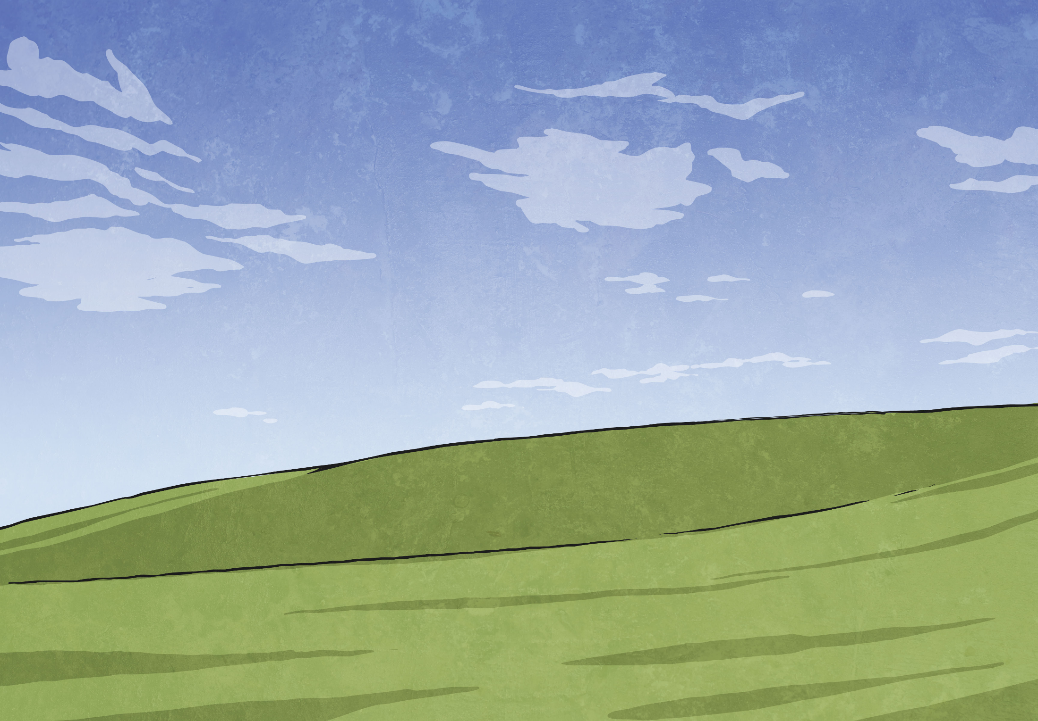
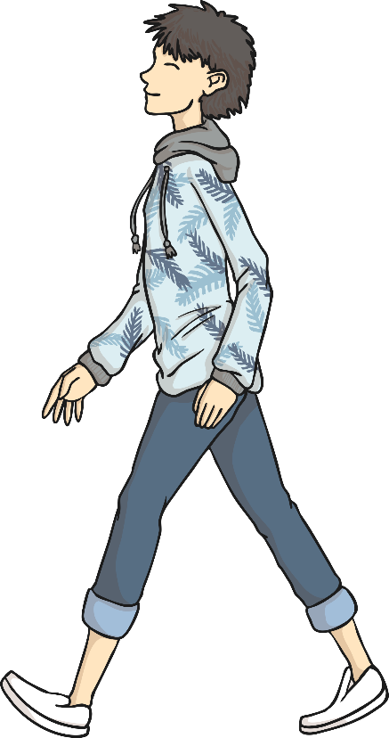
Verbs and Adverbs
An adverb is used to describe how, what, when, where and why a verb happens.
James walked quickly to the shops.
verb
adverb
This explains how James walked.
Who can mime (silently act) what James was doing?

Slide 15

Verbs and Adverbs
An adverb is used to describe how, what, when, where and why a verb happens.
Claire sipped her tea gently.
verb
adverb
This explains how Claire sipped.
Who can mime (silently act) what Claire did?

Slide 16

Verbs and Adverbs
An adverb is used to describe how, what, when, where and why a verb happens.
Gavin always rides his bike.
adverb
verb
This explains when Gavin rides.
Who can mime (silently act) what Gavin is doing?

Slide 17
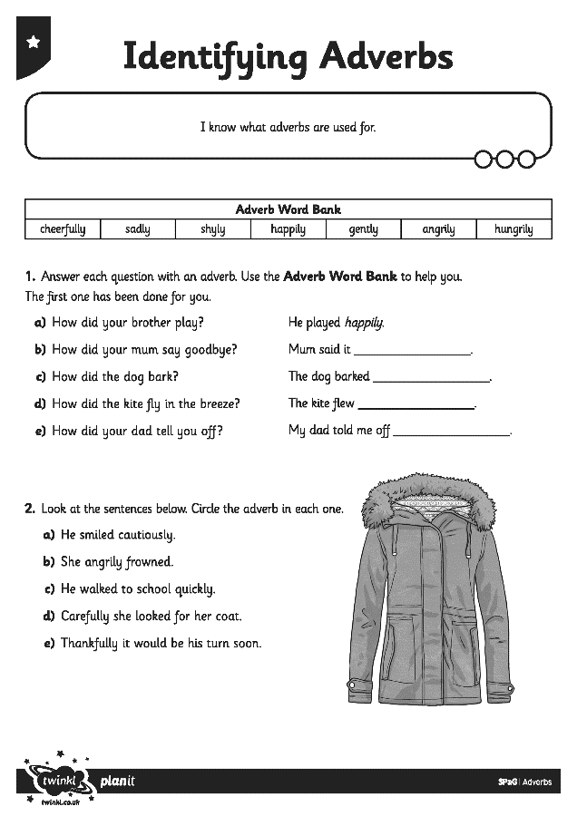
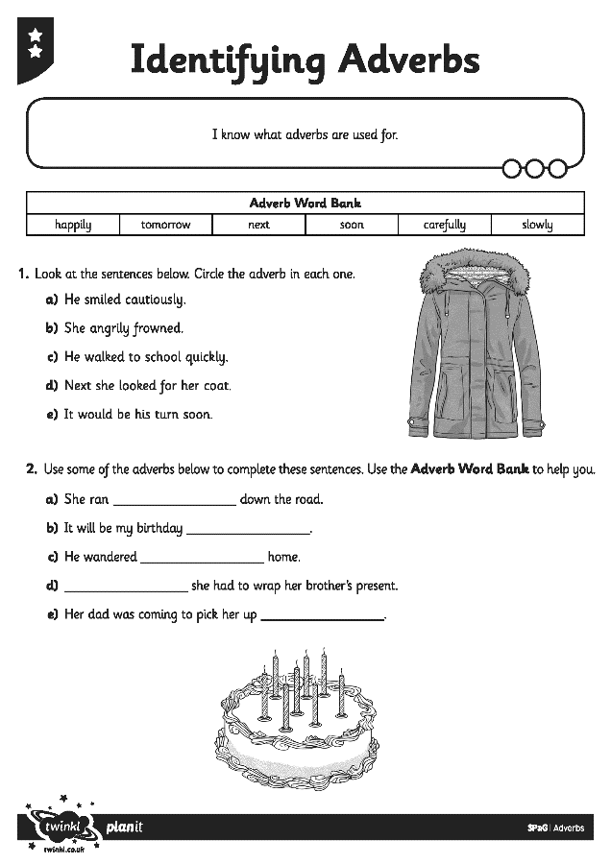
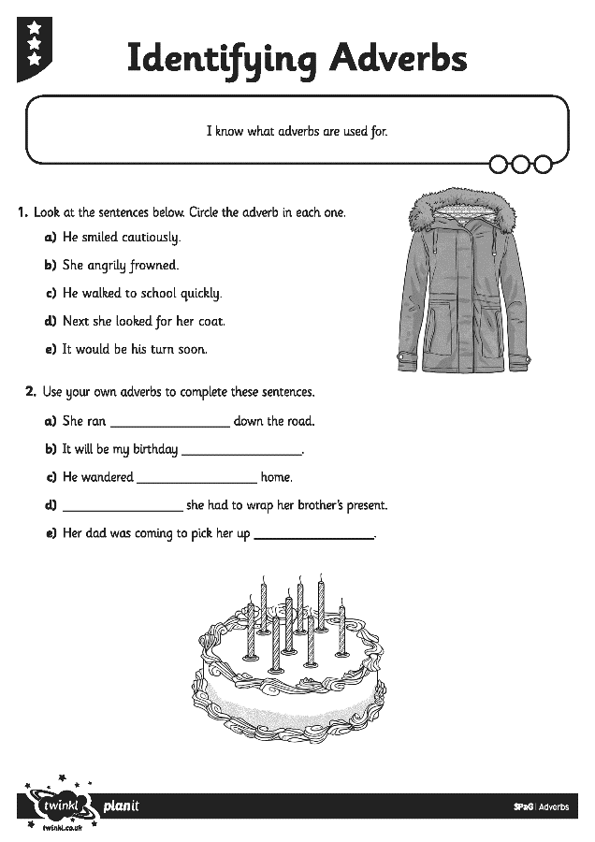
Activity 1 – Year 3
Work on your own to complete Identifying and Adding Adverbs Activity.

Slide 18
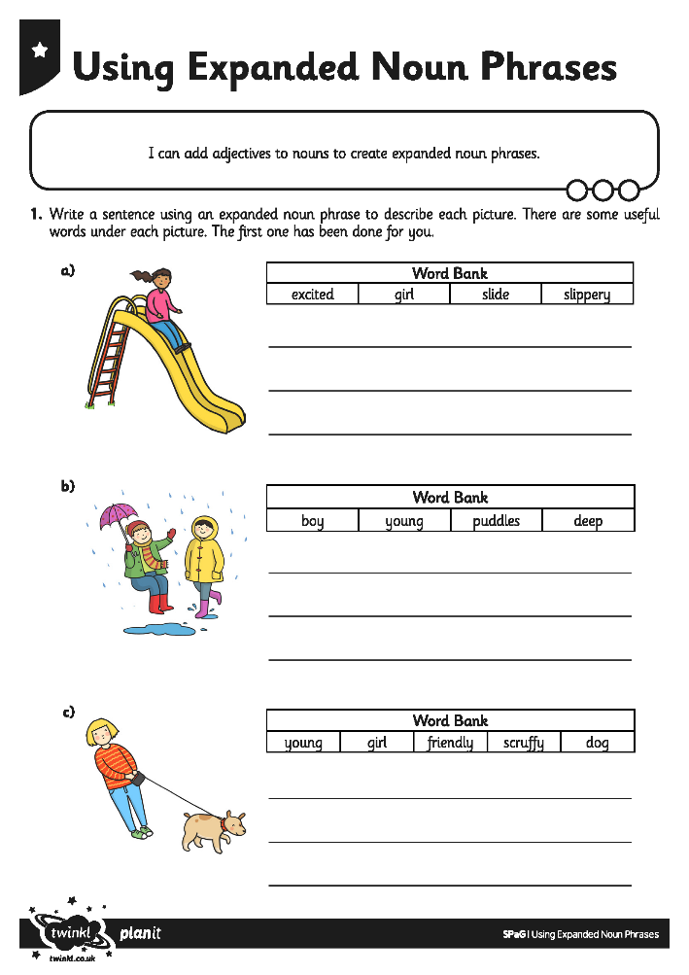
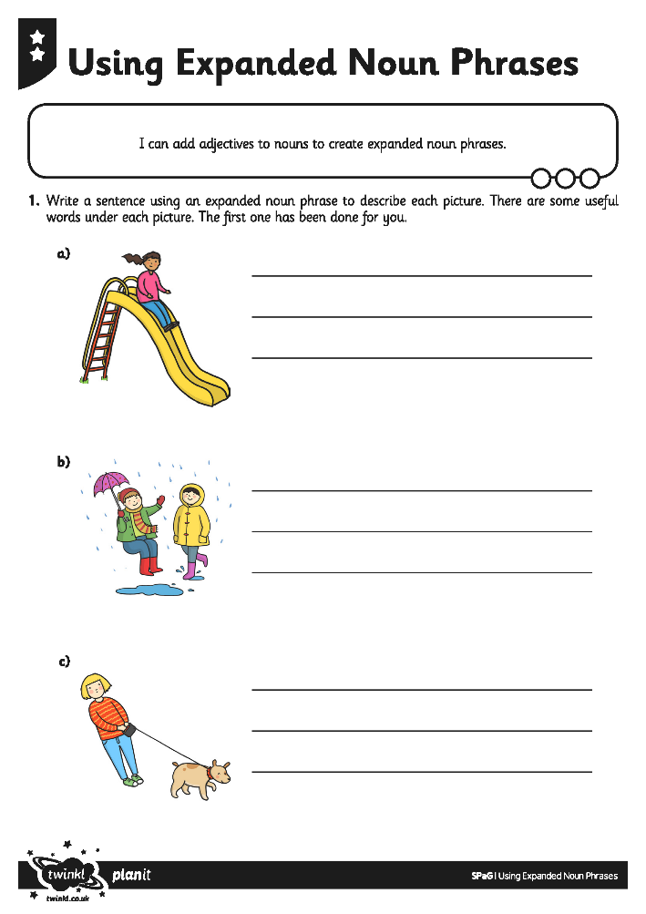
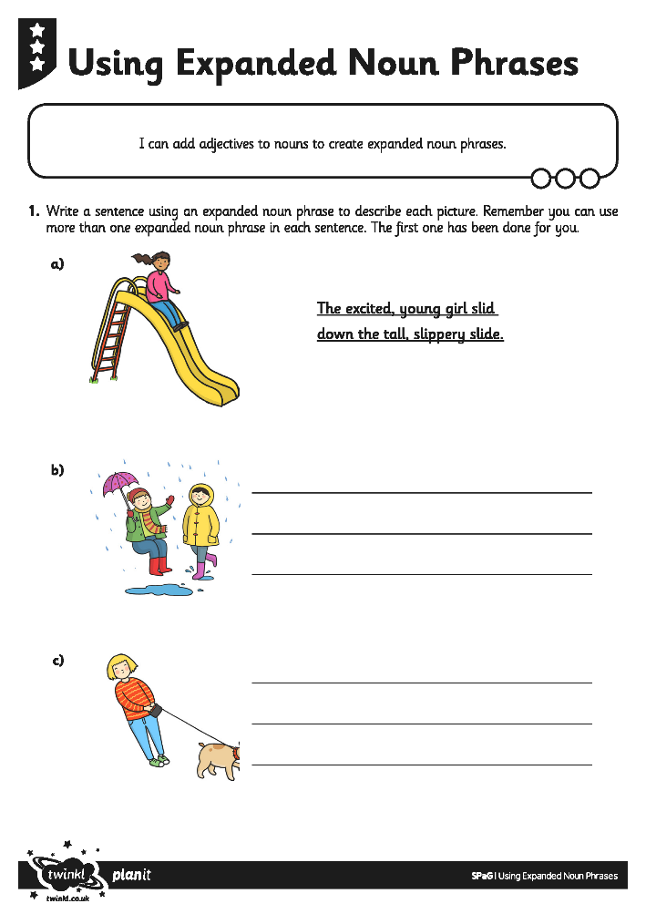
Activity 2 – Year 3
On the Using Expanded Noun Phrases Sheets, can you write a sentence to describe each picture using an expanded noun phrase? I also want you to include an adverb e.g. quickly, slowly, carefully

Slide 19
In your books, can you write some expanded noun phrases to describe what could be happening in this image. Year 3, remember to use adverbs. Once you have finished, can you underline your adjectives and adverbs with a coloured pencil. One colour for adjectives and another for adverbs.
Notes:
Plenary

Slide 20
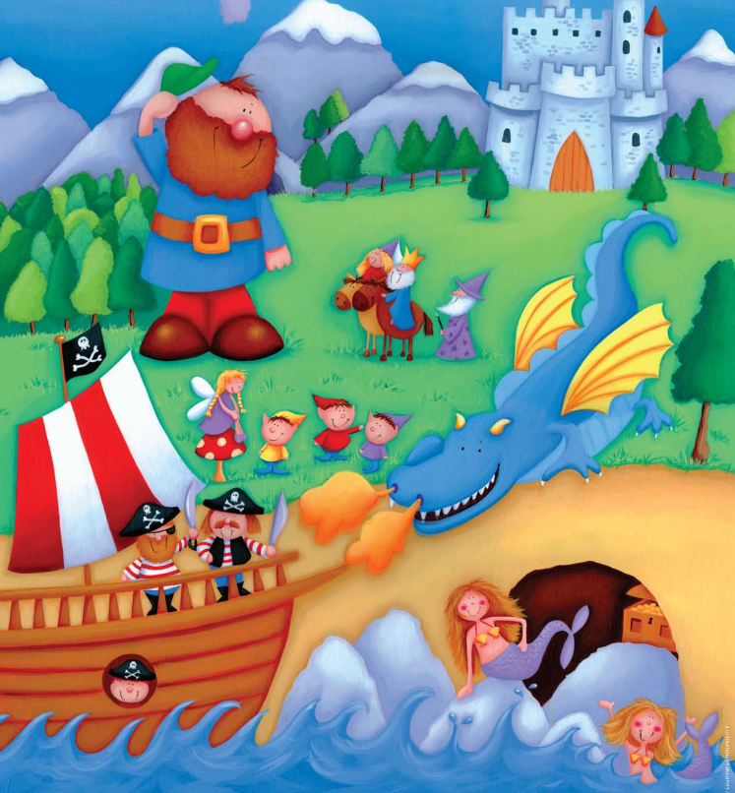
For example: Year 2
The green, pointy trees.
The cold, blue water.
For example: Year 3
The green, pointy trees slowly blew in the wind.
The cold, blue water aggressively crashed against the cave.

