Slide 1
Division
14.01.21
Lesson 4

Slide 2
Learning objectives
LO: To consolidate my understanding of dividing by 2, 5 and 10.

Slide 3

What have we learnt so far?
Multiplication is the inverse operation to division (we can use this to check our answers)
Division does not follow commutative law (we have to keep the question in the right order)
There are three different ways to solve multiplication
There are different ways to ask division questions, but we are always sharing

Slide 4
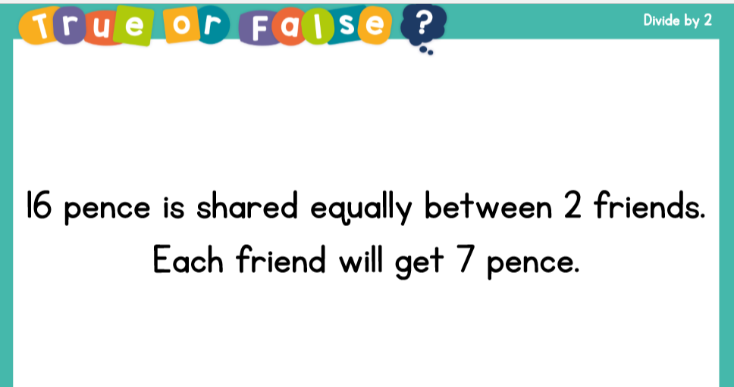

Slide 5
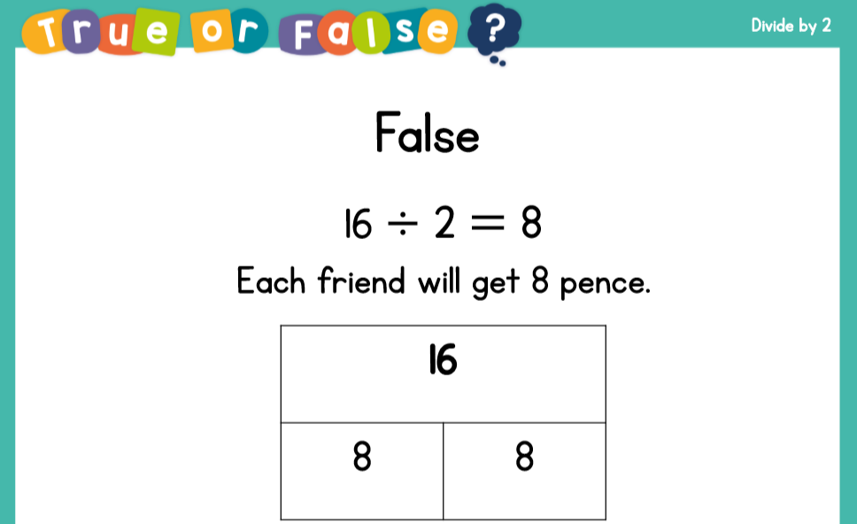

Slide 6
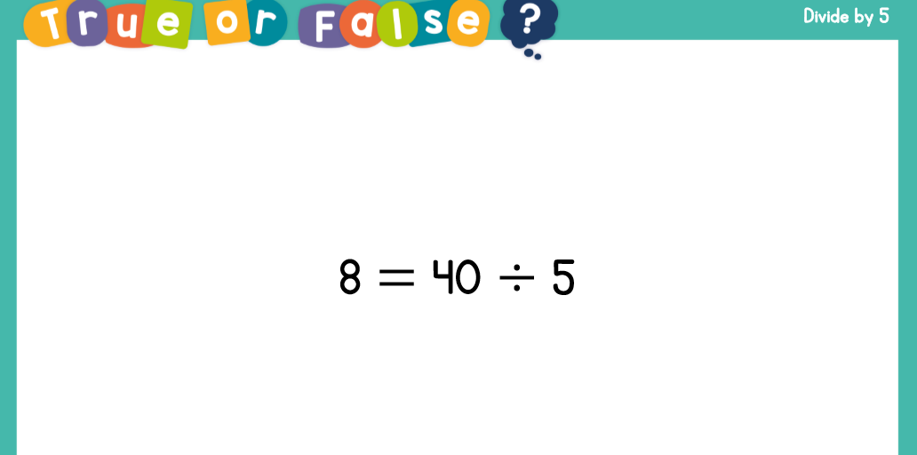

Slide 7
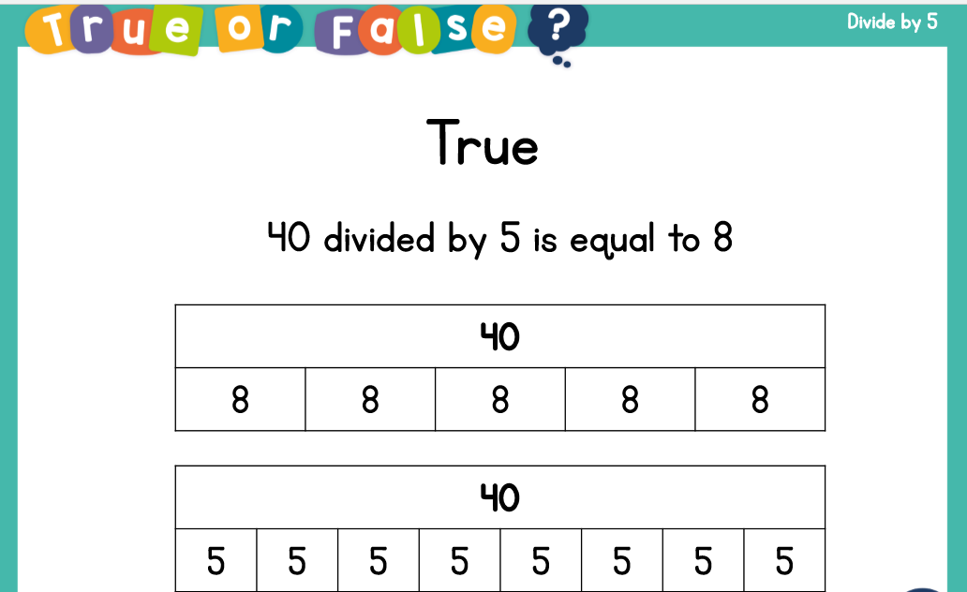

Slide 8
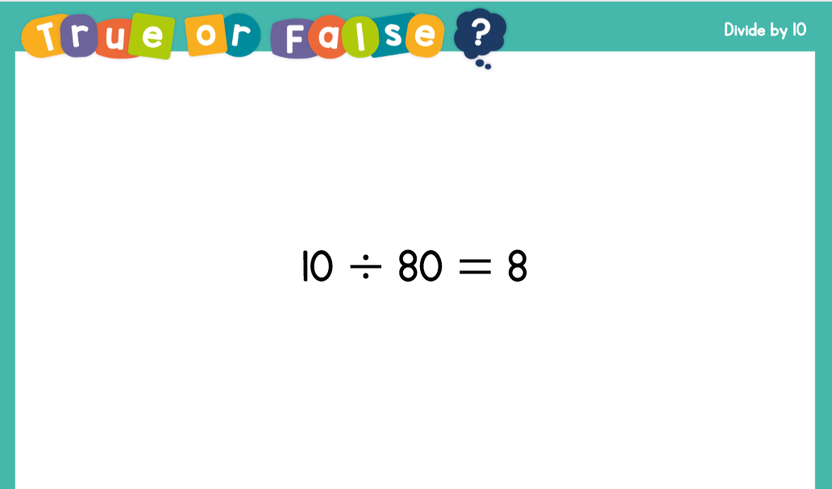

Slide 9
