Slide 1


Progressive Tense
LO: To be able to use the present and past tenses correctly and consistently, including the progressive form..
© Classroom Secrets Limited 2019

Slide 2
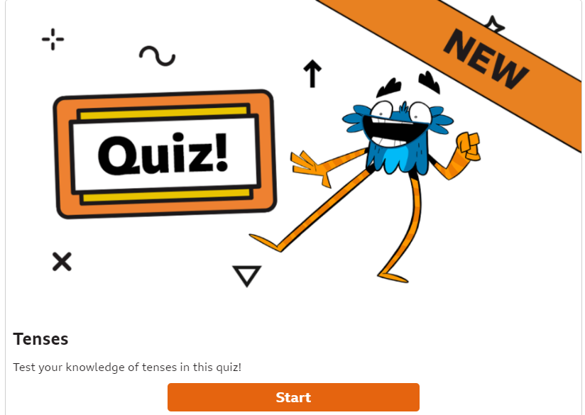
Starter:
To check our understanding of simple past, present and future tense, have a go at this quiz. https://www.bbc.co.uk/bitesize/articles/z4fq96f

Slide 3
Past and Present Tenses
The Progressive Form
In this lesson we are going to learn about a slightly different form of the past and present tenses.
It is called the Progressive form and is used to describe actions that are or were happening.
Another way of saying this is that they were (or are) in progress.
This is where we get the name Progressive from.

Slide 4
Past and Present Tenses
The Progressive Form
Present Progressive Tense: Describes something that is ‘in progress’ now.
It is formed by adding a verb ending in –ing to the present tense of ‘to be’.
Present tense of ‘to be’
Add a verb ending in -ing
I am
You are
He/she/it is
We are
You are
They are
fishing
swimming
sleeping
crying
choosing
jumping

Slide 5
Varied Fluency 1
Tick the sentence that has used the present progressive tense.
I was talking to my friend at school.
My parents are standing next to me.
She dances to the loud music.
© Classroom Secrets Limited 2019

Slide 6
Varied Fluency 1
Tick the sentence that has used the present progressive tense.
I was talking to my friend at school.
My parents are standing next to me.
She dances to the loud music.
✓
© Classroom Secrets Limited 2019

Slide 7
Varied Fluency 2
Circle the words that are in the present progressive tense.
I am opening a Christmas card from my friend Suzie.
© Classroom Secrets Limited 2019

Slide 8
Varied Fluency 2
Circle the words that are in the present progressive tense.
I am opening a Christmas card from my friend Suzie.
© Classroom Secrets Limited 2019

Slide 9

Reasoning 2
Felicity has written the sentence below.
Is Felicity correct? Explain your answer.
I danced with my best friend at the school disco.
My sentence is written in the present progressive tense.
© Classroom Secrets Limited 2019

Slide 10
Reasoning 2
Felicity has written the sentence below.
Is Felicity correct? Explain your answer.
No, Felicity is not correct because she has used the verb ‘danced’ which is in the simple past tense.
I danced with my best friend at the school disco.
My sentence is written in the present progressive tense.
© Classroom Secrets Limited 2019

Slide 11
Introduction
Sort the verb tenses into the table.
simple present | simple past | past progressive | present progressive
was playing
play
am playing
played
© Classroom Secrets Limited 2019

Slide 12
Introduction
Sort the verb tenses into the table.
simple present | simple past | past progressive | present progressive
play
played
was playing
am playing
© Classroom Secrets Limited 2019

Slide 13
Past and Present Tenses
The Progressive Form
Past Progressive Tense: Describes something that was ‘in progress’ for a certain amount of time.
It is formed with the past tense of ‘to be’ and an –ing ending.
Past tense of ‘to be’
Add a verb ending in -ing
I was
You were
He/she/it was
We were
You were
They were
fishing
swimming
sleeping
crying
choosing
jumping

Slide 14
Varied Fluency 1
Is the sentence below written in the present or the past progressive tense?
The narrator was talking in the first part of the play.
© Classroom Secrets Limited 2019

Slide 15
Varied Fluency 1
Is the sentence below written in the present or the past progressive tense?
The narrator was talking in the first part of the play.
past progressive
© Classroom Secrets Limited 2019

Slide 16
Varied Fluency 4
Choose the words that complete the sentence below in the past progressive tense.
At the pantomime, they ________ _________ at the actors on stage.
were shouting
are shouting
© Classroom Secrets Limited 2019

Slide 17
Varied Fluency 4
Choose the words that complete the sentence below in the past progressive tense.
At the pantomime, they ________ _________ at the actors on stage.
were shouting
are shouting
were
shouting
© Classroom Secrets Limited 2019

