Slide 1
Patterns
LO: To create patterns with 2D and 3D shapes.

Slide 2
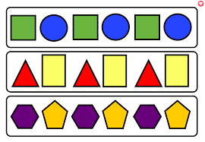
What is a pattern?
A pattern is when there are things that are arranged following a rule or rules.
A pattern can be made from objects, colours, shapes and numbers and sounds.
Patterns are often repeating.

Slide 3
Repeating patterns
Patterns repeat if we find the rule and look back at what has happened previously in the pattern we can work out what comes next.

Slide 4
What colour circle is going to be next in this repeating pattern?
What is the rule for this repeating pattern?

Slide 5
What comes next?

Slide 6


Slide 7
What comes next?

Slide 8
Make your own pattern

Slide 10
Make your own pattern

Slide 11
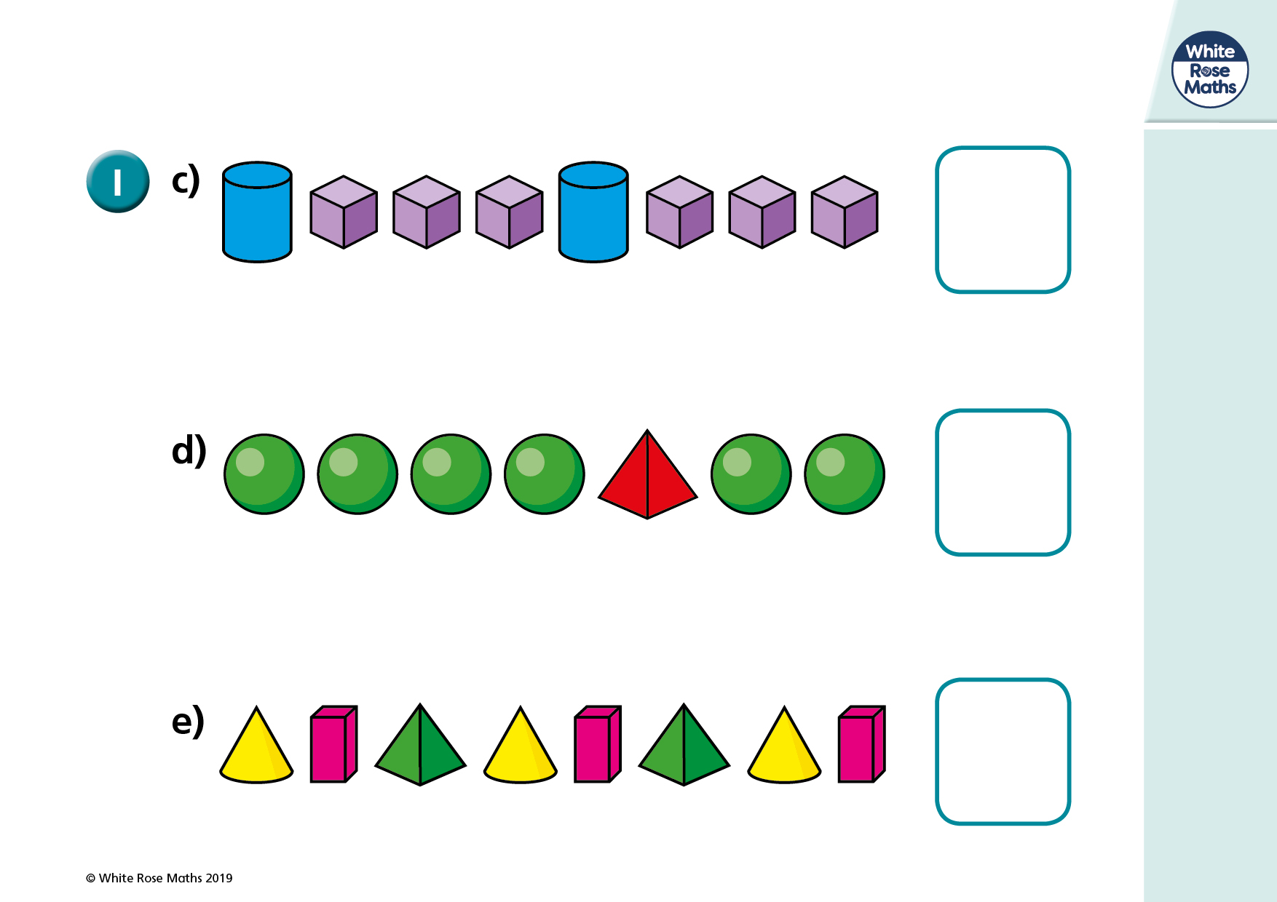
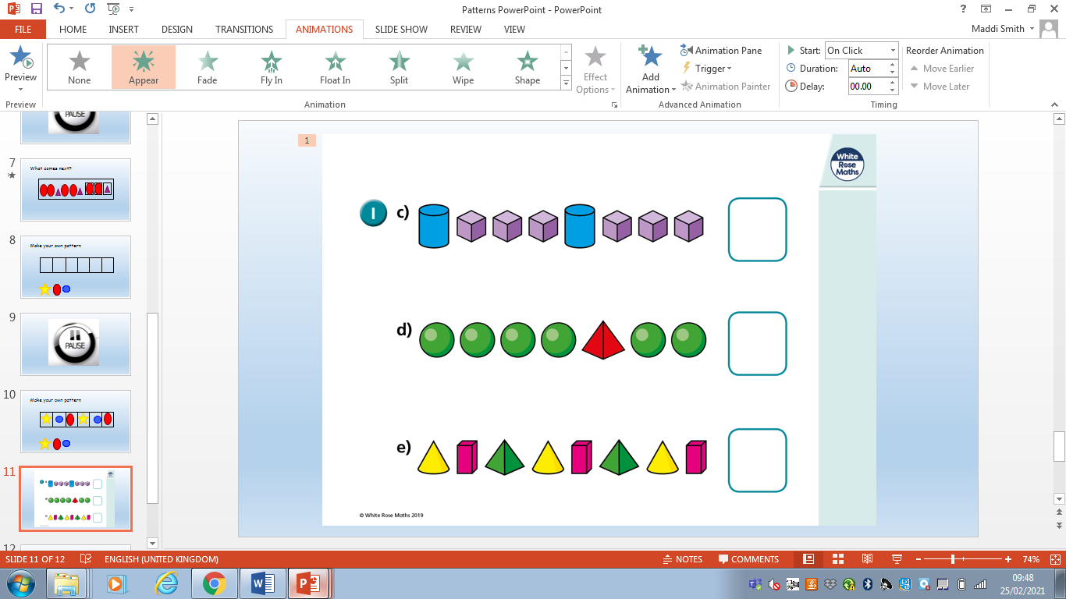

Slide 12
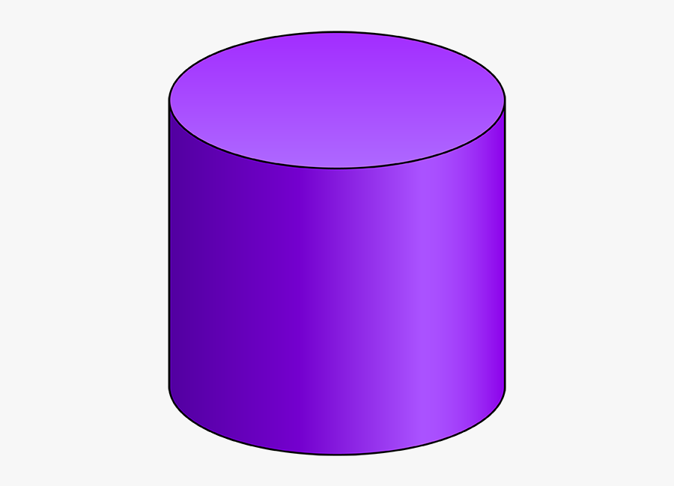


Can you draw my pattern?
My pattern is cylinder, cube, cube, cylinder.
Can you make it a repeating pattern?

Slide 13
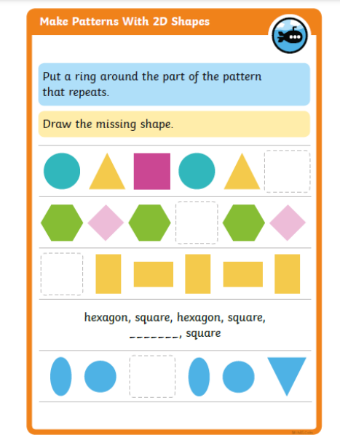
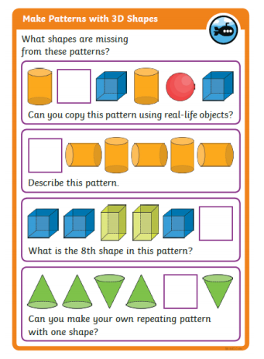
Your task:
Activity one: Follow along with the video and complete the activity sheets attached.

Slide 14
Challenge: Can you draw, or use the flashcards on the website, three of your own patterns using a mixture of 2D and 3D shapes.

Slide 15
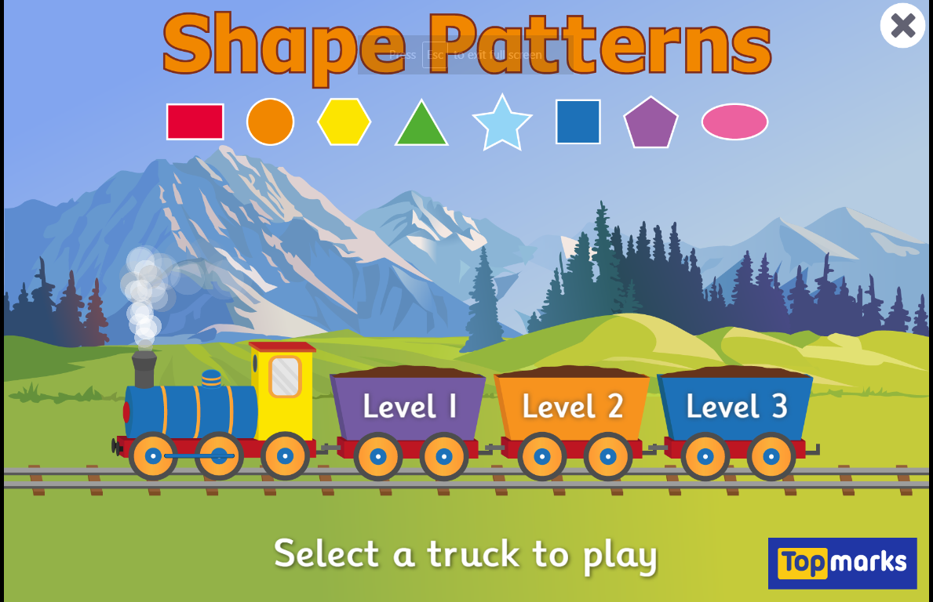
Extension: Have a go at this game.
https://www.topmarks.co.uk/ordering-and-sequencing/shape-patterns

