Slide 1

The Iron Man
Lesson 12

Slide 2
LO: To plan the key features of my poster.
I can understand what a hyperbole is.
I can include a hyperbole in my planning.
I can brainstorm ideas for TIM’s rental.

Slide 3
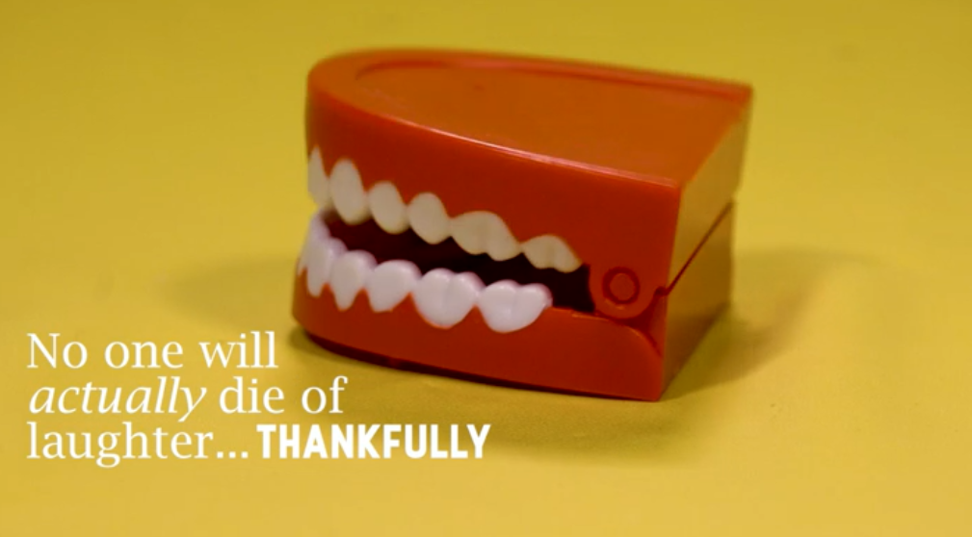
Starter: hyperbole
Figurative language: hyperbole, similes and metaphors - Year 6 - P7 - English - Home Learning with BBC Bitesize - BBC Bitesize
Notes:
Mention to chn that this is not something that they need to know until Yr6 but it is always nice to start early. Hyperbole’s are similar to similies and metpahors because we are not talking literally, we are exaggerating. It also links to the idea of superlatives and comparative adjectives.
E.g. The Iron Man is a god send – he is not really sent from god, it just means he is useful.
Or This offer is out of this world
Or The Iron Man is the fastest helper you will ever meet!

Slide 4
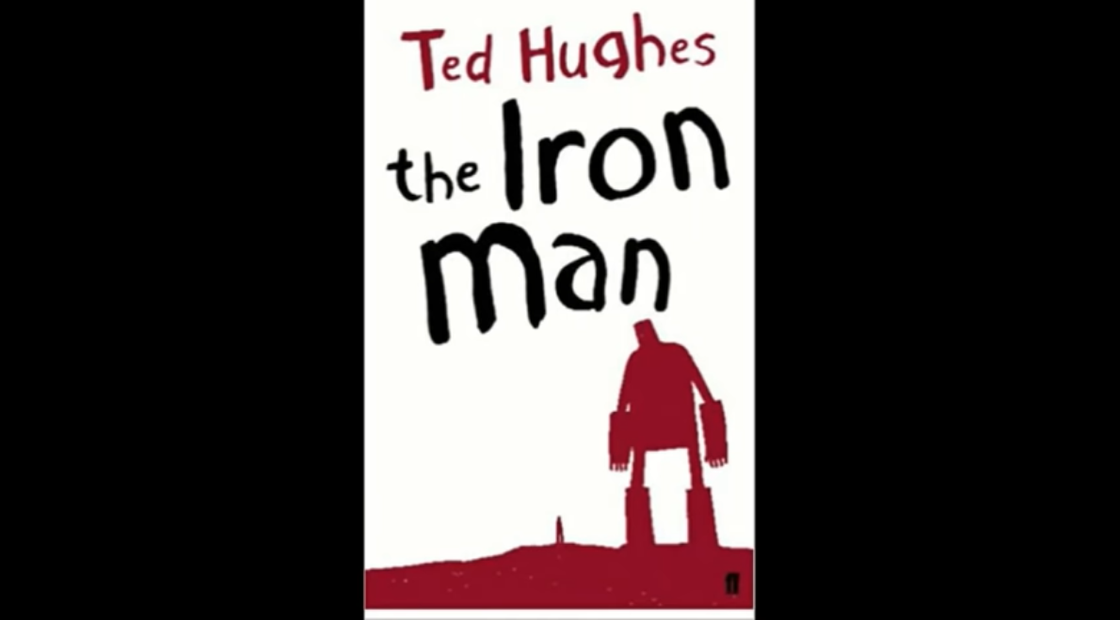
Chapter 3: The Iron Man
The Iron Man - Chapter 3 by Ted Hughes - YouTube
Notes:
Can listen from the start to refresh chn’s memory of events so far.

Slide 5
Key features of a persuasive poster (advert)
Contact information (how can they find you)
Title (what is your product)
Picture (what does your product look like)
Bright colours (catch the reader’s eye)
Rule of 3 (three reasons to buy your product)
Adverts encourage you to buy things. They use memorable words and short descriptions. They can be seen on TV, heard on the radio and printed on posters or within different texts.

Slide 6
Why might you want to rent The Iron Man?
Talk to your partner about what jobs the Iron Man could do? Why do you think people would want to rent him.
Then we will brainstorm together.

Slide 7
Iron Man for rent:
Jobs for The Iron Man

Slide 8
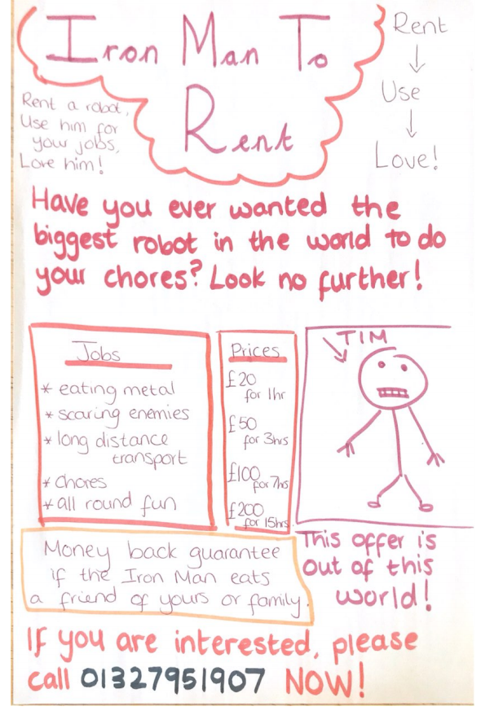
Notes:
What key features can we see? What do we like? What do we not like? What could we do to improve it?

Slide 9
Your task:
In your books, or on your sheets, you are going to create a brainstorm for your advert tomorrow.
Think about:
What colours you might use
What main selling points you have for The Iron Man
Contact information
Prices and hours
Any information that you think will draw the audience member in
Who your target audience is – who do you want to rent TIM?
If you finish early and you have checked your work, start to draw the layout for your poster on a whiteboard to help with your poster tomorrow.

Slide 10
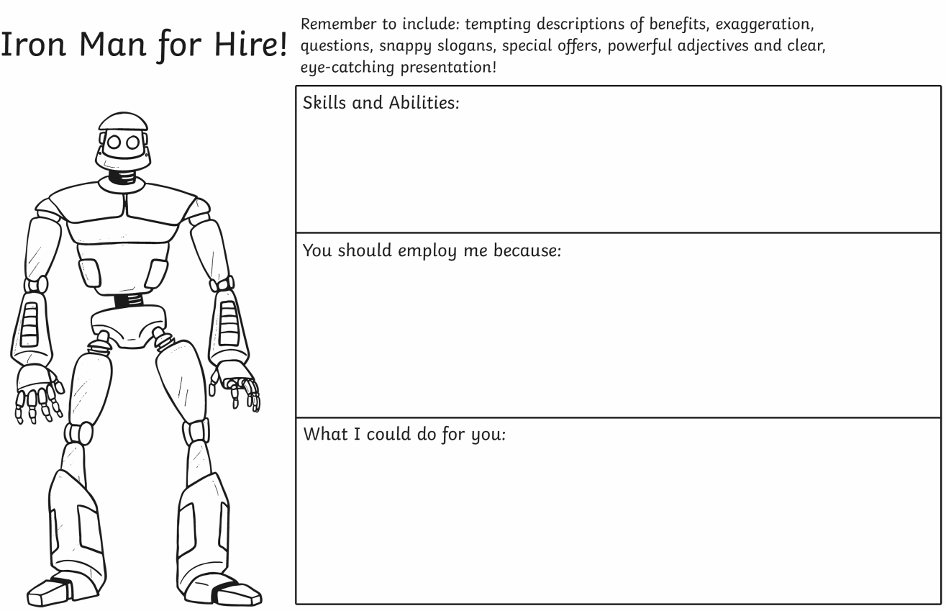
If you have this sheet, use the boxes to help with your planning. You can add extra information around the Iron Man e.g., colours that you might use.

