Slide 1
LO: To apply my knowledge of statistics using my own data.
I can recall the different ways I can record data.
I can collect my own data to use.
I can present my data accurately in a variety of ways.

Slide 2
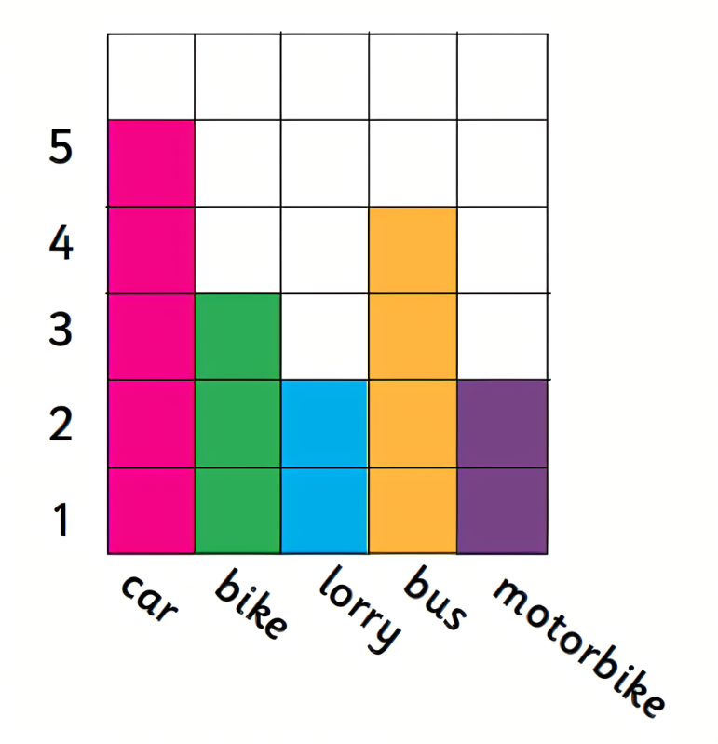
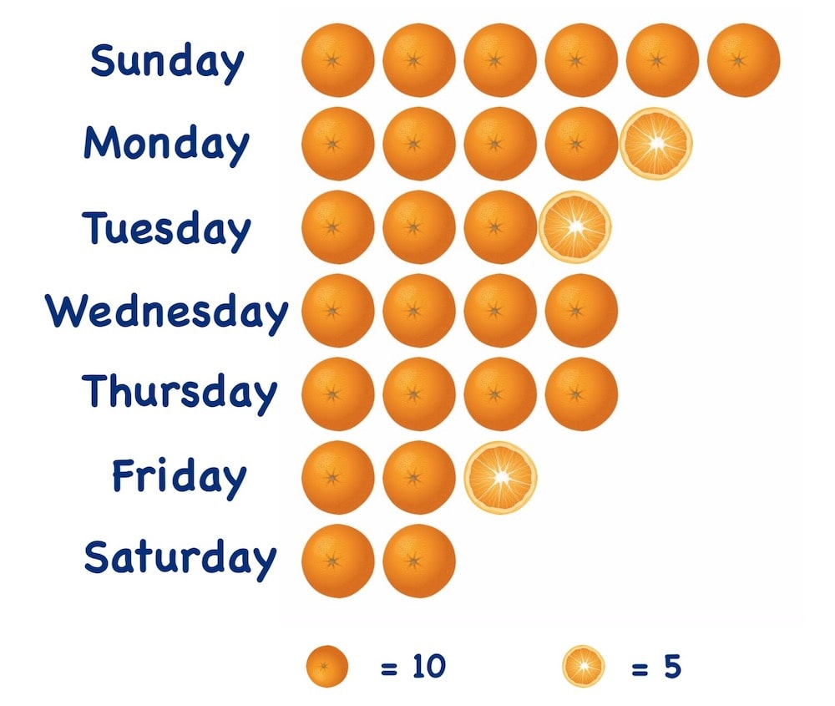
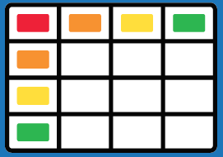

Which ways of showing data have we looked at so far?

Slide 3
In today’s lesson, we are going to be collecting our own data and showing it in different ways. Most of our activities are practical but it is really important that we are counting accurately as well as having fun!

Slide 4
Activity 1: Tally Chart
I am going to set a timer for 1 minute.
5 or 6 children will be trying to do as many squats as they can.
If you are not squatting, you need to be counting carefully how many squats someone does.
Then we will make a whole class tally.

Slide 5
Activity 2: Pictogram
I am going to set a timer for two minutes.
5 or 6 children in the class will try to create the tallest tower they can out of connecting blocks.
We will record the data in a pictogram.
Think carefully about which key we might use.
LA chn to use key of 1:1.

Slide 6
Activity 3: Bar Chart
We are going to create a bar chart or block diagram to show how we got to school this morning. We might have walked, driven, scooted, rode our bikes etc.

Slide 7
Activity 4: Table
Using the lunch list from each class, we are going to create a table of who in which class is having which lunch today.

