Slide 1
Y2 LO: To draw an interpret pictograms on a scale of 1:1.
Y3 LO: To draw and interpret pictograms on a scale of 1:2/5/10 (recap)
To understand how to draw and read a tally chart.
To understand the importance of a key.
To draw pictograms based on information given.
To answer questions based on a pictogram.
To understand how to draw and read a tally chart.
To understand the importance of a key.
To draw pictograms based on information given.
To answer questions based on a pictogram.

Slide 2
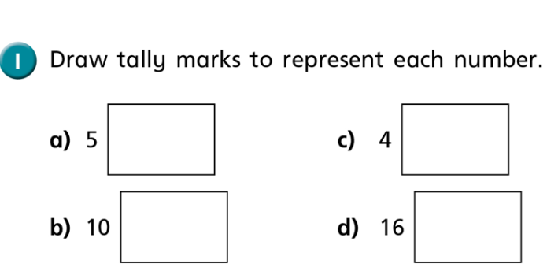
Starter: Tally Charts
When we draw tally marks, we draw a line for each and then cross to make it a group of 5.
We can count some tally marks in groups of 5 to make them easier then count up in 1s to work out the whole number.
Notes:
You could demonstrate this practically. Have two children trying to throw a beanbag in a hoop. Draw a basic tally chart on the board and ask another child to fill in the tally, scoring one mark for each time they get the beanbag in the hoop.

Slide 3
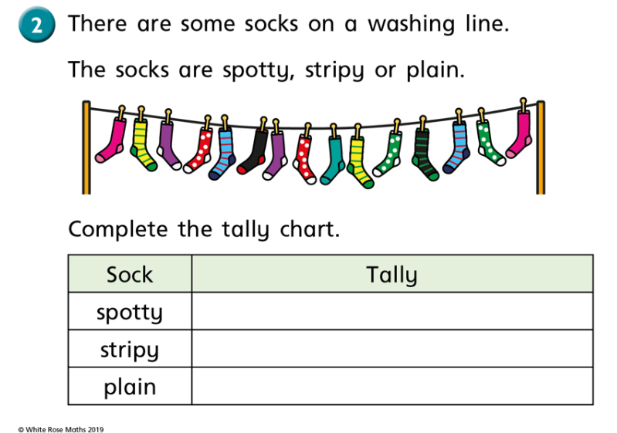
Top Tip: You can count all the spotty socks first OR you can draw a line in each box as you go across the washing line e.g. 1 plain sock, 1 stripy sock, 1 plain sock.

Slide 4
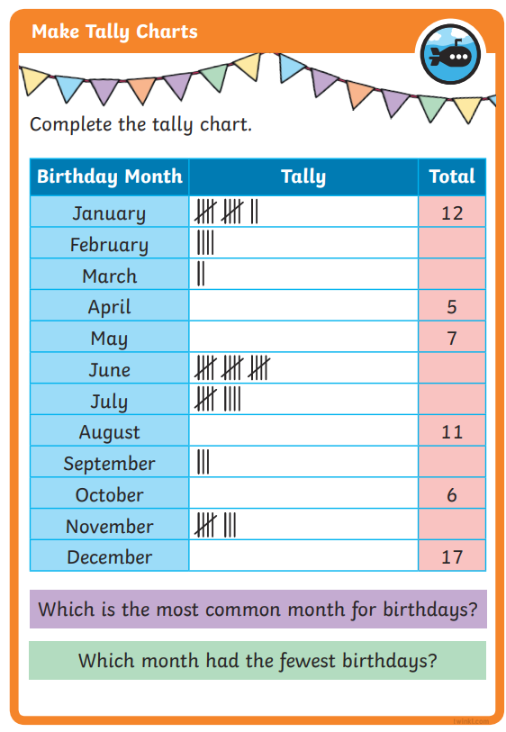
Can you complete the Tally Chart
Then see if you can answer these questions with your partner
Q. How many people had a birthday in January?
Q. How can you count to make it efficient?
Q. What does most common mean?
Q. How many people have birthdays in January?
Notes:
Explain that if we are given the tally, we need to count the marks to find a total. If we are given a total, we need to draw the correct tally marks in the chart, Prompt YR3 chn to answer questions on the board too. Use the tally chart activity to see who understand the concept and who might need a bit more support later on.

Slide 6
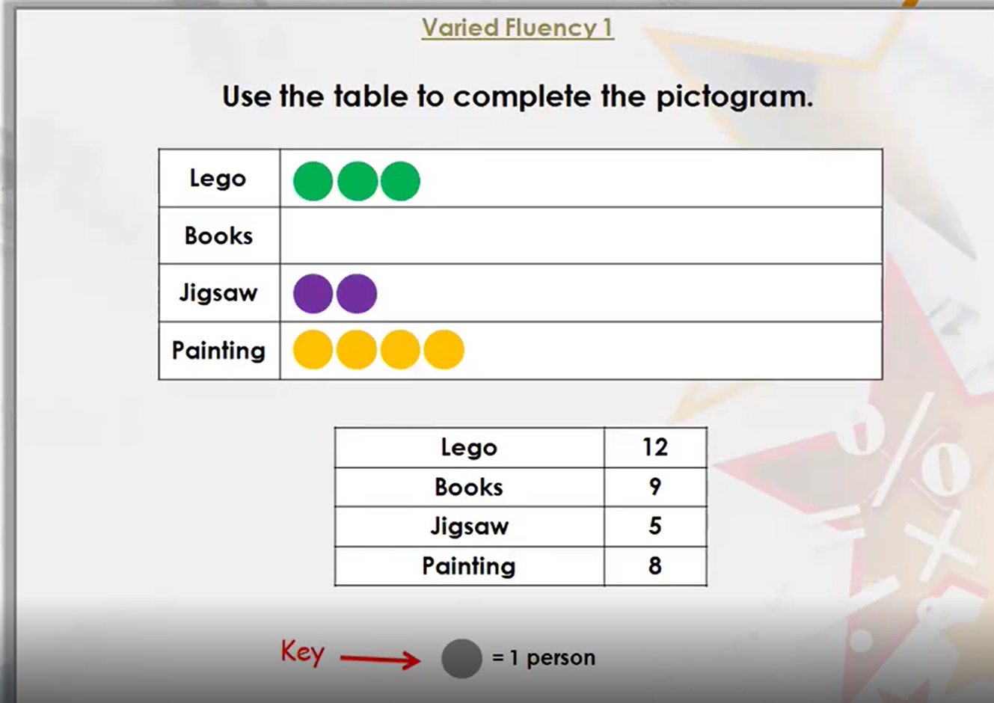
Notes:
Explain to chn that we will see a key when we are looking at pictograms. This tells me how much each shape or picture is worth. We are looking at shapes or pictures that equal 1. Can we complete the pictogram as a class. Remind chn that we already have some circles drawn so we need to count on from what we already have e.g. count on from 3 until you get to 12.

Slide 7
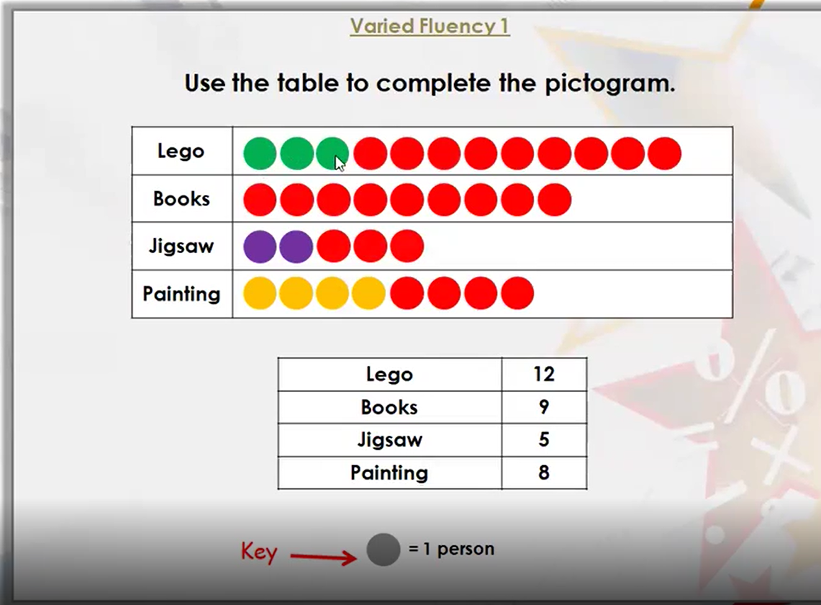

Slide 8
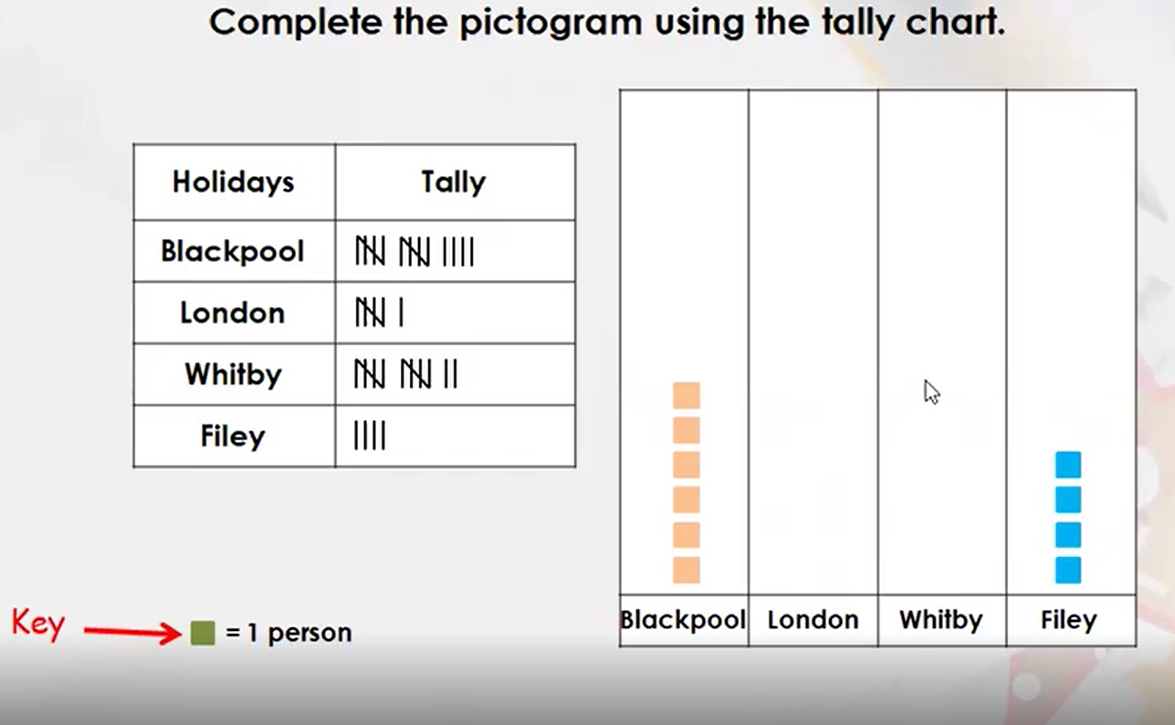
Notes:
For this question, we first need to count the amount shown in the tally chart. This question tells us that each square is equal to one person. Just like before, we need to see how many the chart has already given us and count on.

Slide 9
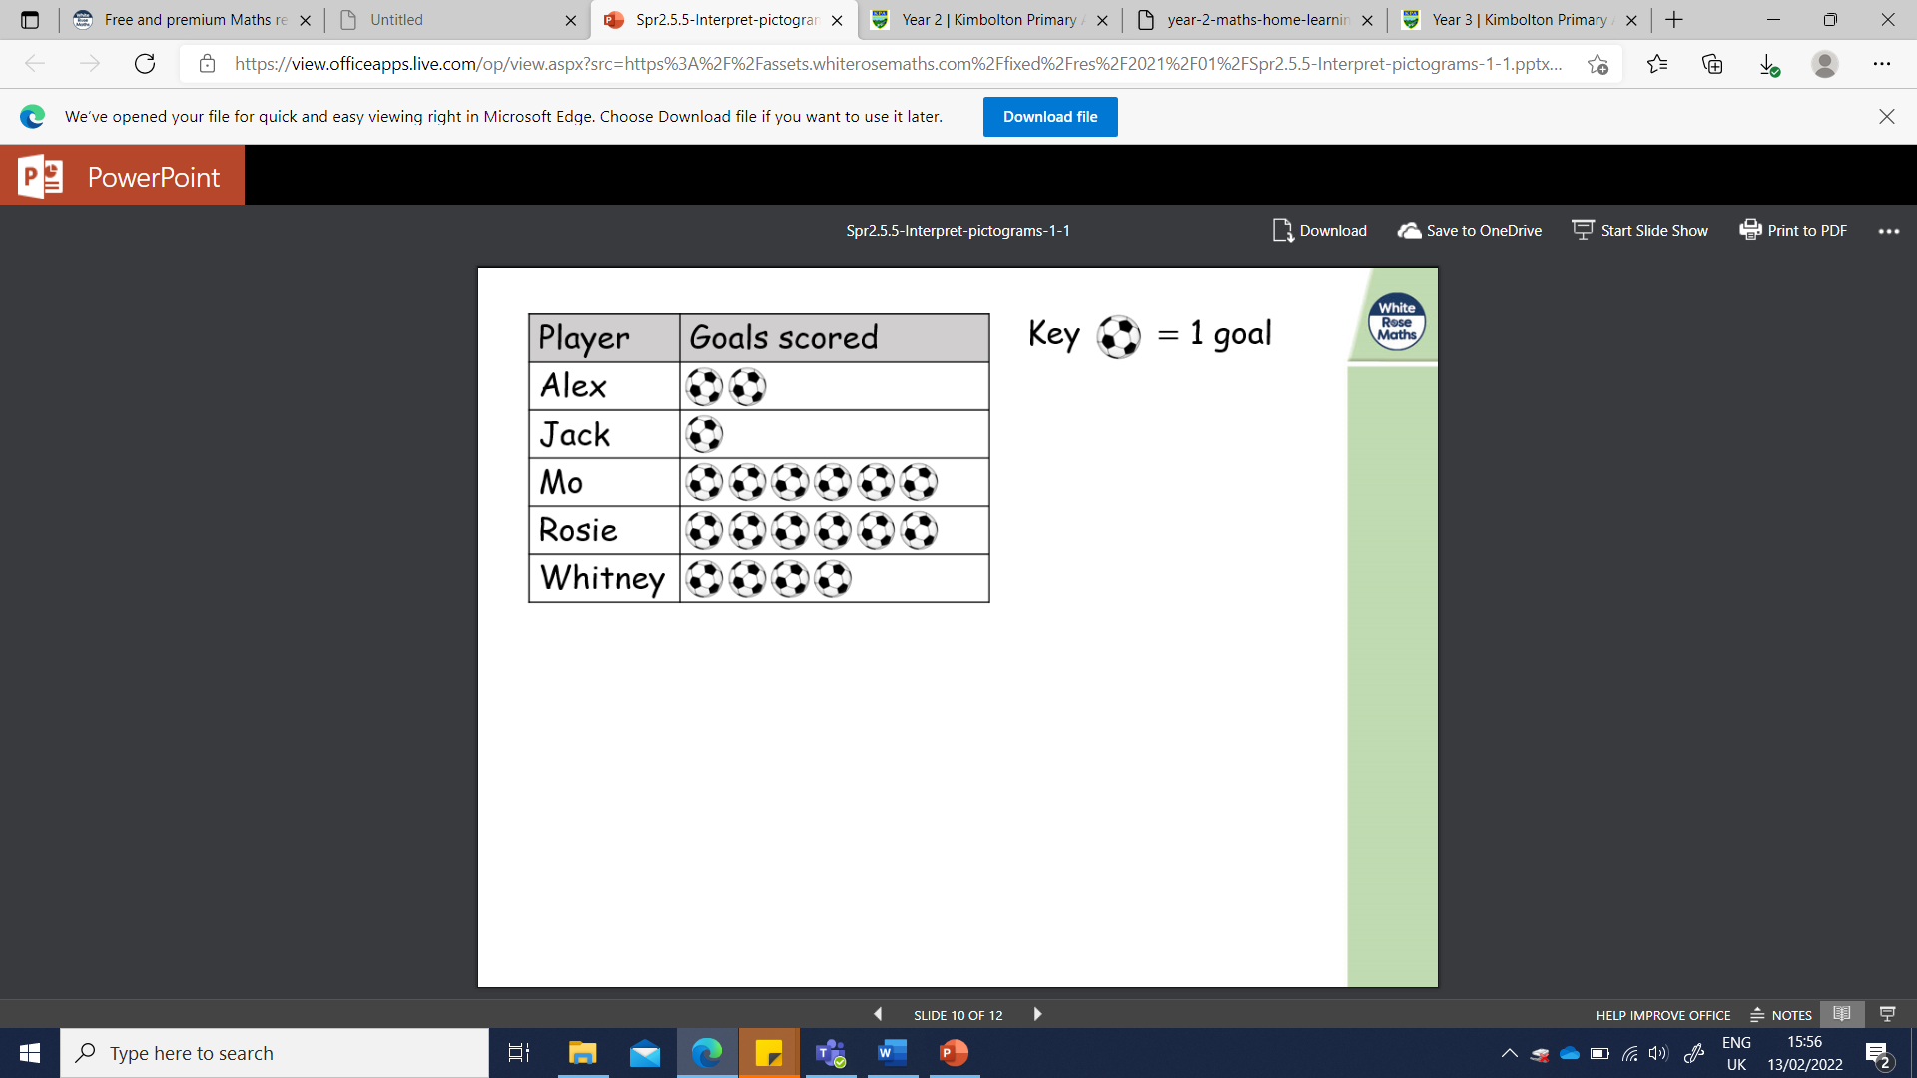
Who scored the most goals?
Who scored the fewest goals?
How many more goals did Whitney score than Alex?
Which two players scored the same amount of goals?
How many goals did the team score all together??
Notes:
Ensure chn know what most, fewest, more than, less than and all together mean. Explain when comparing Alex and Whitney, we are finding the difference. We know Alex scored 2 goals and Whitney scored 4. What do you add to 2 to get to 4?

Slide 10
YR2 Task:
1 star: Complete Q1-Q3 on creating pictograms. Then complete Q1a-1b on interpreting pictograms.
2 star: Complete Q1-Q7 on creating pictograms. Then complete Q1a-3b on interpreting pictograms.
3 star: Complete Q1-Q7 on creating pictograms. Then complete Q4a-6b on interpreting pictograms.

Slide 11
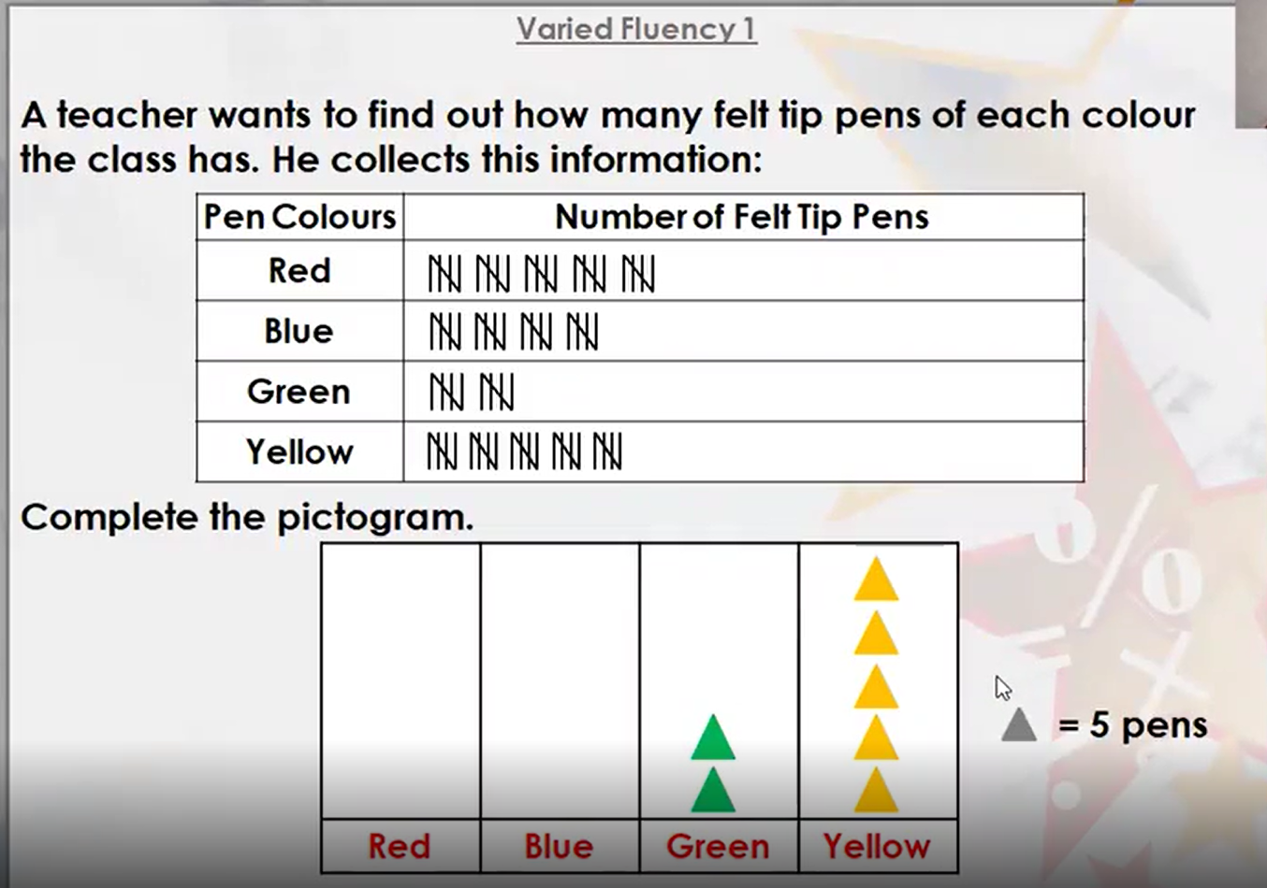
Notes:
We need to play close attention to the key. This is telling us that every triangle is worth 5.

Slide 12
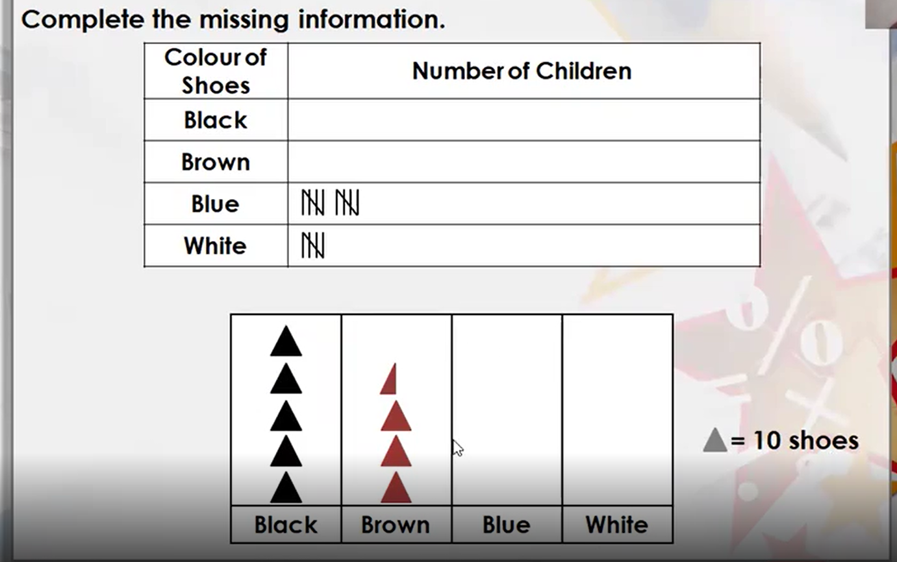
Notes:
Direct chn towards the half triangle shape. This means we have to half the key. Half of 10 is 5 so we know that the half triangle is worth 5.

Slide 13
YR3 Task:
Work through Power of Maths questions at your own pace. Before you start answering a question, use a highlighter to find the key. This is really important, so you are counting in the right amount.
Remember: If they picture is halved, you need to half the number in the key.

Slide 14
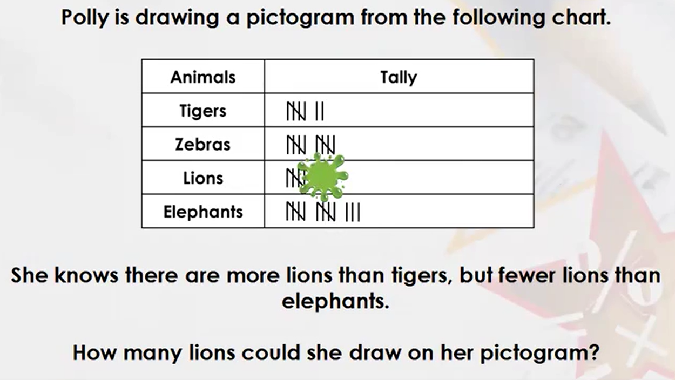
YR2 Plenary:
Notes:
Answer: Polly could have drawn 8,9,10,11 or 12.

