Slide 1
Shape Poems
LO: To explore a variety of poems.
LO: To understand the structure and meaning of a shape poem.

Slide 2
Poetry:
Limerick- these are funny and have rhyming words.
Haiku- this is a Japanese poetic form that consists of three lines, with five syllables in the first line, seven in the second, and five in the third. These are short poems, usually about nature.
Acrostic- the first letter of each line spells out what the poem is about.
Free verse- these have no rhyming words. Lines can be full sentences or even just one word.
Kennings- this is a way of describing something using clues rather than just saying what it is. Each line is two words long.
Shape poems

Slide 3
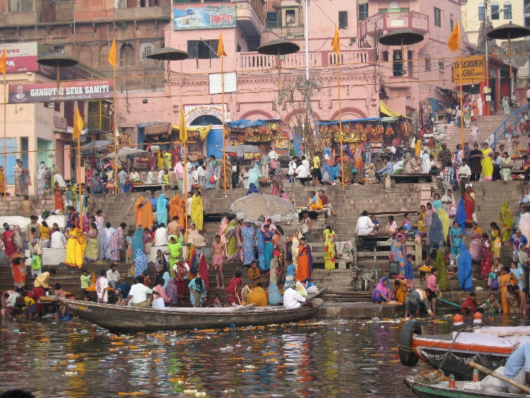
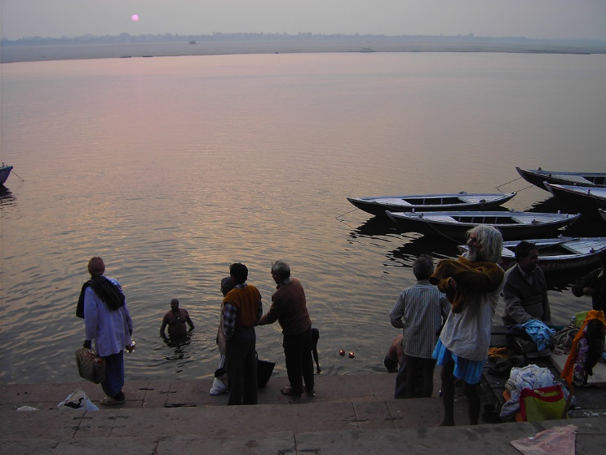
River Ganges Kennings Poem
Life-giver
Mountain-drinker
Glacier-melter
Soil-carrier
Festival-dancer
Nation-visitor
Flower-transporter
Food-accepter
Candle-protector
Mile-eater

Slide 4
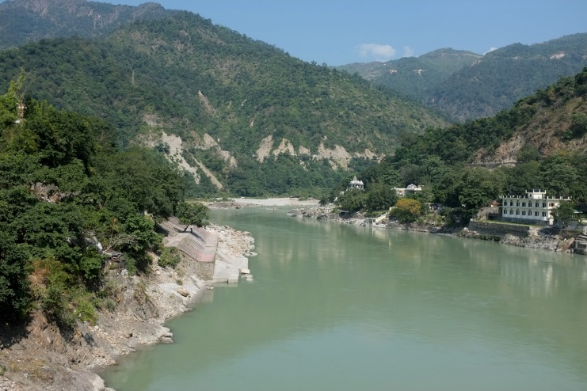
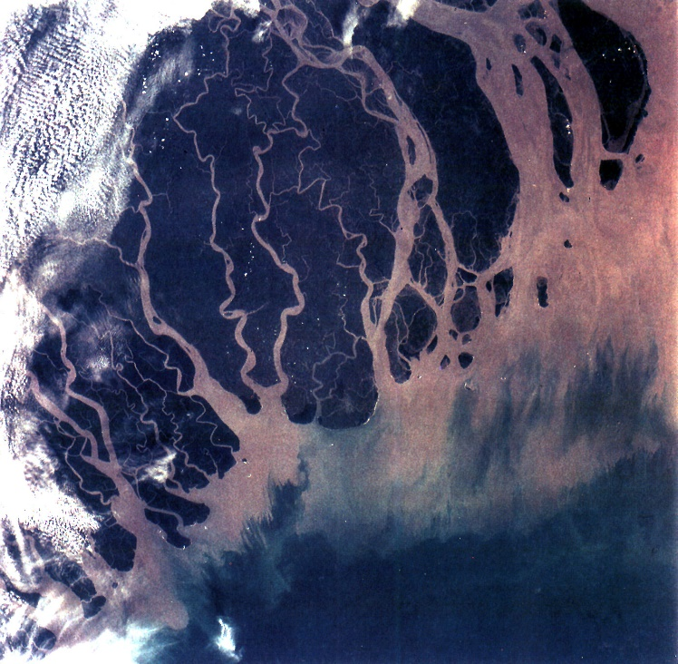

People-attracter
Bath-provider
Fish-shielder
Canyon-carver
Town-passer
Plain-waterer
Direction-changer
City-drifter
Goddess-dweller
River-befriender
Bay-builder
Kennings by Teachallenjoy

Slide 5

What is a Shape Poem?
A shape poem is a poem that describes an object, person or animal.
The special thing about a shape poem is that the
words of the poem form the shape of the object,
person or animal being described.
Shape poems don’t have to rhyme!
Shape poems can use full stops and capital
letters like sentences.
Shape poems often use alliteration
or similes.
They glide across
the golden grass
gathering goblins and
gathering grasshoppers.
They giggle as they
glide above
the ground.

Slide 6
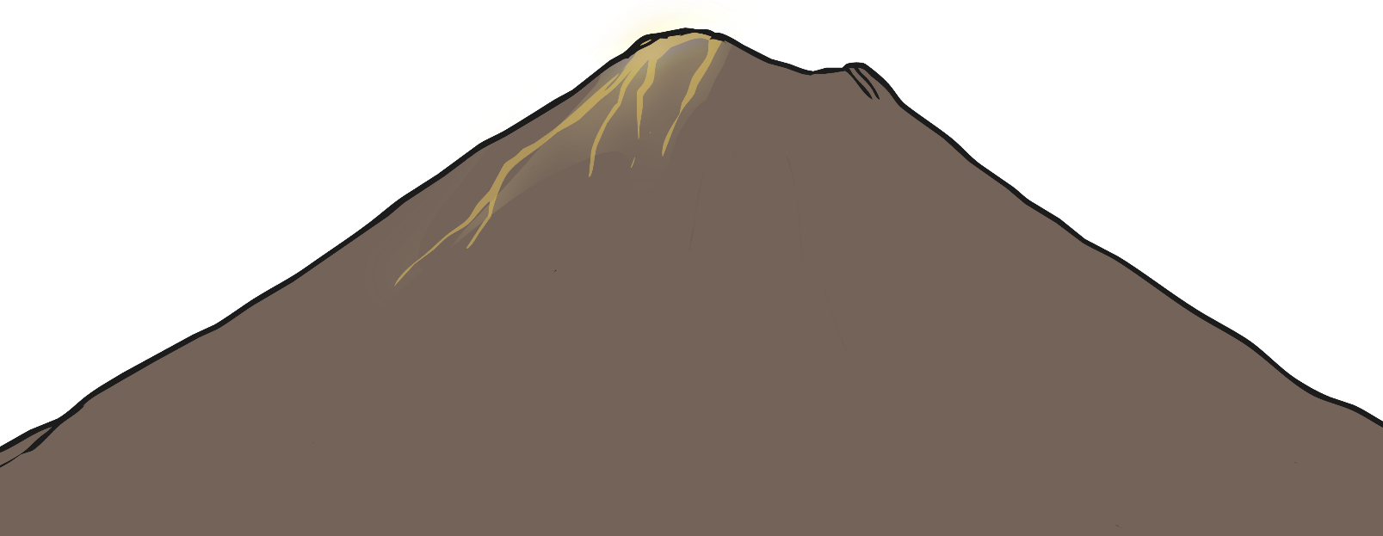
The Features of a Shape Poem
What did you notice about the shape poems we looked at?
Each line can be a different length or be curved to form the shape of the object that is being described.
Full stops and capital letters are used just like you would use in sentences.
A huge rock that
rumbles and roars, wrecking the
ground all around it. It shoots sizzling,
steaming, scorching lava like a monster spitting
out hot liquid into the air. Like a smoking dragon, it finally
starts to calm down. The chaos stops and it goes back to being a
deadly and dangerous rock.
A huge rock that
rumbles and roars, wrecking the
ground all around it. It shoots sizzling,
steaming, scorching lava like a monster spitting
out hot liquid into the air. Like a smoking dragon, it finally
starts to calm down. The chaos stops and it goes back to being a
deadly and dangerous rock.
A huge rock that
rumbles and roars, wrecking the
ground all around it. It shoots sizzling,
steaming, scorching lava like a monster spitting
out hot liquid into the air. Like a smoking dragon, it finally
starts to calm down. The chaos stops and it goes back to being a
deadly and dangerous rock.
Alliteration can be used – this is lots of words in a row beginning with the same letter.
Similes can be used – this is where we use the words ‘like’ or ‘as’ to compare two things to each other.
The lines don’t have to rhyme.

Slide 7
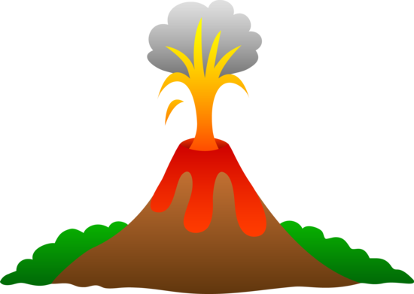
A
Volcano.
A huge rock,
Shooting lava up
in to the air! Everyone runs for
Cover. Lots of thick black smoke,
pours out of the top, giving you a warning
before the explosions start, nothing can stand in its
way. Sometimes they don’t blow up for thousands of years.
Still thousands in the world but they don’t all work, some are even under water.

Slide 8
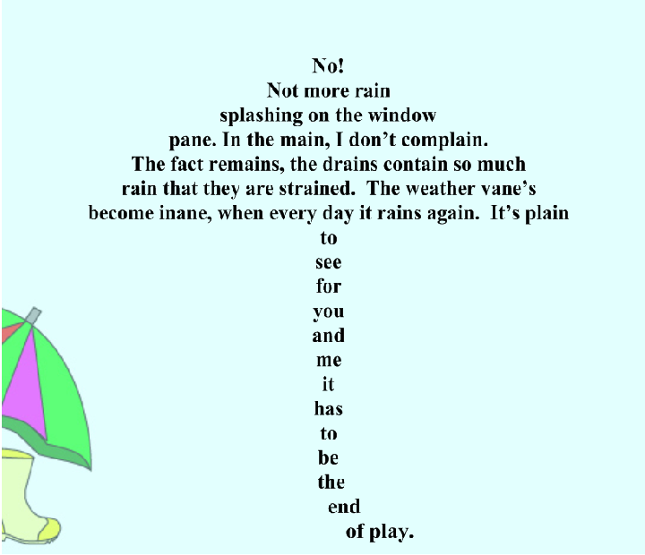

Slide 9
Your task:
Your activity today is to look at a variety of shape poems. Can you discuss or write down what you notice in these poems?
Can you tell me which poem is your favourite and why?

