Slide 1
Problem Solving
Lesson 4

Slide 2
Learning objective
To consolidate our problem solving skills.

Slide 3
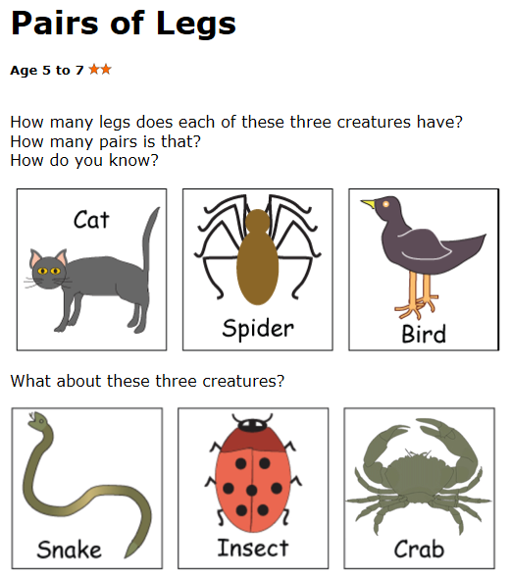
Can you write it as a repeated addition?
Can you write it as a multiplication?

Slide 4
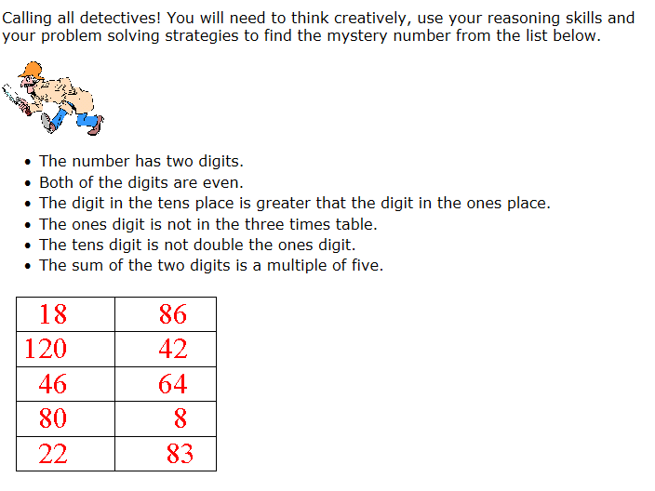

Slide 5
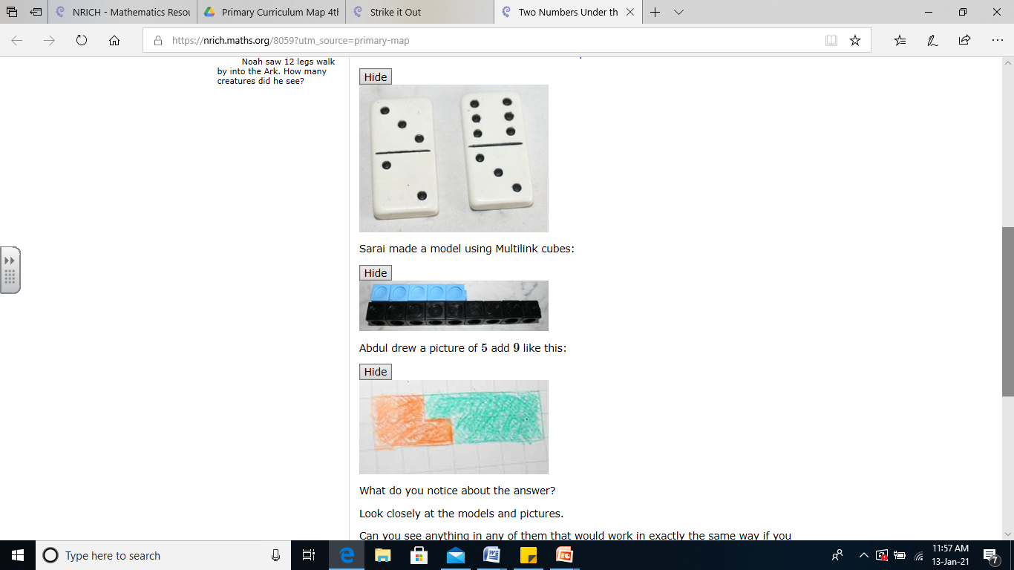
Two Numbers Under the Microscope
Choose any two odd numbers e.g. 5 and 9 and add them together.
Draw a picture to represent this addition.
What do you notice about the answer?

Slide 6
Two Numbers Under the Microscope
Look closely at the models and pictures.
Can you see anything in any of them that would work in exactly the same way if you used two different odd numbers?
Can you use your one example to prove what will happen every time you add any two odd numbers?
See if you can explain this to someone else. Are they convinced by your argument?

Slide 7
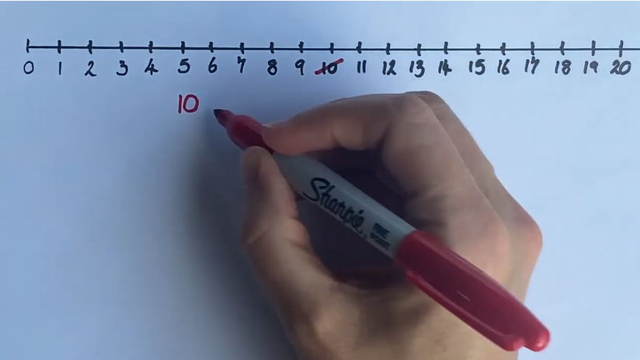
Strike it out
https://youtu.be/G7baaNCYCpY
Can you work out how to play the game?
What do you think the rules might be?
How might someone win the game?

Slide 8
Strike it out
Try playing the game against someone else a few times to get a feel for it.
Do you have any good ways of winning?
Now it's time to work together with a partner, rather than against them.
Try to create a string of calculations that uses as many numbers as possible on the 0-20 number line.
Is it possible to create a string of number sentences that uses all the numbers on the 0-20 number line? Why or why not?

