Slide 1
Place Value

Slide 2
LO: To consolidate our understanding of place value.
Year 2
Year 3
I can identify and represent numbers in different ways.
I can recognise the place value of each digit in a two-digit number.
I can count in 2s, 3s, 5s and 10s forwards and backwards.
I can identify and represent numbers in different ways.
I can recognise the place value of each digit in a three digit number.
I can represent and count in multiples of 100.

Slide 3
Starter
Year 2:
Year 3:
Here are some length measurements. Order them from shortest to longest.
There are 10 millimetres in 1 centimetre.
Convert these centimetres measurements to millimetres:
5cm
7cm
2cm 4mm
6 cm 5mm
9cm 6mm
8mm
23m
10m
45m
58cm
11cm
3m
2mm
4cm
22cm
There are 100 centimetres in 1 metre.
Convert these metre measurements to centimetres:
9m
4cm
2m 45cm
3m 5cm
8m 65cm

Slide 4
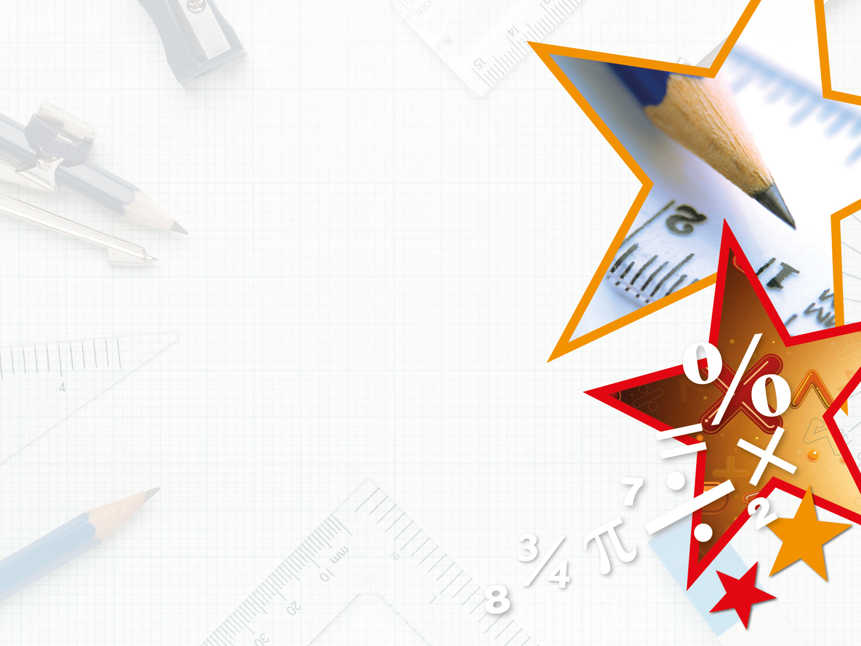
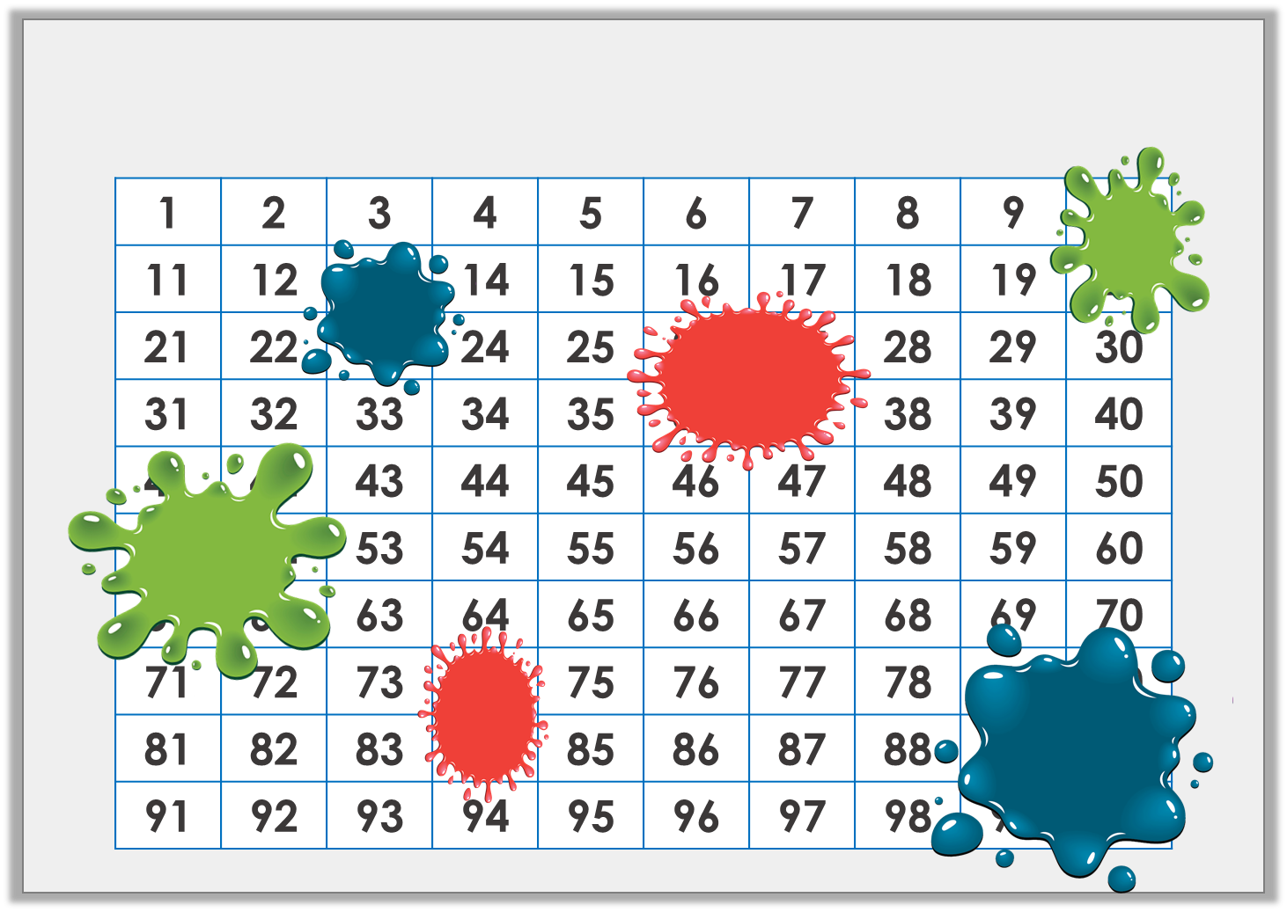

Introduction
Identify the numbers hidden by the splats of paint.
© Classroom Secrets Limited 2018

Slide 5
Introduction
Identify the numbers hidden by the splats of paint.
1 | 2 | 3 | 4 | 5 | 6 | 7 | 8 | 9 | 10
11 | 12 | 13 | 14 | 15 | 16 | 17 | 18 | 19 | 20
21 | 22 | 23 | 24 | 25 | 26 | 27 | 28 | 29 | 30
31 | 32 | 33 | 34 | 35 | 36 | 37 | 38 | 39 | 40
41 | 42 | 43 | 44 | 45 | 46 | 47 | 48 | 49 | 50
51 | 52 | 53 | 54 | 55 | 56 | 57 | 58 | 59 | 60
61 | 62 | 63 | 64 | 65 | 66 | 67 | 68 | 69 | 70
71 | 72 | 73 | 74 | 75 | 76 | 77 | 78 | 79 | 80
81 | 82 | 83 | 84 | 85 | 86 | 87 | 88 | 89 | 90
91 | 92 | 93 | 94 | 95 | 96 | 97 | 98 | 99 | 100
© Classroom Secrets Limited 2018

Slide 6
Two-Digit Numbers
Two-digit numbers are made up of tens and ones. Numbers 10 to 99 are two-digit numbers.
10 99

Slide 7



35
The first digit tells you how many tens there are in the number.
The second digit tells you how many ones there are in the number.
3 tens
5 ones

Slide 8
T | O
20
13
46
74
6
99
Notes:
Chd on whiteboards to partition the numbers on the table.
This should be 1 or 2 minutes maximum, chd know this, just a quick refresher before going onto questions.

Slide 9
Three-Digit Numbers
Three-digit numbers are made up of hundreds, tens and ones. Numbers 100 to 999 are three-digit numbers.
100 999

Slide 10
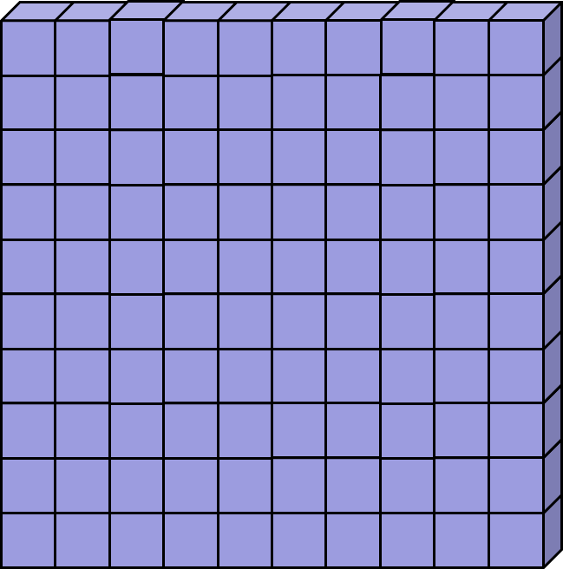
127
The first digit tells you how many hundreds there are in the number.
1 hundred
2 tens
7 ones

Slide 11
H | T | O
680
100
464
109
248
999
Notes:
Chd on whiteboards to partition the numbers on the table.
This should be 1 or 2 minutes maximum, chd know this, just a quick refresher before going onto questions.

Slide 12
Lets look at some example questions together before we go onto our worksheet

Slide 13


Varied Fluency 2
True or false? This representation shows 6 tens and 4 ones.
© Classroom Secrets Limited 2018

Slide 14
Varied Fluency 2
True or false? This representation shows 6 tens and 4 ones.
False. This representation shows 6 tens and 8 ones.
© Classroom Secrets Limited 2018

Slide 15
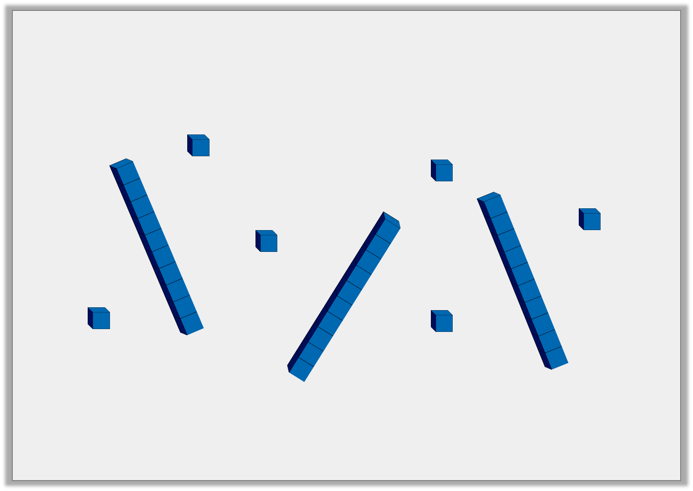
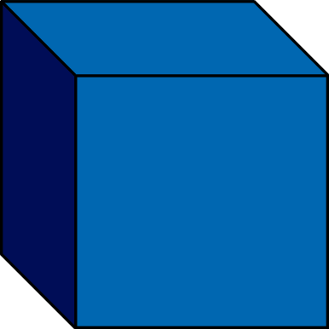
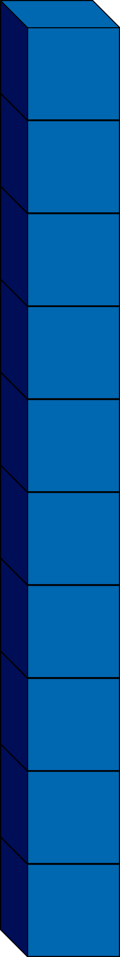
Problem Solving 1
Make three different two-digit numbers using five of these representations each time.
© Classroom Secrets Limited 2018

Slide 16
Varied Fluency 1
Write the number represented by each image.
H | T | O
100
100
100
100
100
100
© Classroom Secrets Limited 2018

Slide 17
Varied Fluency 1
Write the number represented by each image.
H | T | O
200
100
100
100
100
600
100
100
© Classroom Secrets Limited 2018

Slide 18
Varied Fluency 3
If you count backwards in hundreds, what number will you say after the one represented in the image below?
H | T | O
© Classroom Secrets Limited 2018

Slide 19
Varied Fluency 3
If you count backwards in hundreds, what number will you say after the one represented in the image below?
600
H | T | O
© Classroom Secrets Limited 2018

Slide 20
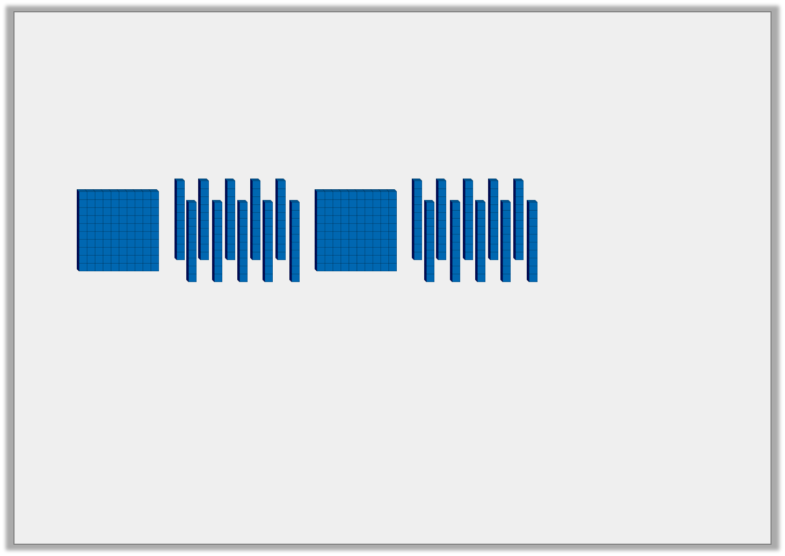
Reasoning 1
Which image is the odd one out?
Explain your answer.
A.
10
10
100
10
10
100
10
10
10
10
10
10
B.
H | T | O
C.
© Classroom Secrets Limited 2018

Slide 21
Reasoning 1
Which image is the odd one out?
Explain your answer.
B is the odd one out because…
A.
10
10
100
10
10
100
10
10
10
10
10
10
B.
H | T | O
C.
© Classroom Secrets Limited 2018

Slide 22
Reasoning 1
Which image is the odd one out?
Explain your answer.
B is the odd one out because A and C are 300, but B is 400.
A.
10
10
100
10
10
100
10
10
10
10
10
10
B.
H | T | O
C.
© Classroom Secrets Limited 2018

Slide 23
If I had 5 hundreds, 3 tens and 6 ones what would my number be?
If I had 7 hundreds, 4 tens and 11 ones what would my number be?
If I had 2 hundreds, 6 tens and 8 ones what would my number be?
385
What would my number be if I took 4 tens away?
What would my number be if I took 13 ones away?
Notes:
Quickfire on whiteboards.

Slide 24

Plenary: Where will I be facing?
The child is facing the circle. If they turn a quarter turn clockwise, which shape will they be facing?

Slide 25

Plenary: Where will I be facing?
The child is facing the square. If they turn a half turn clockwise, which shape will they be facing?

Slide 26

Plenary: Where will I be facing?
The child is facing the triangle. If they turn a three-quarter turn clockwise, which shape will they be facing?

Slide 27

Plenary: Where will I be facing?
The child is facing the rectangle. If they turn a whole turn clockwise, which shape will they be facing?

