Slide 1
Persuasive Writing
Lesson 6

Slide 2
Learning Objective
LO: To write the main part of our letter.

Slide 3
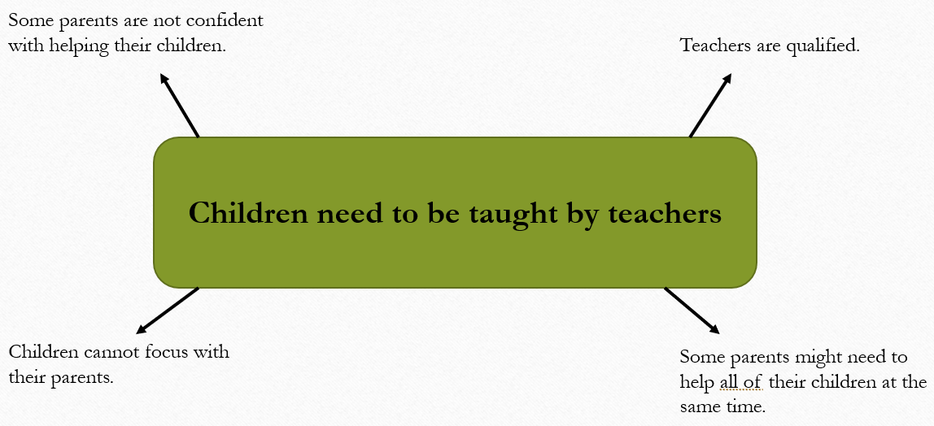
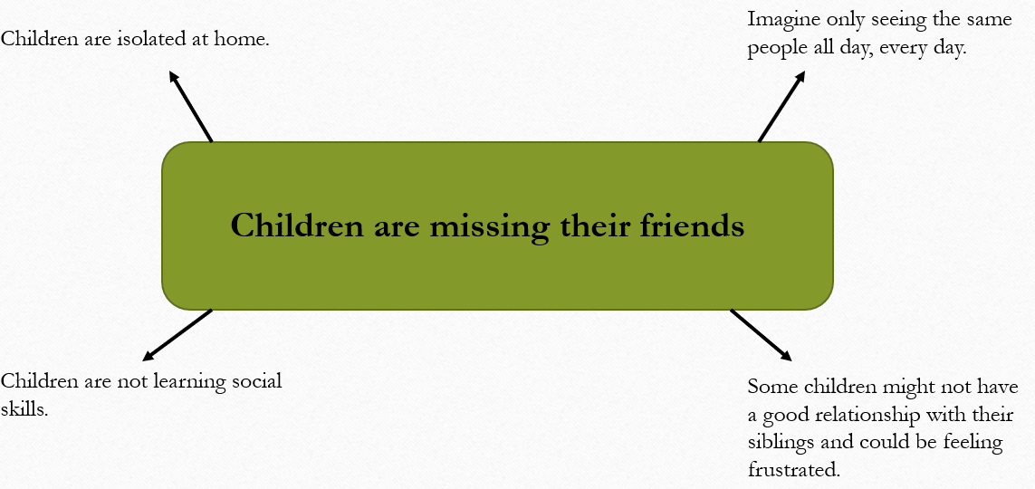
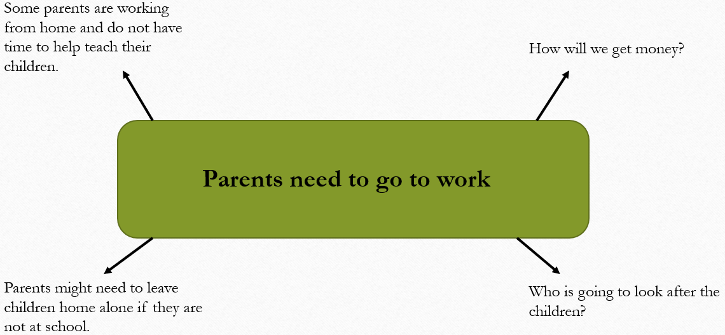

Slide 4
Year 3 - Paragraphs
Paragraphs are a collection of sentences. They are used in writing to introduce new sections of a story, characters or pieces of information.
Paragraphs help readers to enjoy what has been written because they break text up into easy-to-read sections.
We usually show a paragraph by skipping a line.

Slide 5

Paragraph One
What is my main point?
What features have I included in my first paragraph?
Firstly, you need to open the schools because children are missing their friends. Imagine how isolated these poor children must feel at home. Do they deserve to feel so deserted? Children are missing out on the valuable social skills such as having a good relationship with other children that they will use for the rest of their lives. Being with friends will make these children happier than sitting at home with the same people all day, every day.

Slide 6
Paragraph One
What is my main point?
What features have I included in my first paragraph?
Firstly, you need to open the schools because children are missing their friends. Imagine how isolated these poor children must feel at home. Do they deserve to feel so deserted? Children are missing out on the valuable social skills such as having a good relationship with other children that they will use for the rest of their lives. Being with friends will make these children happier than sitting at home with the same people all day, every day.

Slide 7
Paragraph One
time connectives
rhetorical question
emotive language
comparative adjective
Firstly, you need to open the schools because children are missing their friends. Imagine how isolated these poor, helpless children must feel at home. Do they deserve to feel so deserted? Children are missing out on the valuable social skills such as having a good relationship with other children that they will use for the rest of their lives. Being with friends will make these children happier than sitting at home with the same people all day, every day.
expanded noun phrase

Slide 8
Your task
Year 2
Year 3
Use your brainstorm/spider diagram to help you write the main section of your persuasive letter. Use the example given in the lesson to help you.
Use your brainstorm/spider diagram to help you write the main section of your persuasive letter. Use the example given in the lesson to help you. You should use paragraphs to separate your points.

