Slide 1
Persuasive Writing
Lesson 5

Slide 2

Learning Objectives
LO: To recap the features of a letter. LO: To plan the main section of my letter.

Slide 3

Key Features

Slide 4
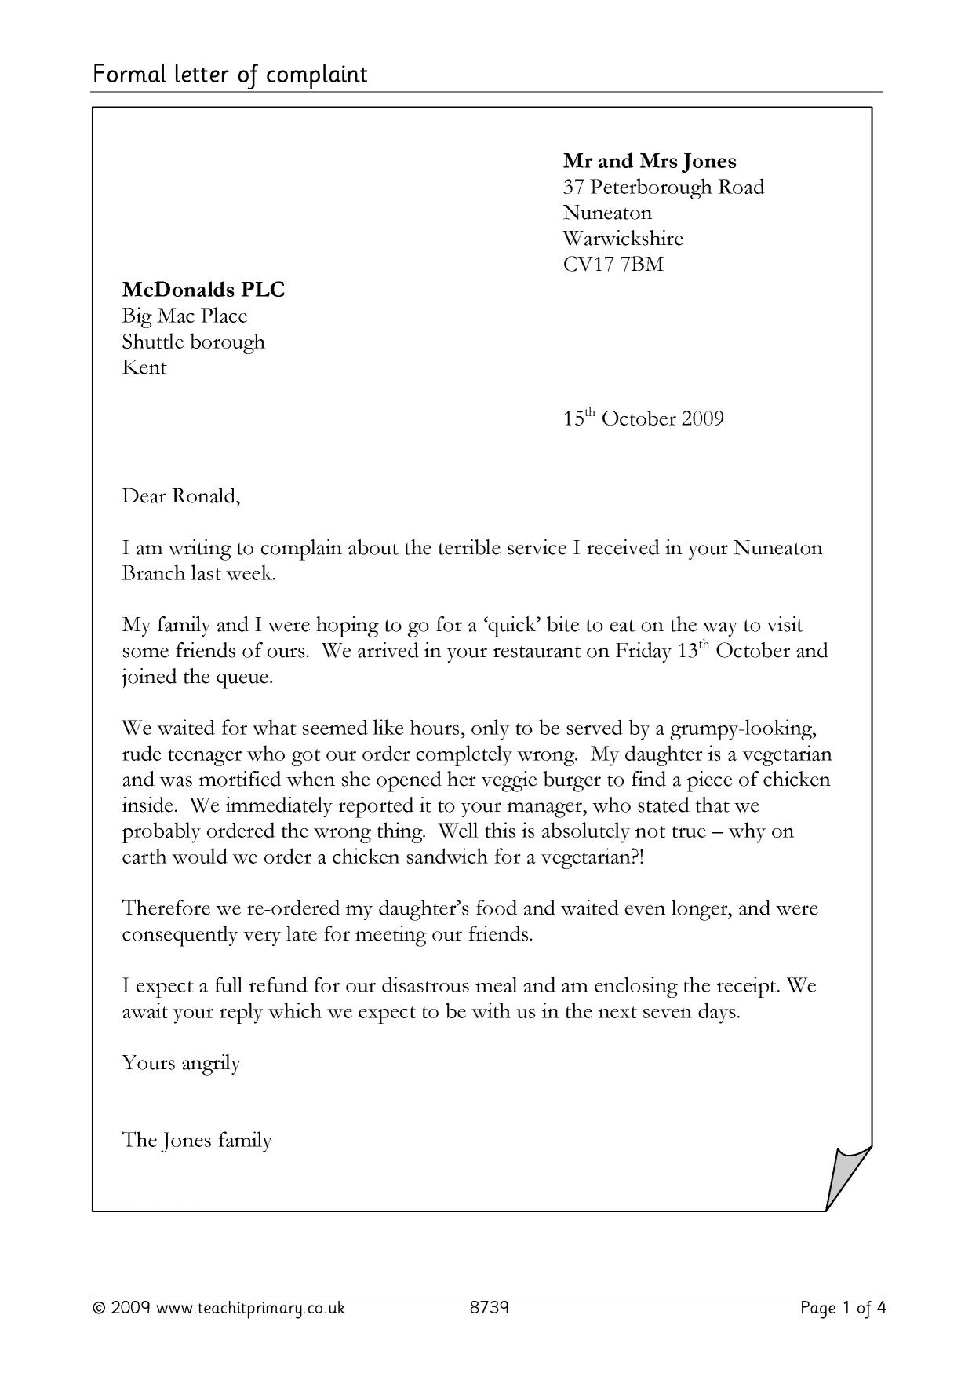

Slide 6
Key Features
your address on the top right side
their address on top left side
date
dear/to
yours sincerely/kind regards/ thank you
your name

Slide 7

Main argument
Three main reasons that Boris Johnson should open the schools.
Remember we are trying to persuade him to open schools next week, so we need to think of the most important reasons to us.

Slide 8
Children need to be taught by teachers

Slide 9
Some parents are not confident with helping their children.
Teachers are qualified and know strategies to teach
Children need to be taught by teachers
Children cannot focus with their parents.
Some parents might need to help all of their children at the same time.

Slide 10
Children are missing their friends

Slide 11
Imagine only seeing the same people all day, every day.
Children are isolated at home.
Children are missing their friends
Some children might not have a good relationship with their siblings and could be feeling frustrated.
Children are not learning social skills.

Slide 12
Parents need to go to work

Slide 13
Some parents are working from home and do not have time to help teach their children.
How will we get money?
Parents need to go to work
Parents might need to leave children home alone if they are not at school.
Will you look after the children while their parents work?

Slide 14
Your task
Year 2
Year 3
Brainstorm three main reasons why Boris Johnson needs to open the schools. Remember to use superlative and comparative adjectives, emotive language, and imperative verbs in your plan.
Brainstorm three main reasons why Boris Johnson needs to open the schools. Remember to use superlative and comparative adjectives, emotive language, and rhetorical questions in your plan.

Slide 15
