Slide 1
LO: To be able to understand equivalent lengths (convert units of measure). -I can use my knowledge of multiplication and division to help calculate equivalent lengths. -I can recognise equivalent lengths. -I can link my understanding of equivalence to fractions.

Slide 2
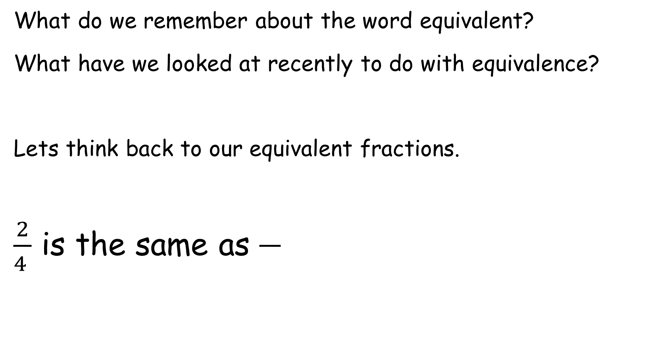
Equivalent Lengths
What do we remember about the word equivalent?
What have we looked at recently to do with equivalence?
Lets think back to our equivalent fractions.
$\frac{2}{4 }$ is the same as
Notes:
Discuss a few more equivalent fractions

Slide 3
Remember we know our halves of numbers. Then to find a quarter we are halving and halving again.
Notes:
Give few examples on board

Slide 4
How many mm go into a cm?
How many cm go into a m?
If we know that 100cm equals 1m, what would ½ meter be?
If we know what ½ meter is, what would ¼ meter be?
Remember to find a quarter we are halving and then halving again.

Slide 5
We need to remember that we can multiply and divide by multiples of 10 to help us.
100cm = 1m / 1m = 100cm
The whole number moves up/down the number line if x or ÷ by 100.
Notes:
You will also need to reflect on multiplying and dividing by multiples of 10.
e.g.
100cm = 1m / 1m = 100cm
The whole number moves up/down the number line if x or ÷ by 100. (Show on whiteboard)
Check that children are aware of the different conversions of metric units of measure. If they are not, display these on the board – for reference.

Slide 6


Introduction
What are the missing markings on the metre stick?
20cm
70cm
© Classroom Secrets Limited 2019

Slide 7
Equivalent lengths
Equal lengths
metres
0
1
2
3
4
5
6
7
8
9
10
0
100
200
300
400
500
600
700
800
900
1,000
centimetres
1,000 cm = 10 m
500 cm = 5 m
600 cm = 6 m
700 cm = 7 m
8 m = 800 cm
9 m = 900 cm
1 m = 100 cm
2 m = 200 cm
3 m = 300 cm
4 m = 400 cm
0 m = 0 cm

Slide 8
4 m =
400 cm
1 m = 100 cm
1 m
100 cm
1 m | 1 m | 1 m | 1 m
100 cm
100 cm
100 cm
100 cm
200 cm =
2 m
1 m
1 m
100 cm
100 cm

Slide 9

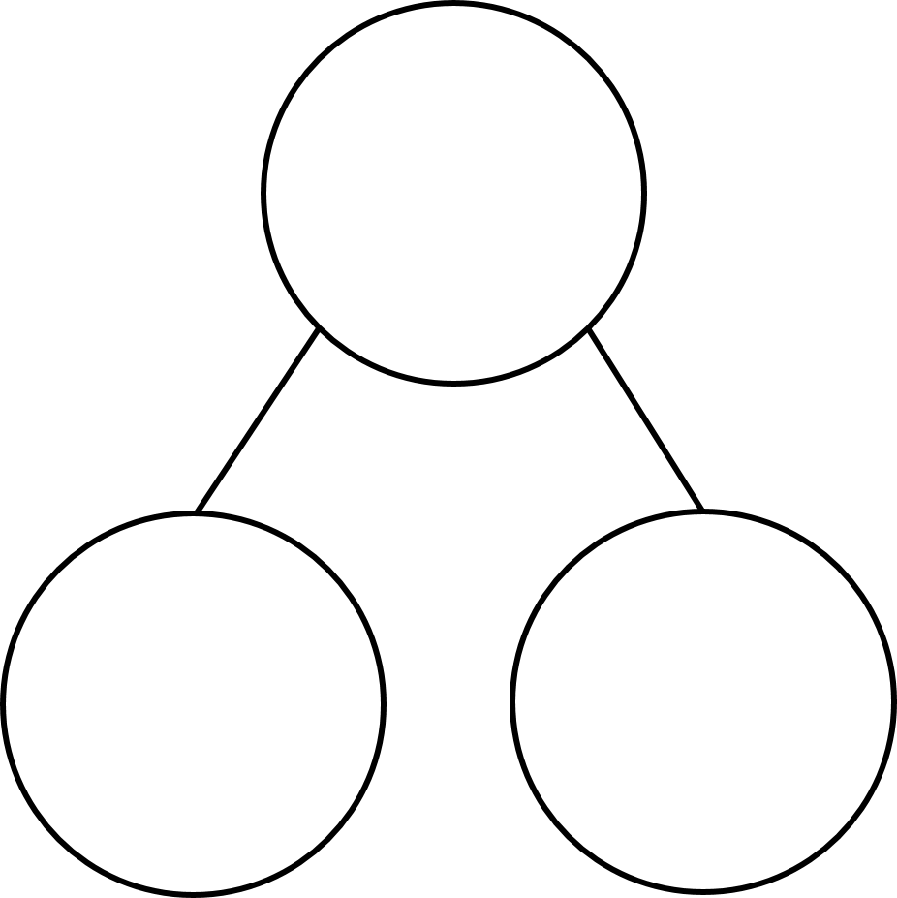
Have a think
600
6 m
590
5 m 90 cm
580
5 m 80 cm
570
5 m 70 cm
510 cm
520 cm
560
5 m 60 cm
550
5 m 50 cm
540
5 m 40 cm
5 m
500 cm
10 cm
20 cm
530
5 m 30 cm
520
5 m 20 cm
510
5 m 10 cm
cm
500
5 m
m and cm

Slide 10
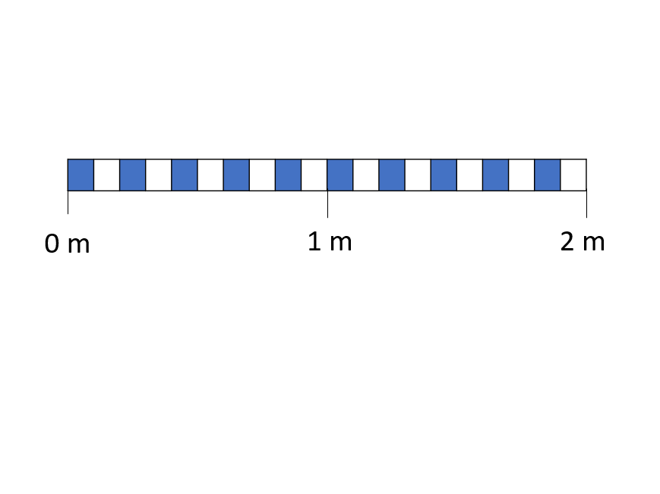
Notes:
Give children measurements and see if they can label them on this

Slide 11
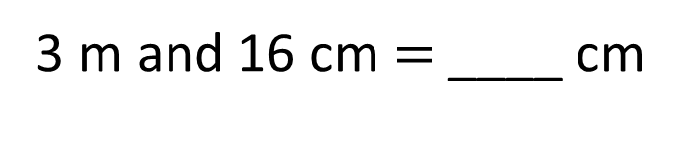
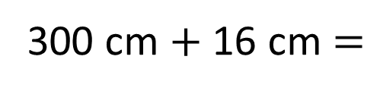
316
3 m and 16 cm $=$ ____ cm
316 cm
316 cm
3 m | 16 cm
300 cm
16 cm
3 m
300 cm $+$ 16 cm $=$
316 cm

Slide 12
Varied Fluency 4
Complete the conversion table:
m and cm | cm
 | 352cm
5m and 25cm
 | 185cm
8m and 89cm
 | 673cm
© Classroom Secrets Limited 2019

Slide 13
Varied Fluency 3
Put these lengths in order from shortest to longest.
(Shortest) 4m and 28cm, 4 m, 482cm, 4m and 98cm,
5m and 11cm and 523cm (longest).
4m and 28cm |  | 523cm |  | 482cm
5m and 11cm |  | 4 m |  | 4m and 98cm
1
2
1
2
1
2
© Classroom Secrets Limited 2019

Slide 14
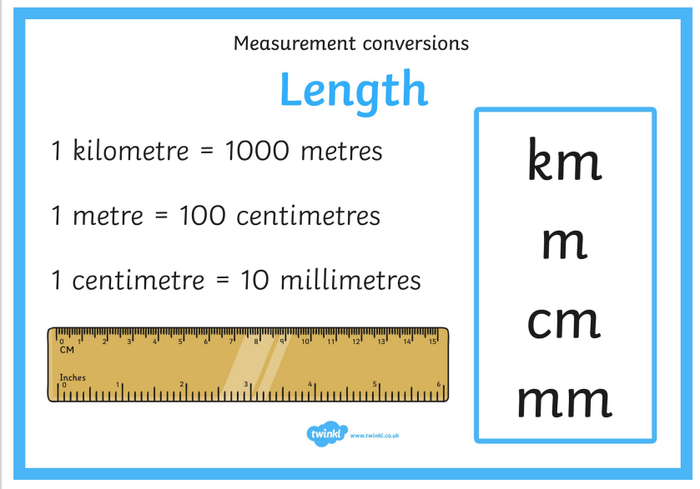

Slide 15
Task:
Complete the worksheet.
Extension:
Complete mixed measurement calculations.
15cm + 60mm = ____cm
1km + 250m = ____m
27cm + 46mm = ______cm
6m + 250cm = _______cm

