Slide 1
Inverse

Slide 2
LO: To use the inverse to work out calculations.
I can recognise the inverse relationship between addition and subtraction calculations.
I can recognise the inverse relationship between multiplication and division calculations.
I can use the inverse relationship to solve missing number problems.

Slide 3






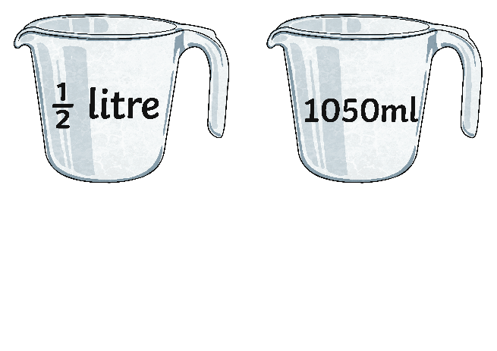
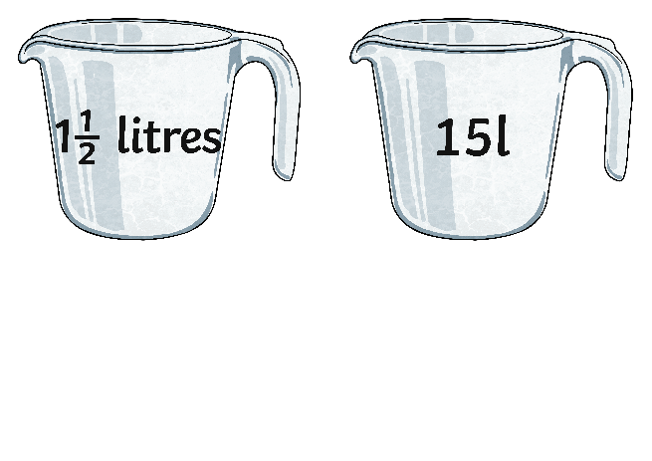
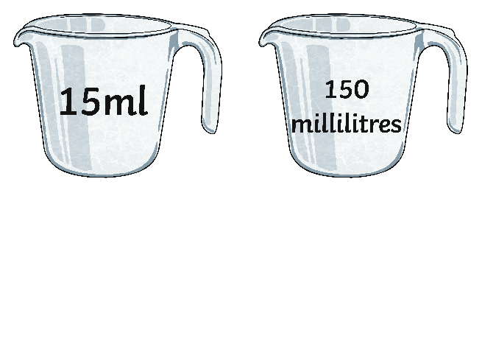

Order It - Volume
Put these volumes in order from the smallest to the greatest.
Explain your reasoning.
Notes:
On whiteboards as starter- quickfire

Slide 4
What does 'the inverse' mean?
Tell your talk partner

Slide 5
Inverse means opposite.
So what is the inverse of addition?
What is the inverse of subtraction?

Slide 6
What do you notice about these number sentences?
14 + 21= 35
21 + 14 = 35
35 - 21= 14
35 - 14 = 21

Slide 7

3 GOLDEN RULES
1. Always use the same 3 numbers.
2. Subtraction starts with the biggest number.
3. Addition ends with the biggest number.

Slide 8
What subtractions can we make from this addition?
23 + 15 =
- =
- =
What other addition can we make?
+ =

Slide 9
What additions can we make from this subtraction?
30 - 12 =
+ =
+ =
What other subtraction can we make?
- =

Slide 10
Try to make the other addition and subtraction number sentences:
1. 31 + 8 = 39 2. 45 – 19 = 26
+ = - =
- = + =
- = + =

Slide 11
Can you use the inverse operation to find the ?
1. 8 + ? = 16 2. 25 - ? = 5
___ - ___ = ? ? + ___ = ___

Slide 12
Can you use the inverse?
Lottie has 15 friends in England. She also has some friends in America. She has 25 friends altogether. How many friends from America does she have?
___ + ? = ___
___ - ___ = ?

Slide 13
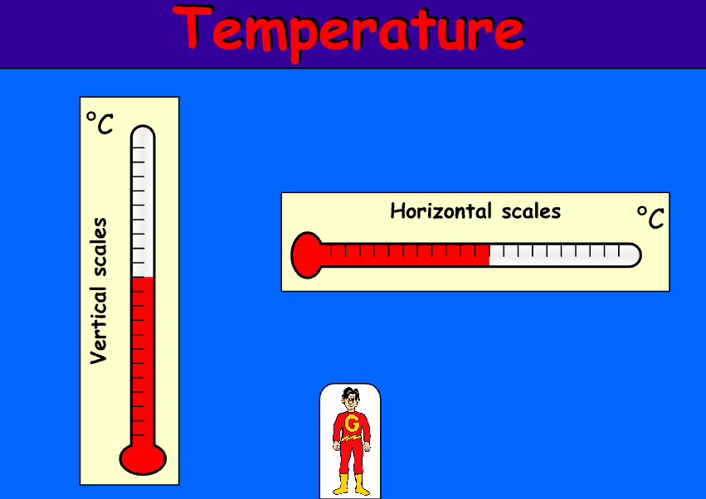
Plenary: Temperature
Temperature - 6-11 year olds - Topmarks

