Slide 1
LO: To strengthen our knowledge of money, with a focus of finding change.
I can recognise and sort coins.
I can convert pence into pounds.
I can use methods to help find change.

Slide 2
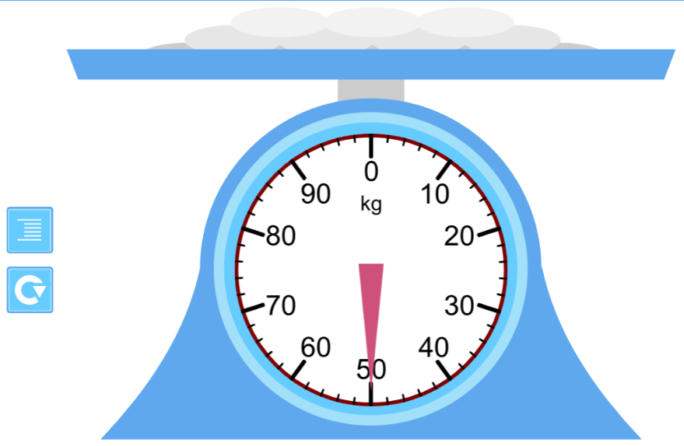
Plenary- Mass
teacherLED.com Time - Scales: Reading Mass

Slide 3

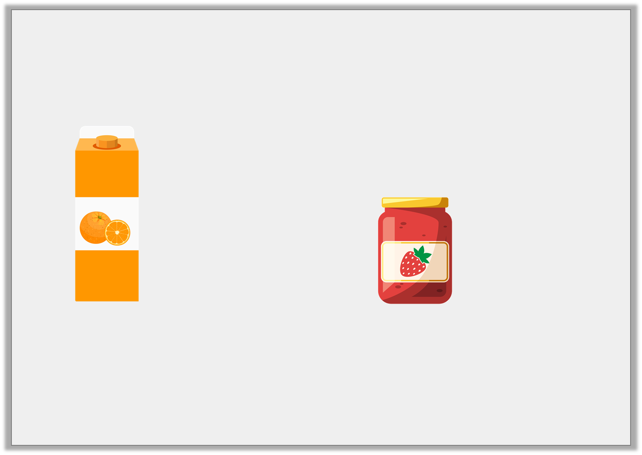

Introduction
Choose the nearest whole pounds for the change you would receive if you bought the jam and the orange juice and paid with a £10 note.
£2 and 69p
£3 and 45p
A. | B. | C.
£6 | £4 | £8
© Classroom Secrets Limited 2019

Slide 4
Introduction
Choose the nearest whole pounds for the change you would receive if you bought the jam and the orange juice and paid with a £10 note.
£2 and 69p
£3 and 45p
A. | B. | C.
£6 | £4 | £8
© Classroom Secrets Limited 2019

Slide 5
Varied Fluency 1
Alice buys a book for £7 and 68p. She pays with a £10 note.
Complete the number line to work out her change.
?
?
?
£7 and 68p
£7 and 70p
£8
£10
© Classroom Secrets Limited 2019

Slide 6
Varied Fluency 1
Alice buys a book for £7 and 68p. She pays with a £10 note.
Complete the number line to work out her change.
The change will be £2 and 32p.
£2
2p
30p
£7 and 68p
£7 and 70p
£8
£10
© Classroom Secrets Limited 2019

Slide 7
Varied Fluency 2
Sophie goes swimming. It costs £3 and 75p.
She pays with a £5 note.
What will her change be?
£5
£3 and 75p | ?
© Classroom Secrets Limited 2019

Slide 8
Varied Fluency 2
Sophie goes swimming. It costs £3 and 75p.
She pays with a £5 note.
What will her change be?
Her change will be £1 and 25p.
£5
£3 and 75p | £1 and 25p
© Classroom Secrets Limited 2019

Slide 9
Varied Fluency 3
Joe buys an ice cream for 87p. He pays with a £2 coin.
Calculate his change.
£2
?
87p
© Classroom Secrets Limited 2019

Slide 10
Varied Fluency 3
Joe buys an ice cream for 87p. He pays with a £2 coin.
Calculate his change.
His change will be £1 and 13p.
£2
£1 and 13p
87p
© Classroom Secrets Limited 2019

Slide 11

Varied Fluency 4
If you buy the ball, what will your change be
if you pay with a £10 note?
£3 and 65p
© Classroom Secrets Limited 2019

Slide 12
Varied Fluency 4
If you buy the ball, what will your change be
if you pay with a £10 note?
His change will be £6 and 35p.
£3 and 65p
© Classroom Secrets Limited 2019

Slide 13
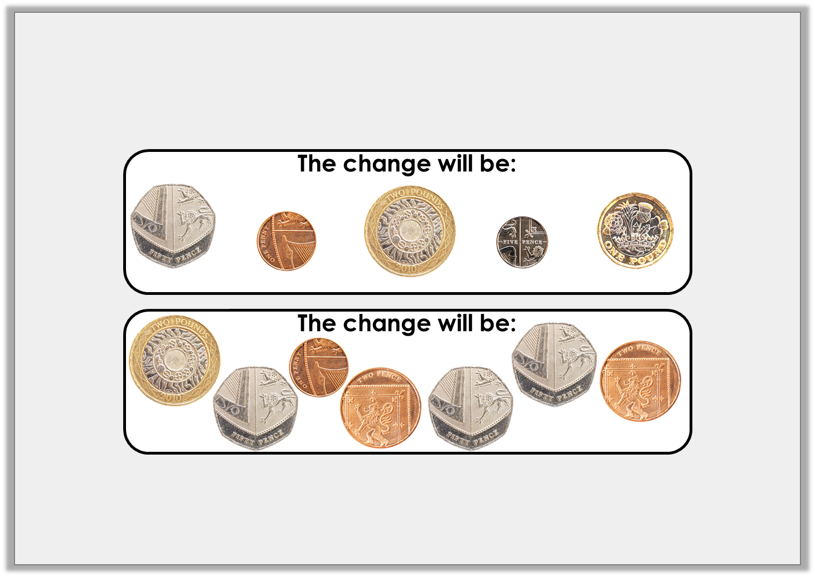
Reasoning 1
Andrew buys a chocolate bar which costs £1 and 44p.
He gives the shop keeper a £5 note.
Which is correct? Prove it.
A.
B.
© Classroom Secrets Limited 2019

Slide 14
Reasoning 1
Andrew buys a chocolate bar which costs £1 and 44p.
He gives the shop keeper a £5 note.
Which is correct? Prove it.
A is correct because...
A.
B.
© Classroom Secrets Limited 2019

Slide 15
Reasoning 1
Andrew buys a chocolate bar which costs £1 and 44p.
He gives the shop keeper a £5 note.
Which is correct? Prove it.
A is correct because £5 – £1 and 44p = £3 and 56p change.
A.
B.
© Classroom Secrets Limited 2019

Slide 16

Problem Solving 1
Matt bought an ice cream. He paid with a £2 coin.
In his change he got three different silver coins.
How much could the ice cream cost?
Show your working.
?
£2
© Classroom Secrets Limited 2019

Slide 17
Problem Solving 1
Matt bought an ice cream. He paid with a £2 coin.
In his change he got three different silver coins.
How much could the ice cream cost?
Show your working.
Various answers, for example: The ice cream cost £1 and 25p.
£1 and 25p
50p
5p
20p
£1 and 25p
£1 and 30p
£1 and 50p
£2
© Classroom Secrets Limited 2019

Slide 18
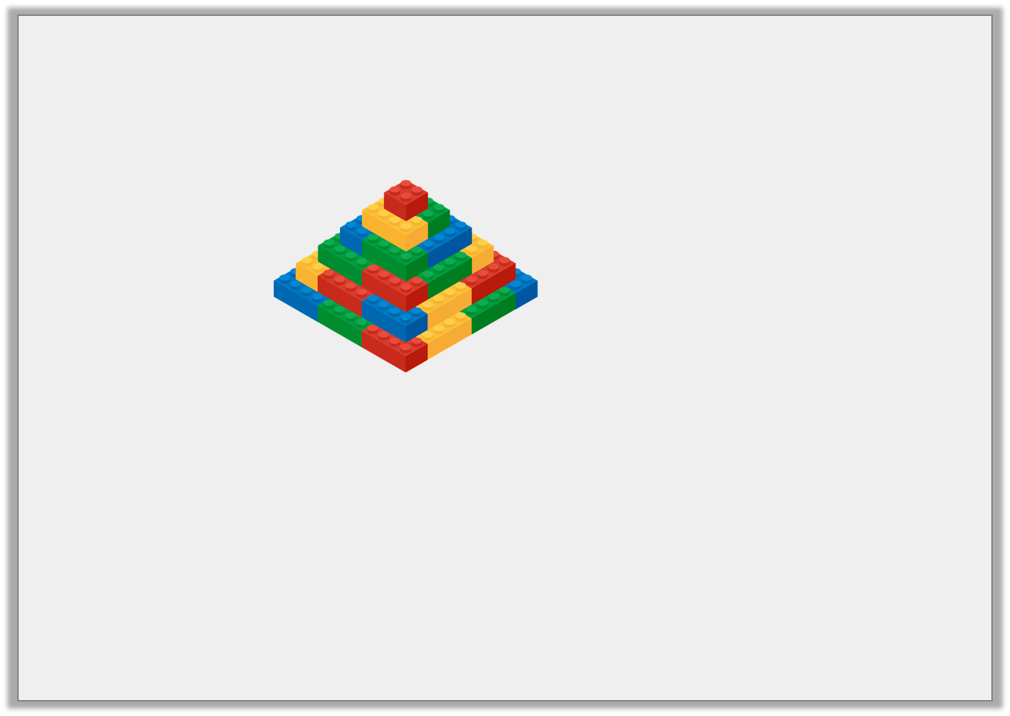
Problem Solving 2
Veronica bought some building blocks. She paid with a £10 note.
Which coins might she get in her change? Give 3 possible answers.
£3 and 52p
£10
£3 and 52p | ?
© Classroom Secrets Limited 2019

Slide 19
Problem Solving 2
Veronica bought some building blocks. She paid with a £10 note.
Which coins might she get in her change? Give 3 possible answers.
Various answers, for example:
£2 + £2 + £2 + 10p + 10p + 10p + 10p + 5p + 2p + 1p = £6 and 48p
£2 + £2 + £1 + £1 + 20p + 20p + 2p + 2p + 2p + 2p = £6 and 48p
£2 + £2 + £1 + 50p + 50p + 20p + 10p + 10p + 5p + 1p + 1p + 1p = £6 and 48p
£3 and 52p
£10
£3 and 52p | £6 and 48p
© Classroom Secrets Limited 2019

Slide 20
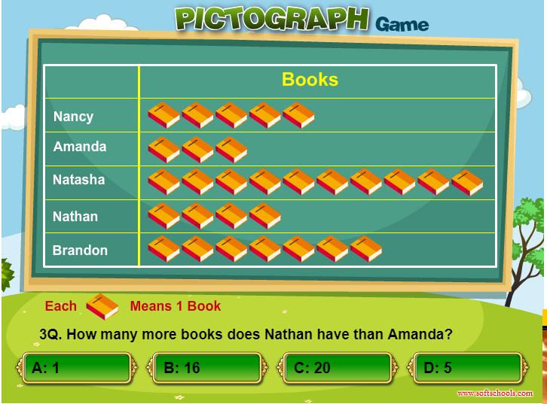
Plenary- Statistics
Pictograph Games (softschools.com)

