Slide 1
LO: To complete division calculations.
- I can use my knowledge of properties of number (including number bonds) to help with calculations
- I know different ways to complete division – e.g. repeated subtraction, grouping, sharing
- I can use written jottings (in pictorial or number form) to help with calculations

Slide 2
Starter:
Can we link this multiplication calculation to division?
10 x 5 =
6 x 5 =
16 x 5=

Slide 3
Lets remind ourselves of equal groups and sharing equally.
They are similar but we show them slightly differently.
20 ÷ 5 = have 5 in a group and continue until all 20 counters have been used.
20 ÷ 5 = start with 20 and split into 5 groups until all counters have been used.
Notes:
Model on whiteboard

Slide 4
15 ÷ 5 =
25g ÷ 5 =
110ml ÷ 10 =
12 ÷ 3g =
48 ÷ 8 =
54l ÷ 6 =
Can you use your preferred method to divide?
Can you explain your method or check your work with a partner?

Slide 5
Lets look at different methods we could use to divide
Making equal groups:
Spr2.3.2 - Make equal groups - sharing on Vimeo
Remember if the number is large, making equal groups is not the efficient way.
Think about the method we learnt last term, partitioning the number.
Spr3.2.4 - Divide 2-digits by 1 digit (2) on Vimeo
Notes:
Model on whiteboard or flipchart so can keep up during task.
Show how you would like it set out.

Slide 6
Remember:
Division can be just repeated subtraction.
Some of you should use your knowledge of times tables as well as number bonds to make the numbers more manageable.

Slide 7
Task:
Complete the worksheet.
There are two different levels, choose the level you are most comfortable with.
In your books you need to use jottings to show your working out. Use the method you are most comfortable with.

Slide 8
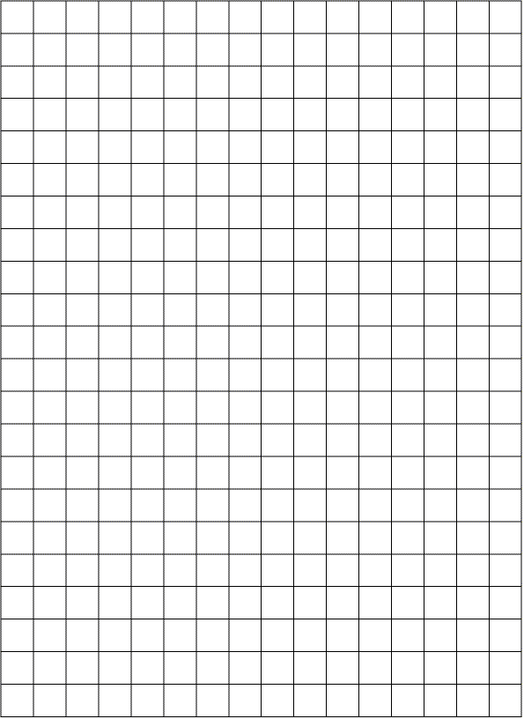
Notes:
To show how to set it out

