Slide 1
Division
12.01.21
Lesson 2

Slide 2

Learning objective
To divide numbers by 2, 5 and 10 using jottings.

Slide 3
Dividing by 2

Slide 4

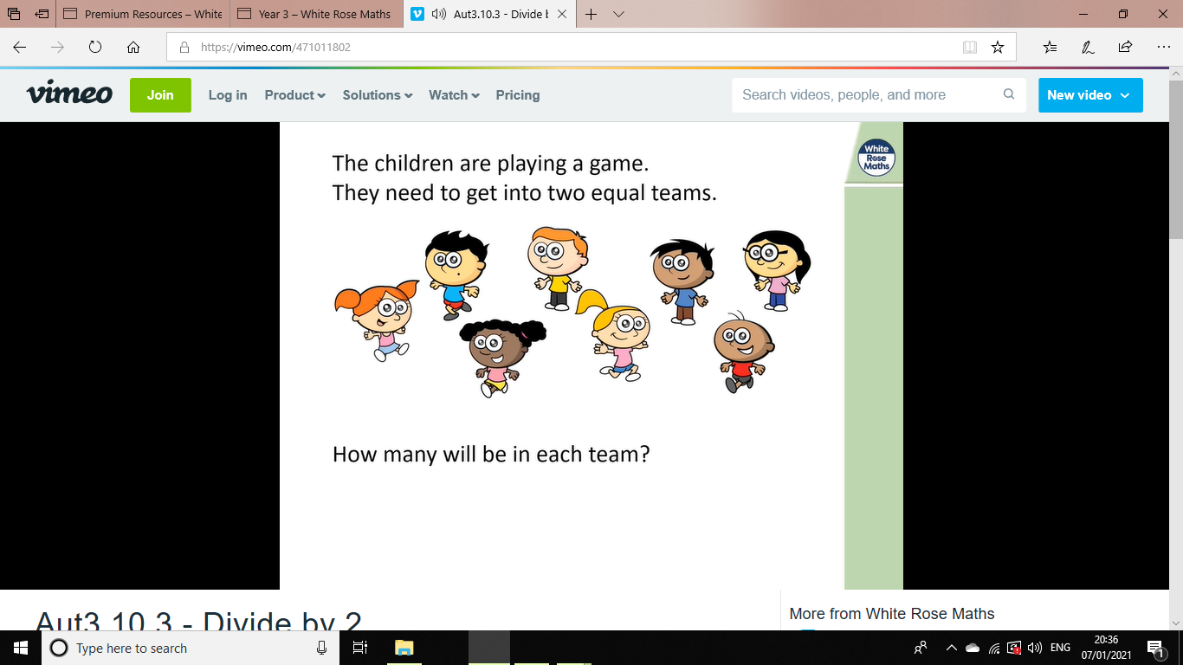

Slide 5
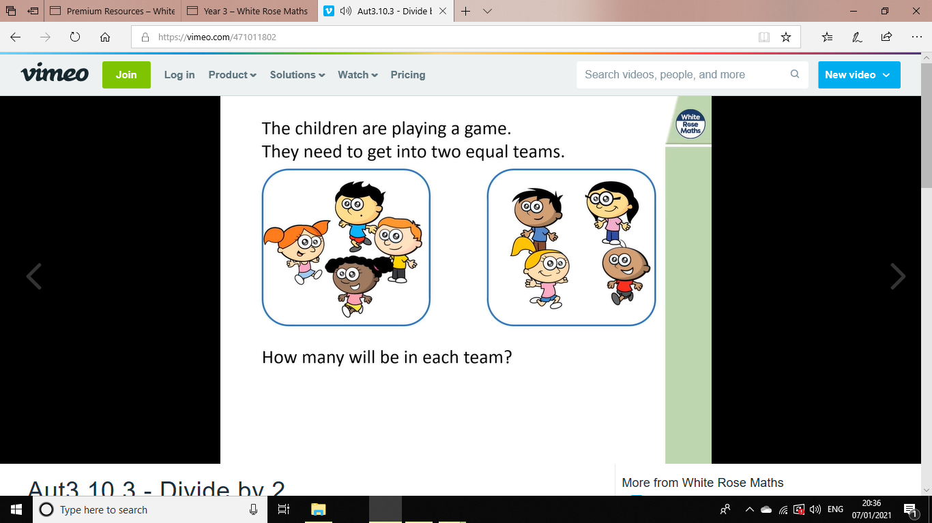
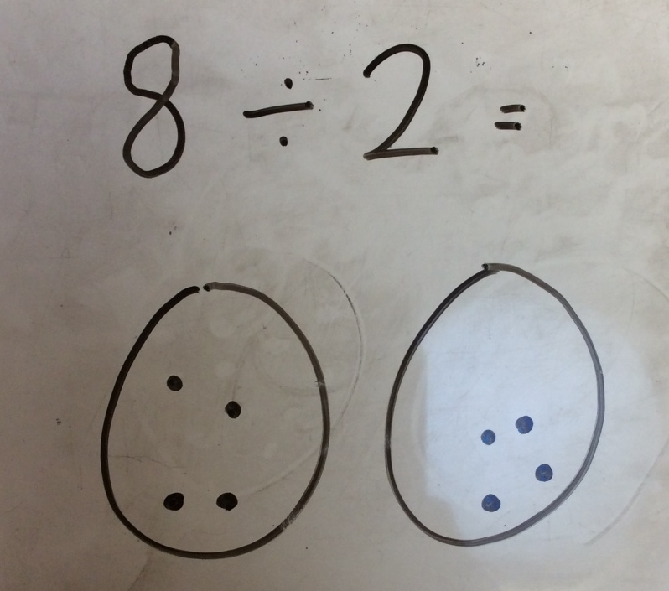

Slide 6
Dividing by 5

Slide 7
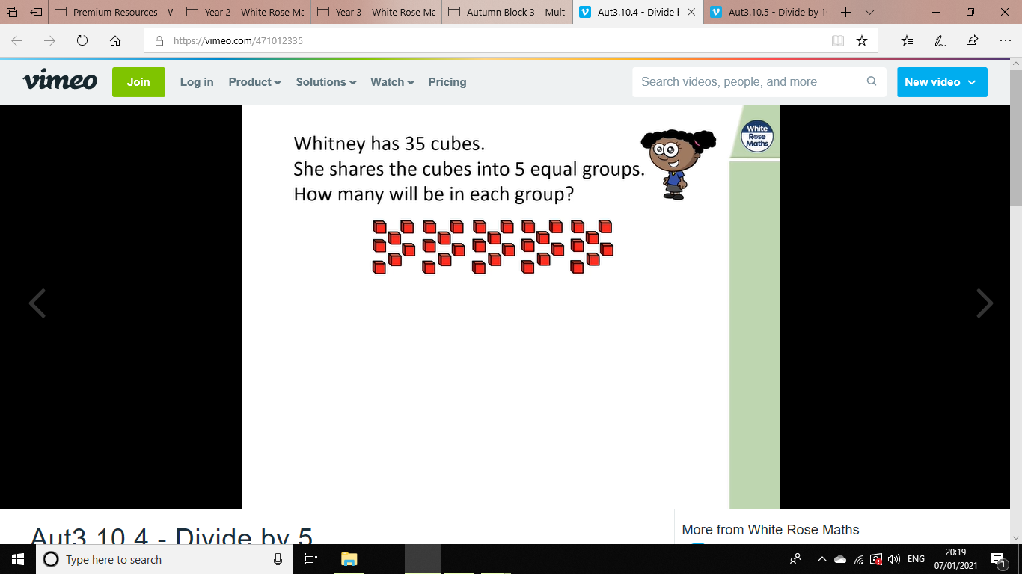

Slide 8
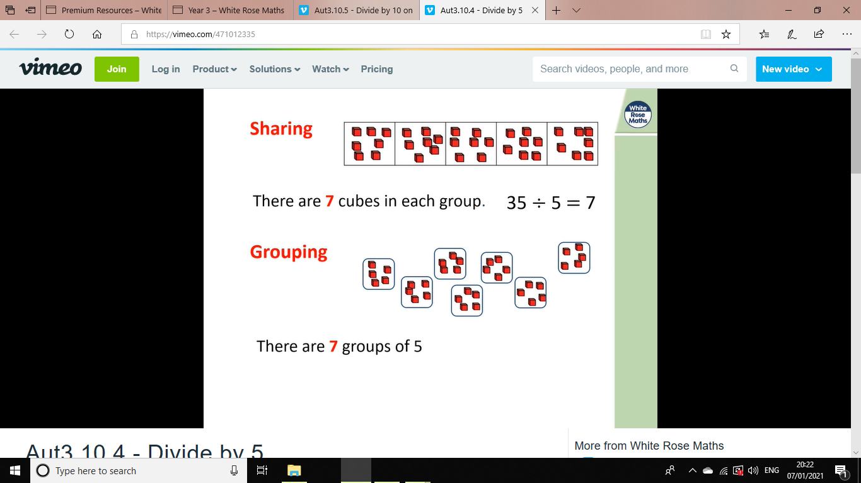
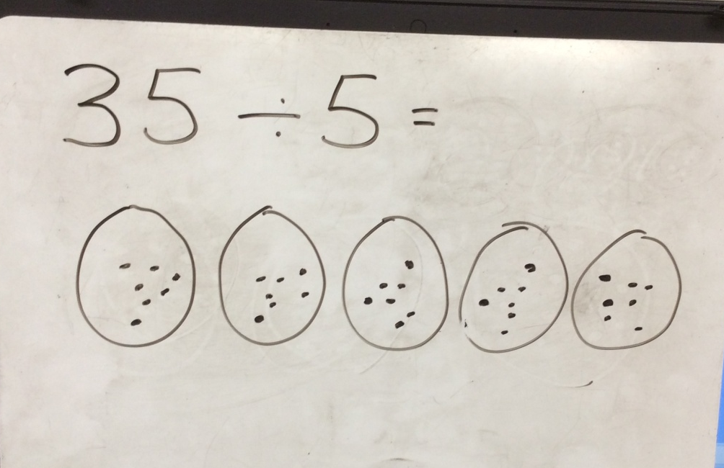

Slide 9
Dividing by 10

Slide 10
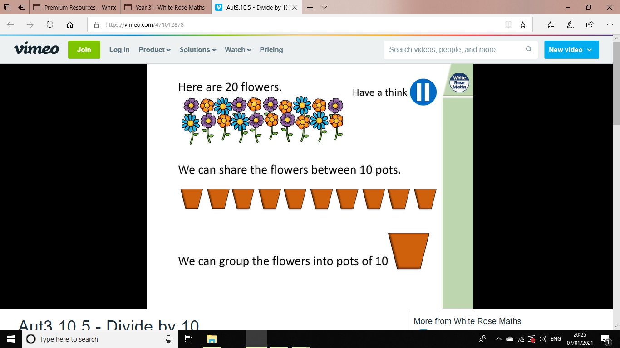

Slide 11
