Slide 1
Division
11.01.21
Lesson 1

Slide 2

Learning objectives
Year 2
To divide numbers by 2, 5 and 10 practically
Year 3
To divide numbers by 3,4 and 8 practically

Slide 3
Number sentence families
2 x 7 = 14
7 x 2 = 14
14 ÷ 2 = 7
14 ÷ 7 = 2

Slide 4
Number sentence families
2 x 7 = 14
7 x 2 = 14
14 ÷ 2 = 7
14 ÷ 7 = 2
Multiplication
Multiplication
Division
Division

Slide 5
What is division?
Dividing is sharing into equal groups. You might see it written differently in questions e.g.
divided by
share equally
equal groups of
divided into
share

Slide 6
Different ways to divide:
Splitting into equal groups
Counting back
Groupings of a number until you reach the total number

Slide 7
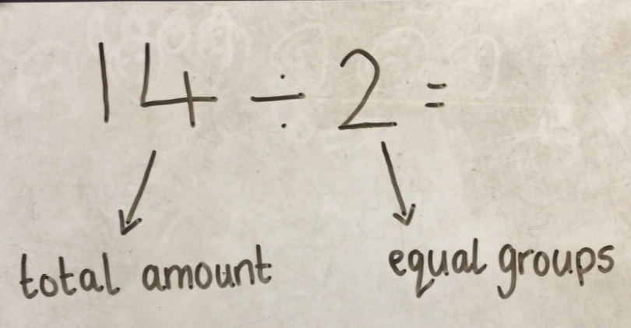
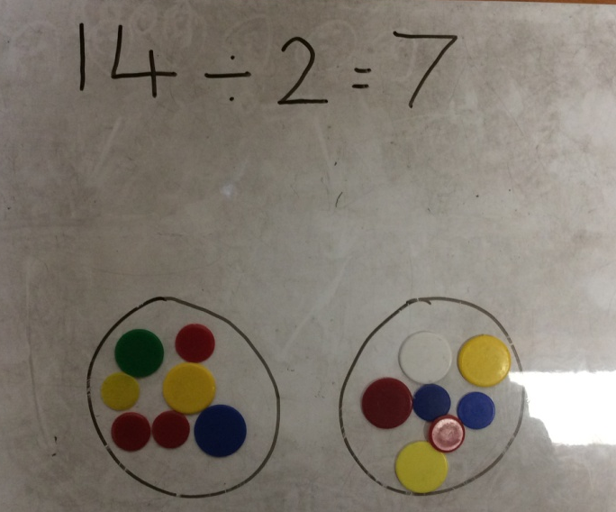
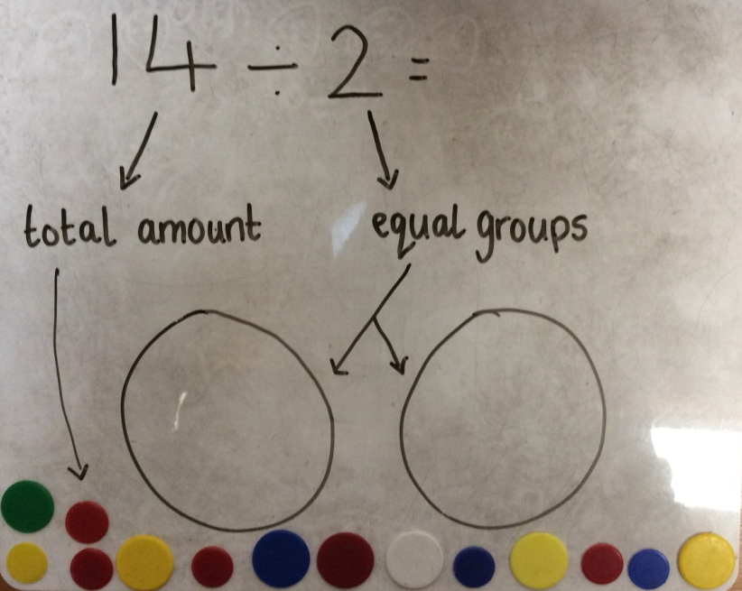
14 ÷ 2 = 7
Step 1
Step 3
Step 2

Slide 8
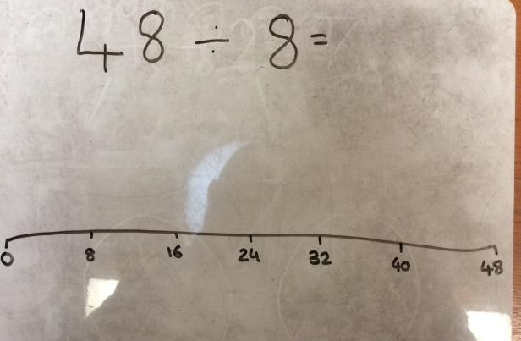
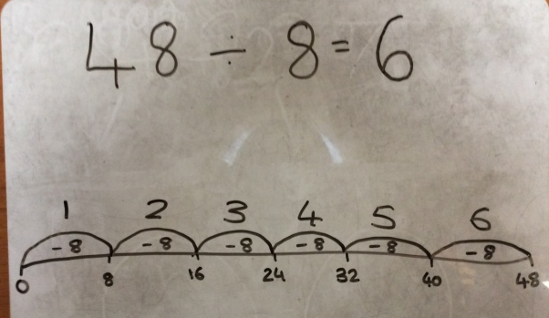
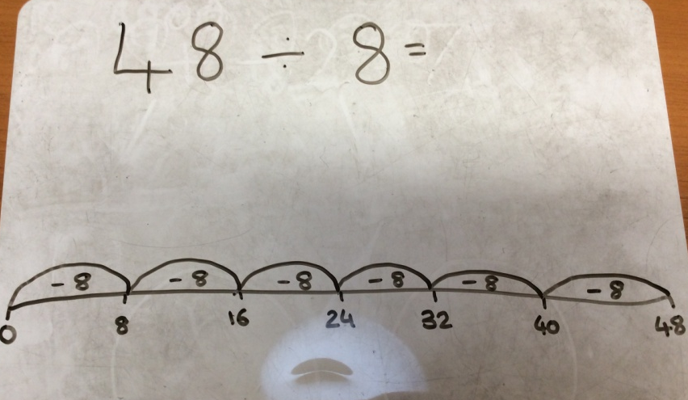
48 ÷ 8 = 6
Step 1
Step 3
Step 2

Slide 9
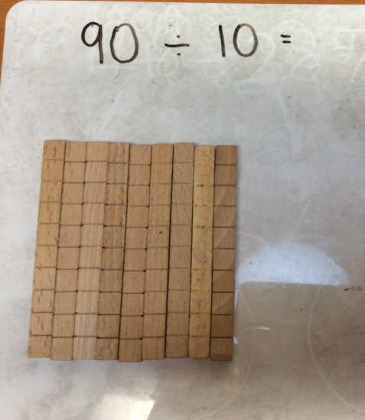
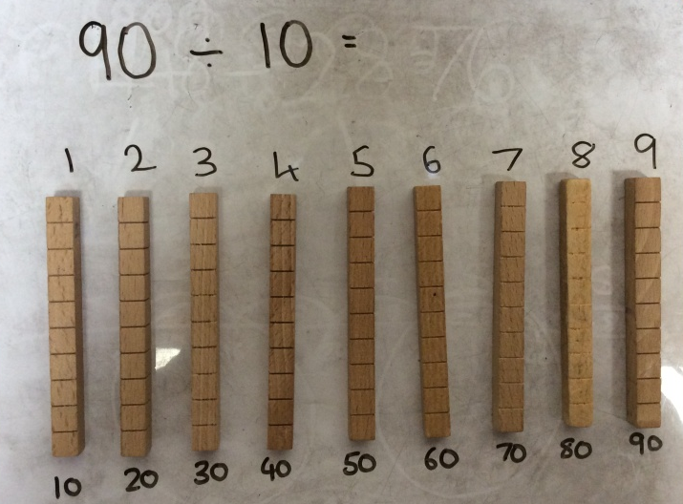
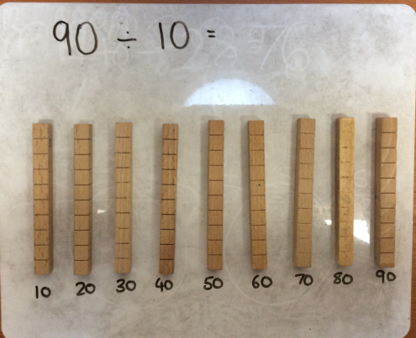
90 ÷ 10 = 9
Step 1
Step 3
Step 2

Slide 10
Your task:
Choose which task you think is best suited to your learning and complete the questions practically. Use things that are around your home such as pencils, shoes, books, toys OR you could collect sticks, stones etc. on your walks to use.
Get creative ☺

Slide 11

One last thing!

