Slide 1
Comparing measurements
LO: To be able to compare measurements using different methods.

Slide 2
68
Show me as many different ways to represent:
Notes:
Ask children to show as many different ways as possible to represent this number on their whiteboards.
Have a timer up on the board and only give children 1/ 2 minutes to do so.

Slide 3
Today we are comparing measurements.
What do we mean by comparing?

Slide 4
When comparing mass or capacity, we use these words:
heavier and heaviest
lighter and lightest
Most full or least full

Slide 5

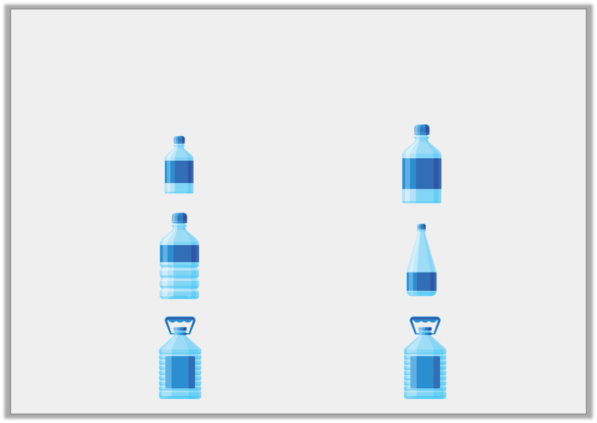

Varied Fluency 2
Use <, > and = symbols to compare the capacity
of container A with container B.
A
B
© Classroom Secrets Limited 2018

Slide 6
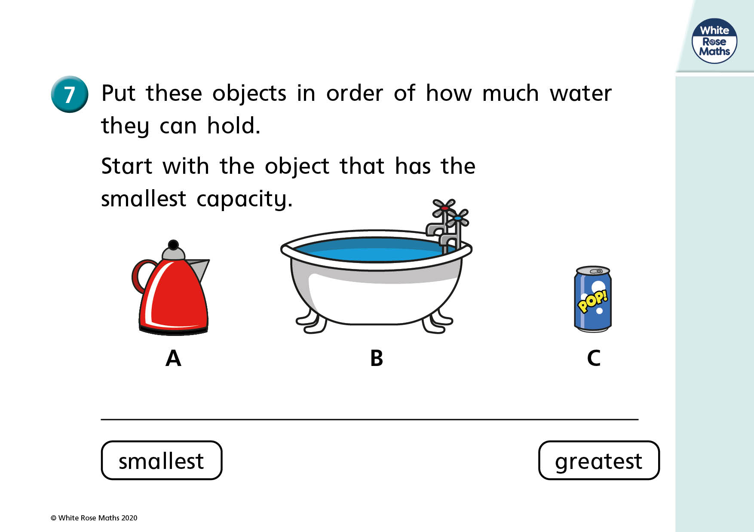

Slide 7
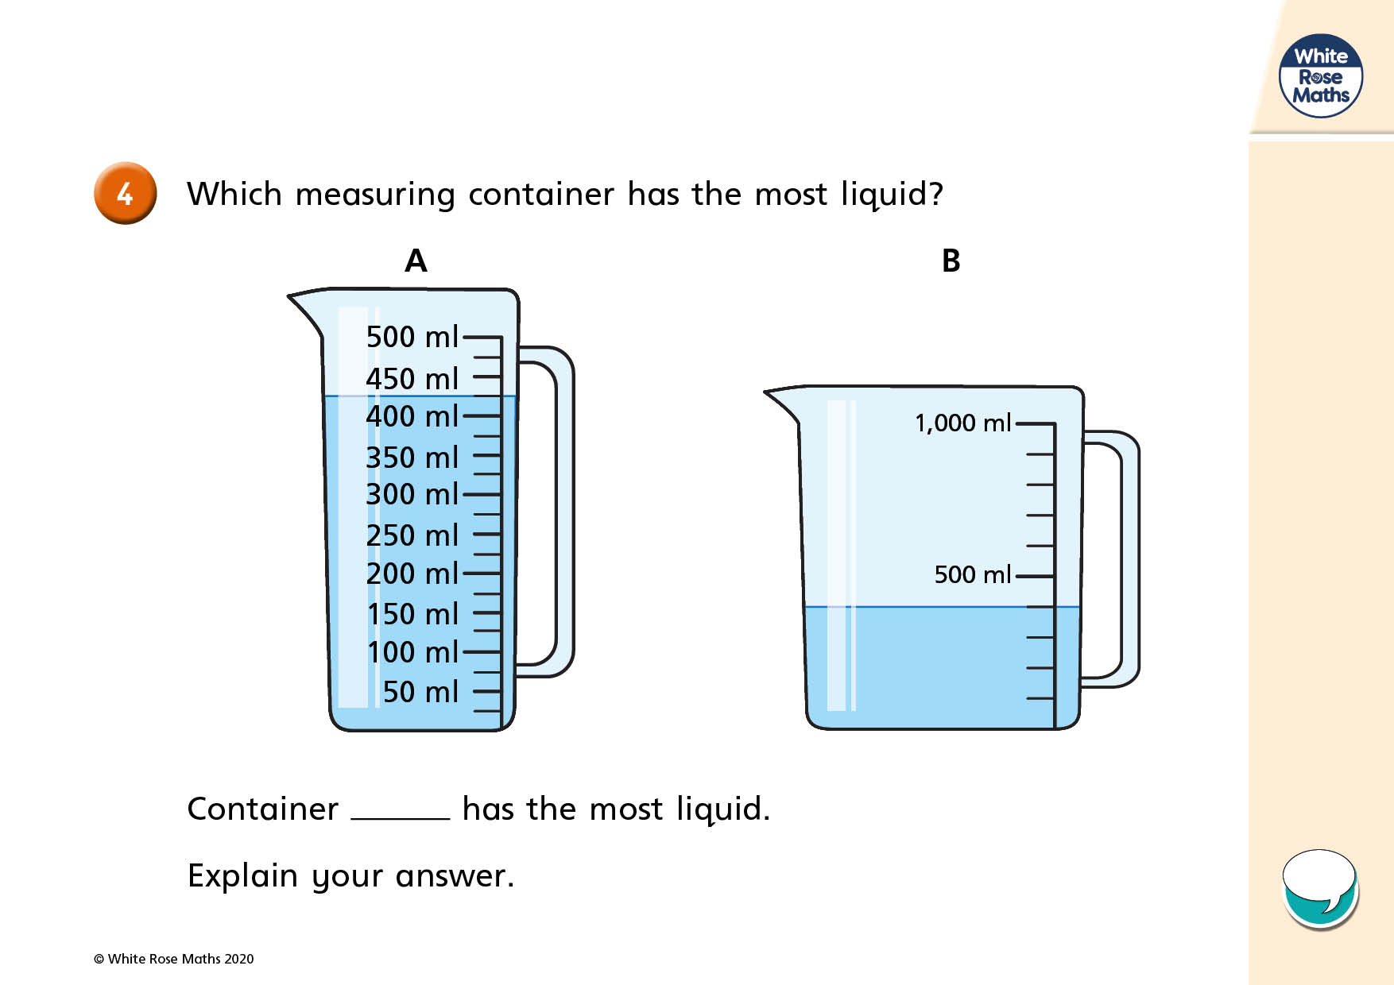

Slide 8
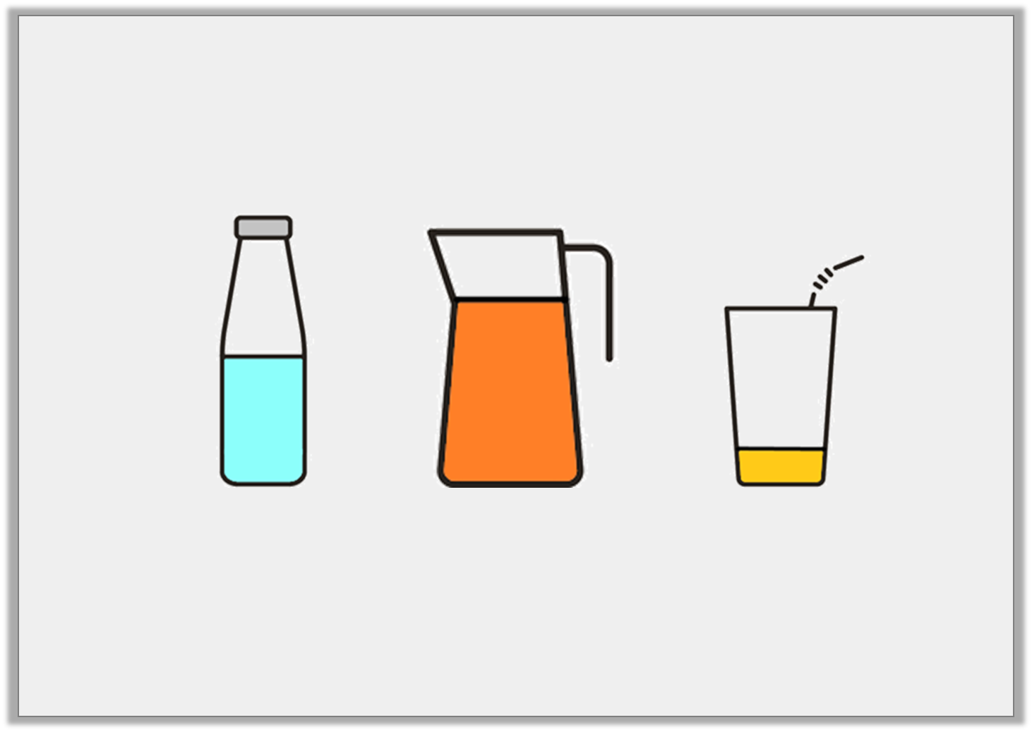
Varied Fluency 3
Draw a line to the word that best describes
the volume of each container.
full | quarter | half | three-quarters
© Classroom Secrets Limited 2018

Slide 9
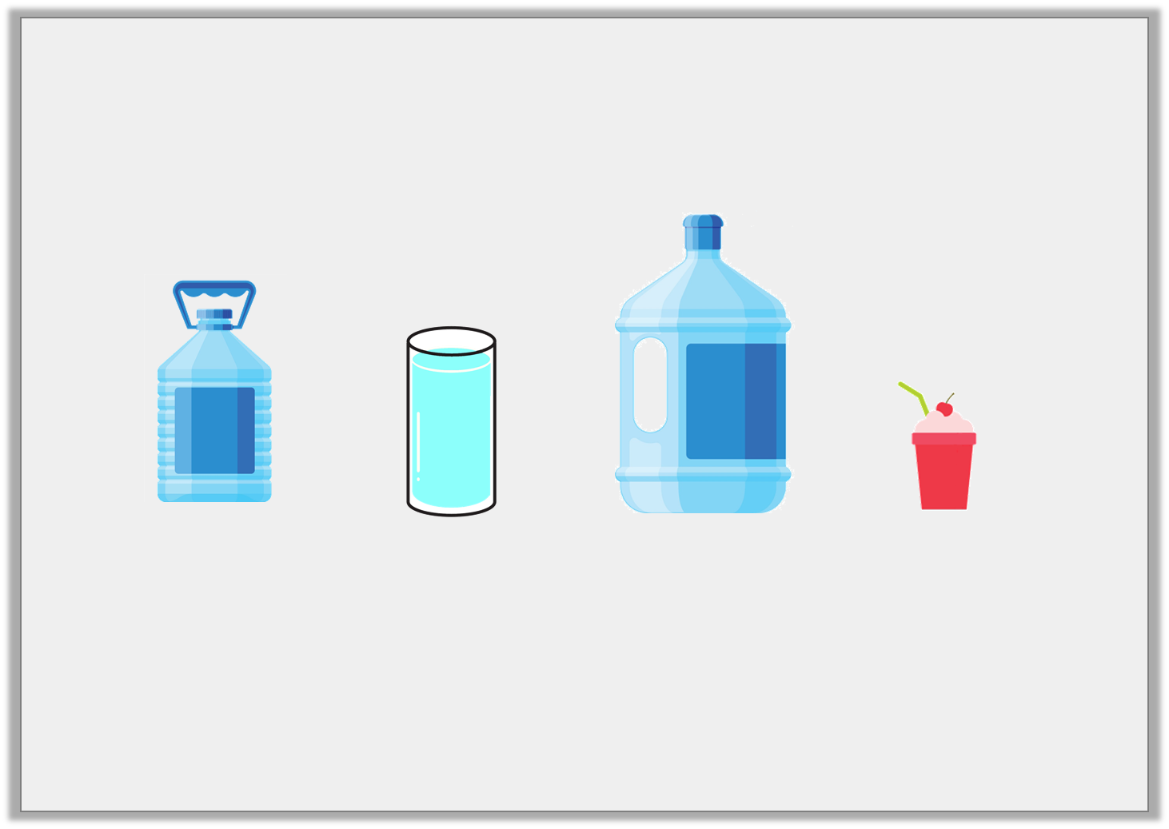
Varied Fluency 4
Order these items from the
largest capacity to the smallest capacity.
A | B | C | D
© Classroom Secrets Limited 2018

Slide 10
Finding the difference
Finding Difference using a Number Line – Mathsframe
Let’s practice finding the difference using a number line.

Slide 11
Counting on
If my friend has 600ml of water and I have 750ml, what is the difference?
Notes:
Model on whiteboard using a number line, or counting on using fingers.

Slide 12
Counting backwards
If my friend has 400ml of water and I have 500ml, what’s the difference?
Notes:
Model on whiteboard using a number line, or counting back using fingers,

Slide 13
Always think about what the most effective way to compare.
If we have a number which is much greater than another, for example comparing 38 and 95, is the best method to count on our fingers? What is the best way to do this?

Slide 14
Can you weigh or measure objects around the classroom?
Lets estimate which object will be heavier or lighter, most full or least full.
Can we find the difference between the two measurements?
Then complete the worksheet.

