Slide 1


Investigation 1
Put one of every coin in order from smallest to greatest value. What do you notice?
© Classroom Secrets Limited 2018

Slide 2
Investigation 1
Question Prompts:
What do you notice about the colours?
What do you notice about the shapes?
What do you notice about the sizes?
What do you think the coins are made of? Are they all made of the same material?
© Classroom Secrets Limited 2018

Slide 3
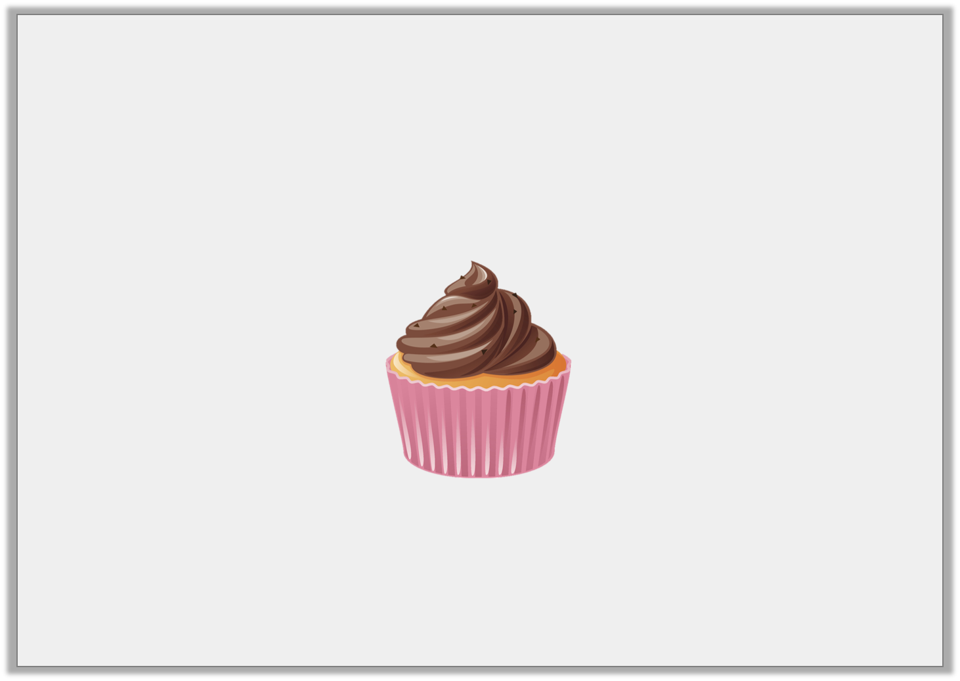
Investigation 2
Sasha buys a cupcake.
She uses 5 silver coins to pay for it.
How much could the cupcake cost?
How many different combinations can you find?
© Classroom Secrets Limited 2018

Slide 4
Investigation 2
Question Prompts:
What values can you make with 5 of the same silver coins?
What is the lowest value you could make with 5 silver coins?
What is the highest value you can make with 5 silver coins?
© Classroom Secrets Limited 2018

