Slide 1

L.O. To identify rhyming pairs.
Miss Bleakley’s Voice
Notes:
Today we are going to be exploring a range of poems. Some of them you might have heard of before and some might be new. Some of the poems might link to the 5 senses. Do you know what the 5 senses are??
Taste, Touch, Smell, Sight and hearing.

Slide 2






Can you match the rhyming words?
Can you match the rhyming words?

Slide 3
The sound collector
A stranger called this morning
Dressed all in black and grey
Put every sound into a bag
And carried them away
The whistling of the kettle
The turning of the lock
The purring of the kitten
The ticking of the clock
The popping of the toaster
The crunching of the flakes
When you spread the marmalade
The scraping noise it makes
The hissing of the frying pan
The ticking of the grill
The bubbling of the bathtub
As it starts to fill
Miss Bleakley’s comments
The drumming of the raindrops
On the windowpane
When you do the washing-up
The gurgle of the drain
The crying of the baby
The squeaking of the chair
The swishing of the curtain
The creaking of the stair
A stranger called this morning
He didn't leave his name
Left us only silence
Life will never be the same
Roger McGough
Task
Notes:
This poem is called ‘The Sound Collector’ by Roger McGough.
While you are listening, think carefully about what sense is being used in this poem.
Read the poem.
Talk with your grown up about these poems.
What did you like about them? What didn’t you like about them? Which one if you favourite? Did you spot any senses in the poems?
Can you remember the 5 senses?
Can you spot any rhyming words?

Slide 4
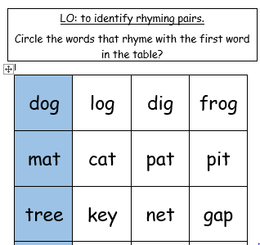
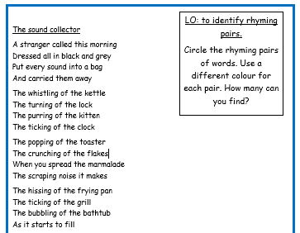
Your task:
Reception Task
Year 1 task

