Slide 1

L.O. To continue a rhyming string.
Miss Bleakley’s Voice
Notes:
Today we are going to be exploring a range of poems. Some of them you might have heard of before and some might be new. Some of the poems might link to the 5 senses. Do you know what the 5 senses are??
Taste, Touch, Smell, Sight and hearing.

Slide 2
The sound collector
A stranger called this morning Dressed all in black and grey Put every sound into a bag And carried them away
The whistling of the kettle The turning of the lock The purring of the kitten The ticking of the clock
The popping of the toaster The crunching of the flakes When you spread the marmalade The scraping noise it makes
The hissing of the frying pan The ticking of the grill The bubbling of the bathtub As it starts to fill
Miss Bleakley’s comments
The drumming of the raindrops On the windowpane When you do the washing-up The gurgle of the drain
The crying of the baby The squeaking of the chair The swishing of the curtain The creaking of the stair
A stranger called this morning He didn't leave his name Left us only silence Life will never be the same
Roger McGough
Notes:
This poem is called ‘The Sound Collector’ by Roger McGough.
While you are listening, think carefully about what sense is being used in this poem.
Read the poem.
Talk with your grown up about these poems.
What did you like about them? What didn’t you like about them? Which one if you favourite? Did you spot any senses in the poems?
Can you remember the 5 senses?
Can you spot any rhyming words?

Slide 3
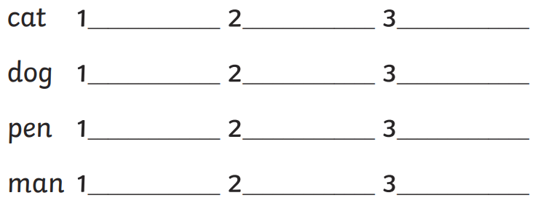
Continue a rhyming string:
Miss Bleakley’s comments

Slide 4
Your task: Complete the Espresso Tasks
Activity 1: https://central.espresso.co.uk/espresso/primary_uk/subject/module/activity/item1074105/grade1/module1122235/index.html
Activity 2: https://central.espresso.co.uk/espresso/primary_uk/subject/module/activity/item1075726/grade1/module1122235/index.html?source=search-all-all-all-all&source-keywords=rhyming
English 1/ Poetry/ Rhyming words
English 1/ Poetry/ Rhyming sentences
Miss Bleakley’s top tip!

