Slide 1
Reception LO: to sequence words to form a sentence. Must: read cvc words. Should: put words in order to make a sentence. Could: read my sentence out loud. Year 1 LO: to write an introduction. Must: punctuate sentences correctly. Should: sequence sentences logically. Could: use conjunctions such as ‘and’ and ‘so’

Slide 2

Stories | Information
Not real | Real and true
Characters | Gives us information
Made up | Teaches us new things
Setting | Text features – headings, captions
Beginning | Real pictures
Middle | Contents
End
Illustrations

Slide 3
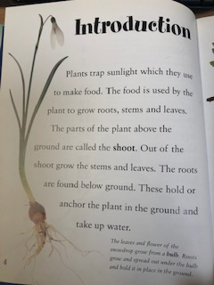
Introductions
An introduction introduces the book or topic.
What do you notice about the following introductions?

Slide 4
Introduction
The Great Fire of London was devastating for many people. The Fire destroyed most of London in 1666. The fire raged for 4 days and 4 nights, with many houses, shops and special buildings being destroyed.
What makes a good introduction?
Notes:
A good introduction gives a brief overview of the topic without sharing too much detail that will be shared later in the book..

Slide 5
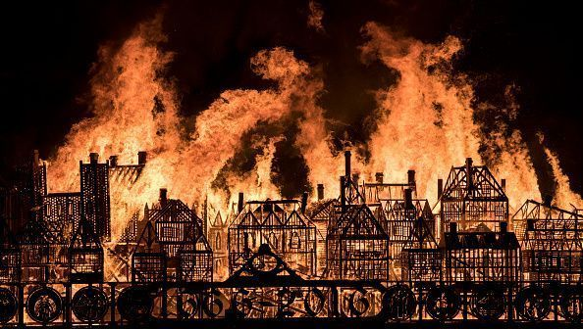
Task:
Write your own introduction to your Great Fire of London book.
Remember- give an overview of the topic to explain what the book is about.

Slide 6
Plenary
Share your introduction with a partner. Can you check your punctuation. Do your sentences all make sense?

