Slide 1
Reception LO: to write a simple title. Must: discuss titles for a book Should: use phonics knowledge to write a title Could: fill your book with pictures, writing or marks. Year 1 LO: to write a contents and title page. Must: write a catchy title. Should: select content for your information book. Could: sequence the content for your information book.

Slide 2

Stories | Information
Not real | Real and true
Characters | Gives us information
Made up | Teaches us new things
Setting | Text features – headings, captions
Beginning | Real pictures
Middle | Contents
End
Illustrations

Slide 3

Title
What is the job of a title?
Notes:
A title tells you what the book is about without you even opening the front cover. Especially important for information books.

Slide 4
Can you think of some titles for a book about The Great Fire of London?
Fire! Fire!
London’s Burning!
The Great Fire
London on Fire
Can you think of some more?

Slide 5
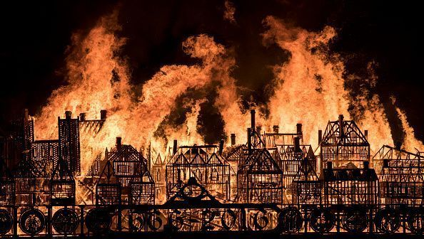
Task:
Select your best title and add it to your non-fiction booklet/ template.
Is it catchy? Does it tell people what the book is about?

Slide 6
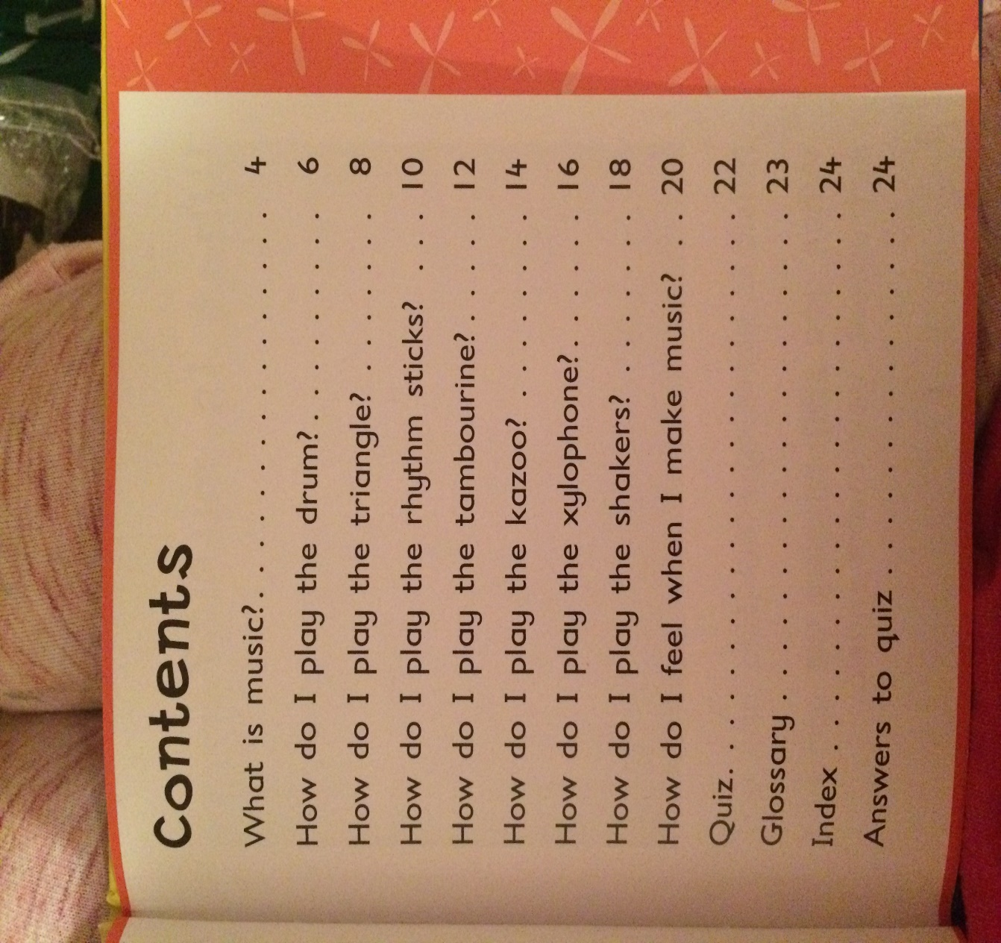
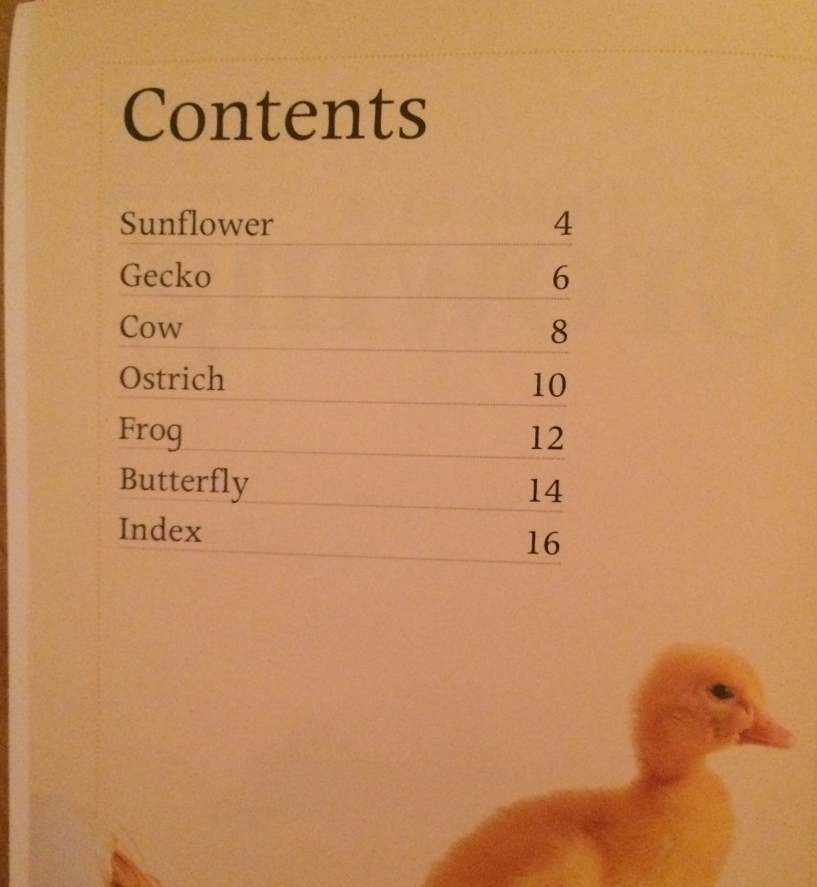
Contents page
What is the job of a contents page?
Notes:
Notice how the contents page above uses questions to order the content of the book. We wrote our own questions last week..

Slide 7
What does a contents page need?
Title- ‘Contents Page’
List of headings in the order they are in the book.
Page numbers for each section.

Slide 8
Task:
Use your questions from last week to create your own contents page.
Think carefully about what you need to include!
Title- ‘Contents Page’
List of headings in the order they are in the book.
Page numbers for each section.

