Slide 1
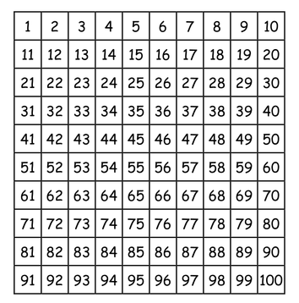
LO: to count forwards and backwards in 2s.
Must: count in 2s forwards and backwards from any number to 100.
Should: count objects in multiples of 2.
Could: record as repeated addition.

Slide 2
1) What is missing? 1, 2, 3, __ , 5 , 6 , 7, __
2) How do spell 2?
3) What is missing? 10, 11, ___, 13, ___
4) You have only 1 nose and 1 mouth.
What do you have 2 of?

Slide 3
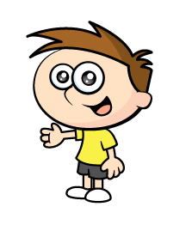
1) What is missing? 1, 2, 3, __ , 5 , 6 , 7, __
2) How do spell 2?
3) What is missing? 10, 11, ___, 13, ___
4) You have only 1 nose and 1 mouth.
What do you have 2 of?
4
8
two
12
14

Slide 5
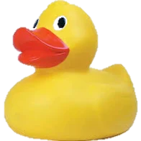
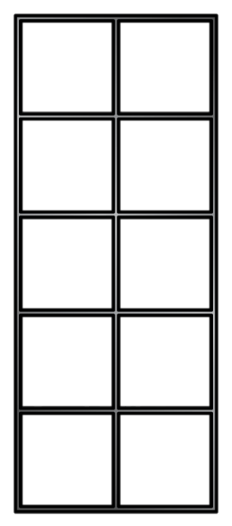
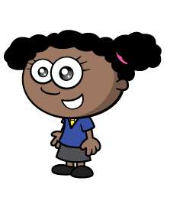
How many ducks?
Now I can count by 2s!
2 , 4 , 6 , 8
There are 8 ducks.

Slide 6
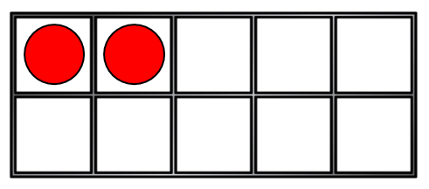
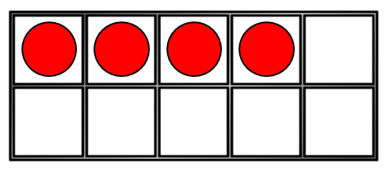
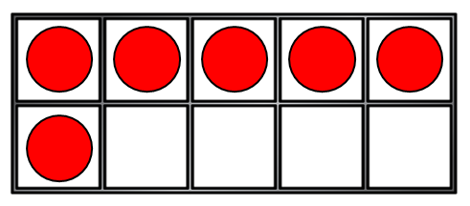
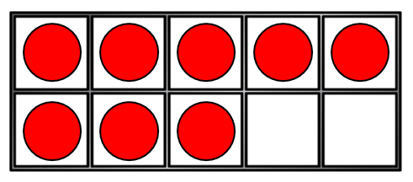
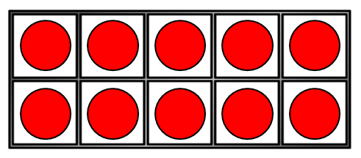
How many counters?
0
2
4
6
8
10

Slide 7

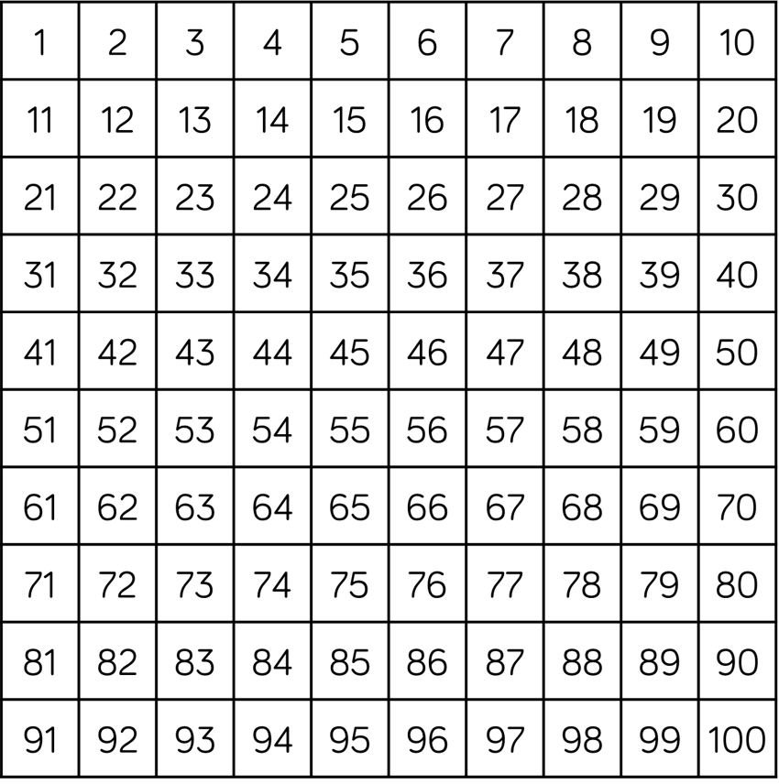

Have a think
How many gloves?
There are 20 gloves.

Slide 8

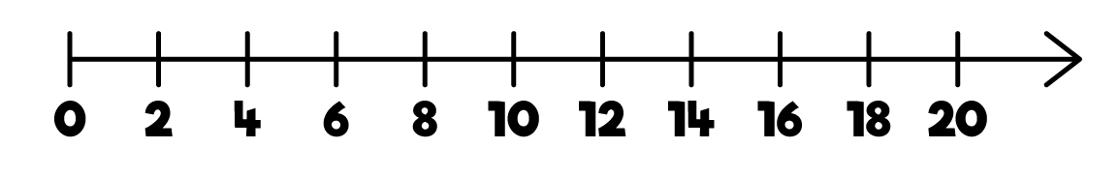
Have a think
Can you count in 2s starting at 8?
There are 20 eyes!

Slide 9


Have a think
How many pencils?
16
How many cans of pop?
12

Slide 10
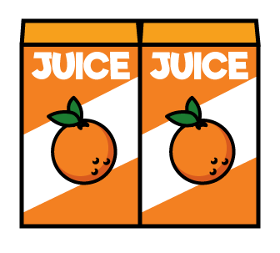
Let’s count backwards in 2s!
There were 12 boxes of juice.
After playtime the children were thirsty.

Slide 11
What is missing?
36 | 38 | 40 | ? | 44 | 46 | 48 | ?
36 | 38 | 40 | 42 | 44 | 46 | 48 | 50

Slide 12
Your task:
Something easier: Complete the missing number sheet.
Year 1: Complete a varied fluency sheet to practise counting in tens.
Something harder: Complete the ‘something harder sheet’. Can you record the multiples of 2 as a repeated addition number sentence?

