Slide 1
Reception LO: to recite and recognise the alphabet.
Must: recite the alphabet with support.
Should: recognise and name the letters of the alphabet.
Could: order the letters of the alphabet.
LO: to use capital letters and full stops.
Must: know when to use a capital letter.
Should: know when to use a full stop.
Could: use capital letters and full stops to write a sentence.

Slide 2
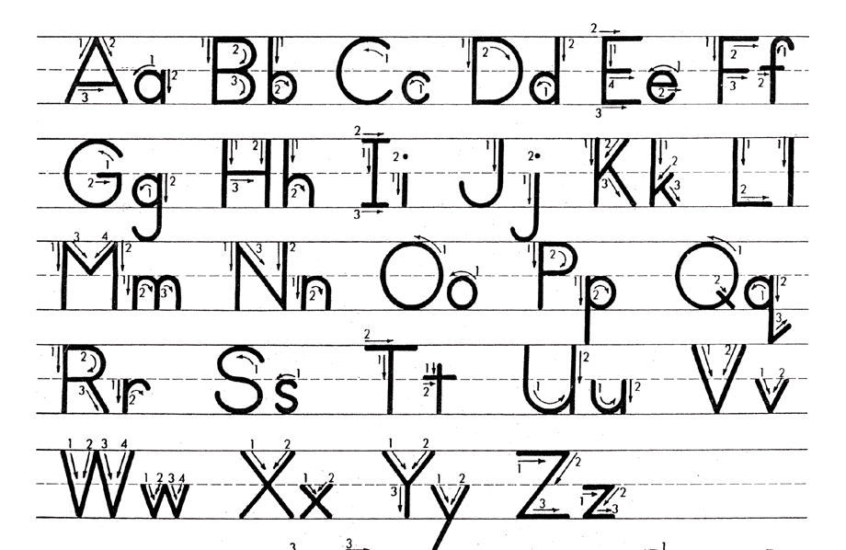
Recite the alphabet

Slide 3
Order the words to make a sentence:
When do we need capital letters and full stops?
On I like park. to go to the Saturday
On Saturday I like to go to the park.
Click here to reveal the answer.

Slide 4
Capital letters
We use capital letters at the start of every sentence and for the names of people and places.
Eg
Vlad and Boxton ran from the fire.
We live in England.
Why do the words in these sentences need capital letters?

Slide 5
Full stops
Remember to sit your letters and the full stop on the line!
We end statement sentences with a full stop.
E.g.
The fire burned brightly.
Boxton squeezed under the door.

Slide 6
Correct the punctuation. What is missing?
the forest is full of trees
the fish swim in the pond
the cow goes moo
The forest is full of trees.
The fish swim in the pond.
The cow goes moo.

Slide 7
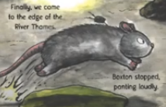
Your Task!
Vlad
Boxton
Write a sentence on a whiteboard about Vlad, Boxton or the Great Fire of London. Remember capital letters and full stops.
burning
running
fire
London

Slide 8
Independently…
Write a sentence or more about Vlad and Boxton in the Great Fire of London.
Remember your capital letters and full stops!
Read your sentence to a partner.

Slide 9
Plenary
Share your sentences by reading them out loud!

