Slide 1
English
Tuesday 1st March 2022

Slide 2

Notes:
Recap on learning so far – instructions and their features.
What did we learn yesterday? Time connectives.
What do we use them for?
Why are they important.

Slide 3
First spot the time connective.
Notes:
Spot the time connective and imperative verb

Slide 4
Next put your hand up and tell Miss Atlay.
Notes:
Spot time connective and imperative verb

Slide 5
LO: To use time connectives in an instruction text.
Must: Use time connectives.
Should: Use time connectives to correctly sequence instructions.
Could: Use conjunctions to give more detailed instructions.

Slide 6
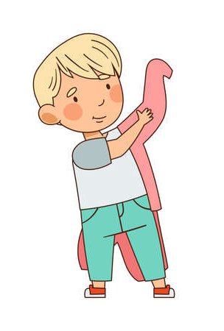



How to get ready for break.

