Slide 1
Reception LO: to recite and write the alphabet.
Must: sing the alphabet.
Should: write lowercase letters correctly.
Could: write capital letters correctly.
Year 1 LO: to sequence words alphabetically.
Must: recite the alphabet.
Should: sequence letters in the alphabet.
Could: sequence words alphabetically.

Slide 2
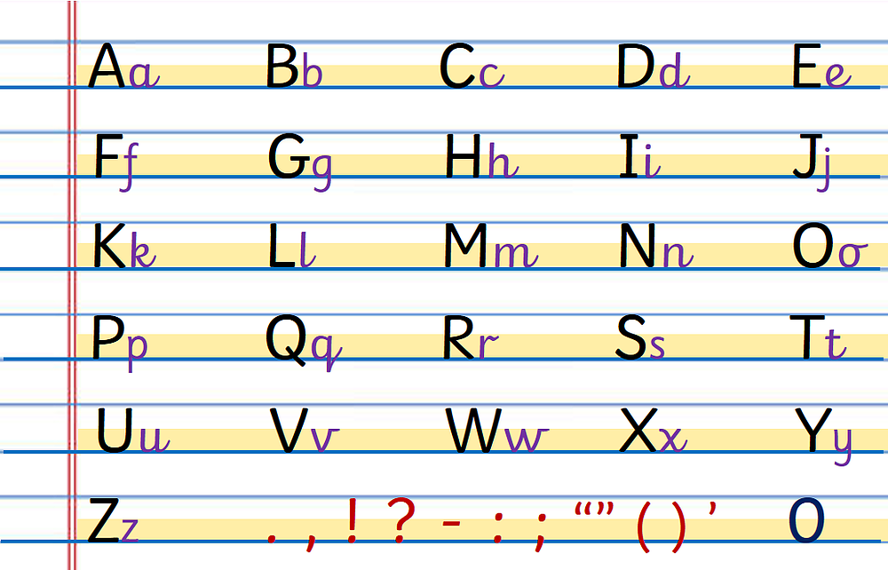
Alphabet
Can you sing the alphabet?
Use a set of flashcards to sequence the alphabet.

Slide 3
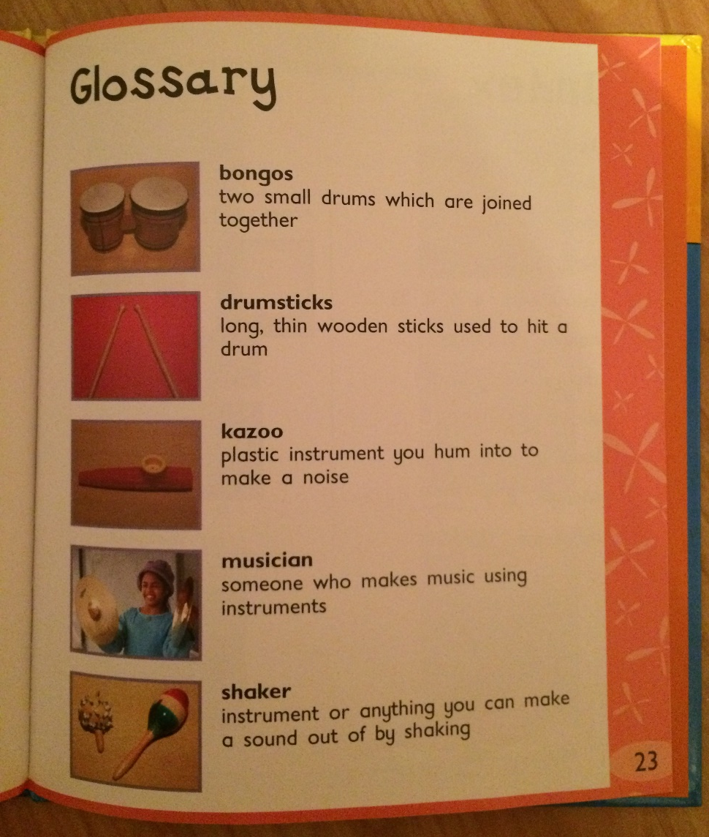
Glossary
Today we are going to make a glossary!
We need to know the alphabet! Why?
What is a glossary?

Slide 4

A glossary contains words in alphabetical order. Put these words into alphabetical order:
fire
London
bakery
river

Slide 5
Now try these words:
hook
water
spark
cheese

Slide 6
Task:
Sequence the words on your sheet in alphabetical order.
Challenge: then match them with the correct definition.

