Slide 1


Slide 3


1) How many?
2) What comes next? 36, 37, 38, 39 ___
3) Which is equal to 5 tens?
fifty or fifteen
4) What comes next? 32, 31, 30, ___

Slide 4
1) How many?
2) What comes next? 36, 37, 38, 39 ___
3) Which is equal to 5 tens?
fifty or fifteen
4) What comes next? 32, 31, 30, ___
34
40
29

Slide 6
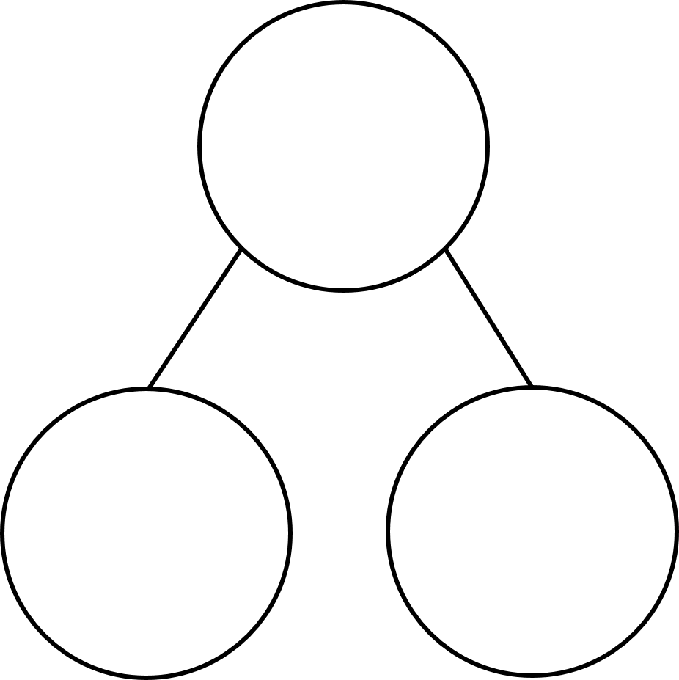
Part whole model
16
1 ten and 6 ones =
16

Slide 7

Part whole model
Have a think
38
3 tens and 8 ones =
38

Slide 8
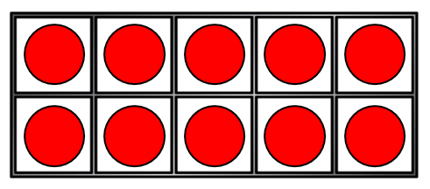
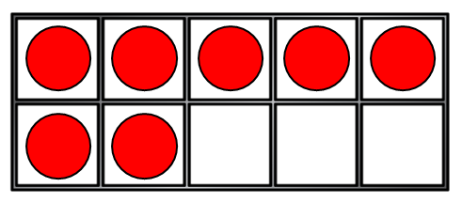
Part whole model
27
2 tens and 7 ones =
27

Slide 9


Part whole model
Have a think
41
4 tens and 1 one =
41

Slide 10
Have a go at question 1 on the worksheet

Slide 11
Representing numbers to 50
13
thirty
31

Slide 12
What is missing?
Have a think
35
23
50

Slide 13
Have a go at questions 3 and 4 on the worksheet

