Slide 1
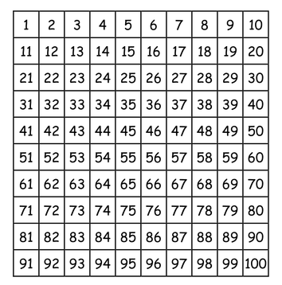
LO: to count forwards and backwards in tens.
Must: count in multiples of ten from 0-100.
Should: count objects in groups of ten and find ten more and ten less.
Could: problem solve and reason.

Slide 2


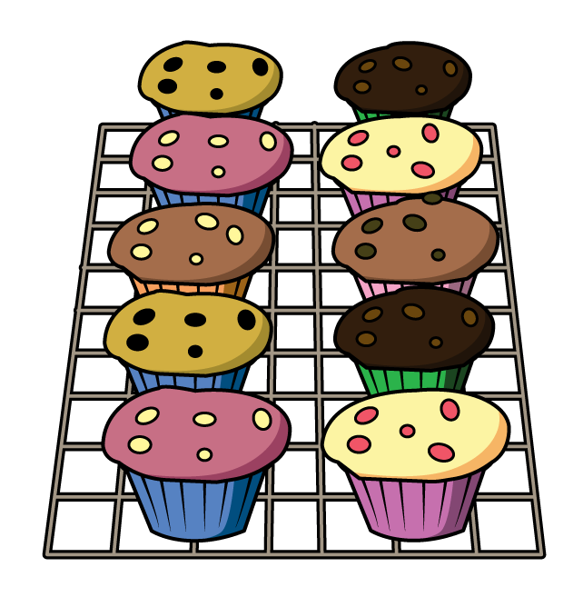


How many?
Have a think
How did you count them?

Slide 3


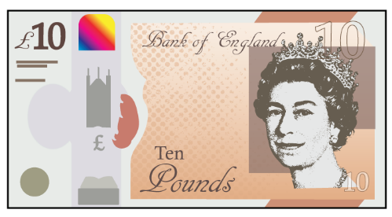


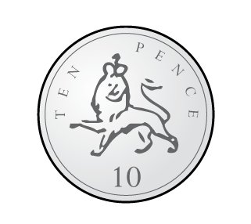
Why count in 10s?
Have a think

Slide 4
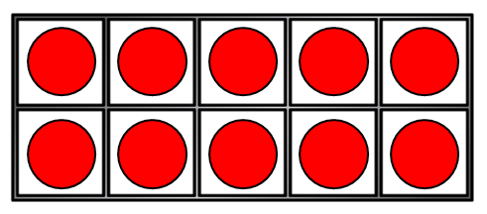


Let’s count in 10s
Have a think
1 ten = 10
2 tens = 20
3 tens = 30
4 tens = 40
I can see a
pattern!
I know that
5 tens = 50

Slide 5
Multiples of ten:
Order the multiples of ten.
90
80
50
10
0
20
100
30
70
40
60

Slide 6

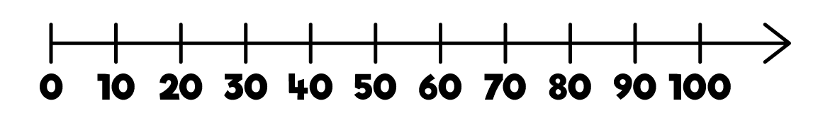
Have a think
I think I need to practice counting forwards and backwards in 10s.

Slide 7
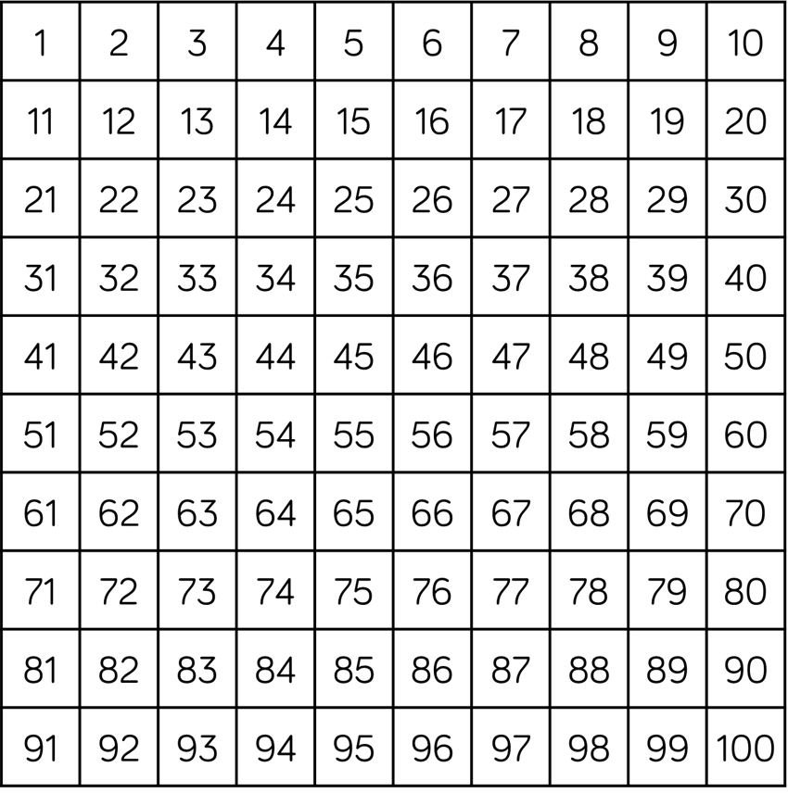
Let’s count in 10s
Have a think
I love how it
makes a column!

Slide 8
Ten more and ten less
tens
ones
2
4
When you find ten more and ten less, the number in the tens column increases or decreases. Eg ten more than 24.

Slide 9
Finding ten more and ten less
Using a hundred square can you find ten more and ten less?
Ten more than 32
Ten more than 67
Ten less than 62
Ten less than 98
Ten less than 54
Ten more than 49

Slide 10



Varied Fluency 1
If one packet of seeds has 10 seeds, how many seeds do 5 packets of seeds have?
© Classroom Secrets Limited 2018

Slide 11
Varied Fluency 1
If one packet of seeds has 10 seeds, how many seeds do 5 packets of seeds have?
5 packets of seeds will have 50 seeds altogether.
© Classroom Secrets Limited 2018

Slide 12
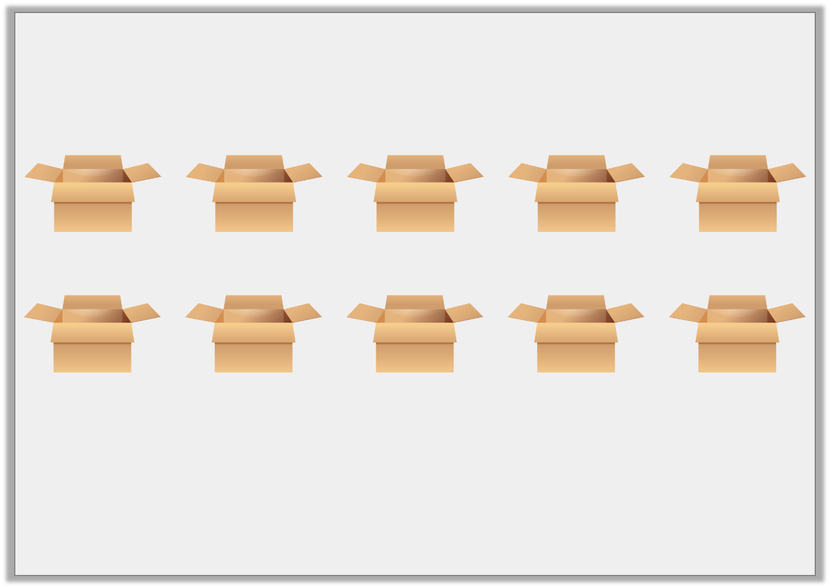
Varied Fluency 2
If one box holds 10 toys, circle the boxes you need to hold 60 toys.
© Classroom Secrets Limited 2018

Slide 13
Varied Fluency 2
If one box holds 10 toys, circle the boxes you need to hold 60 toys.
You will need 6 boxes.
© Classroom Secrets Limited 2018

Slide 14

Varied Fluency 3
Complete the sequence to find the missing numbers.
50 , | 60 , | 70 , |  | ,
© Classroom Secrets Limited 2018

Slide 15
Varied Fluency 3
Complete the sequence to find the missing numbers.
50 , | 60 , | 70 , | 80 | , | 90
© Classroom Secrets Limited 2018

Slide 16
Varied Fluency 4
Label the missing numbers on the number line.
30 |  | 40 |  | 50 |  |  |  |  |  | 80 |  | 90
© Classroom Secrets Limited 2018

Slide 17
Varied Fluency 4
Label the missing numbers on the number line.
30 |  | 40 |  | 50 |  | 60 |  | 70 |  | 80 |  | 90
© Classroom Secrets Limited 2018

Slide 18
Reasoning 1
Lea is counting in 10s starting from 10.
She thinks she will land on the number 44.
Is she correct? Explain your answer.
1 | 2 | 3 | 4 | 5 | 6 | 7 | 8 | 9 | 10
11 | 12 | 13 | 14 | 15 | 16 | 17 | 18 | 19 | 20
21 | 22 | 23 | 24 | 25 | 26 | 27 | 28 | 29 | 30
31 | 32 | 33 | 34 | 35 | 36 | 37 | 38 | 39 | 40
41 | 42 | 43 | 44 | 45 | 46 | 47 | 48 | 49 | 50
51 | 52 | 53 | 54 | 55 | 56 | 57 | 58 | 59 | 60
61 | 62 | 63 | 64 | 65 | 66 | 67 | 68 | 69 | 70
71 | 72 | 73 | 74 | 75 | 76 | 77 | 78 | 79 | 80
81 | 82 | 83 | 84 | 85 | 86 | 87 | 88 | 89 | 90
91 | 92 | 93 | 94 | 95 | 96 | 97 | 98 | 99 | 100
© Classroom Secrets Limited 2018

Slide 19
Your Task: year 1
Something easier: Complete the ‘something easier’ sheet. Can you count the objects in 2s?
Something harder: Complete the ‘something harder’ activity sheet. Share your ideas with a partner. How did you solve the problem?
Year 1: Complete a main activity sheet. Check your answers with a partner.

