Slide 1
Reception LO: to add two groups of objects and record using + and = symbols.
Must: recognise and write numbers to 20.
Should: touch count accurately.
Could: record using + and =.
Year 1 LO: to add single and two digit numbers using a number line.
Must: recognise, write and use + and = symbols.
Should: add single and two digit numbers using a number line.
Could: solve addition word problems.

Slide 2
What do these symbols mean? Can you think of all the different words for these symbols?
+
-
=

Slide 3
5 + 2 =
7 + 4 =
6 + 6 =
8 + 9 =
What happens when you add to a number?
Notes:
The number gets bigger.
Model adding 5 children and then adding 2 more. What is the total?

Slide 4
Reception: record the number sentence on your whiteboard.
+
=

Slide 5
Try these using objects:
5 + 4 =
7 + 5 =
12 + 6 =
5 + 9 =

Slide 6
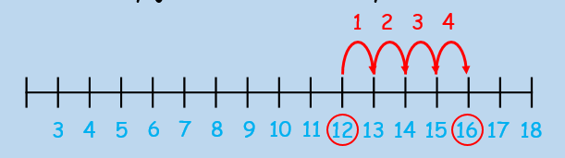
Try these on your number line:
12 + 4 =
7 + 3 =
14 + 5 =
11 + 4 =
Top tip: start on the biggest number!

Slide 7
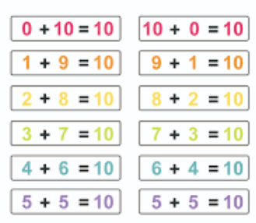
Do you know your number bonds?
Let’s play ‘quick fire’ number bonds!

Slide 8
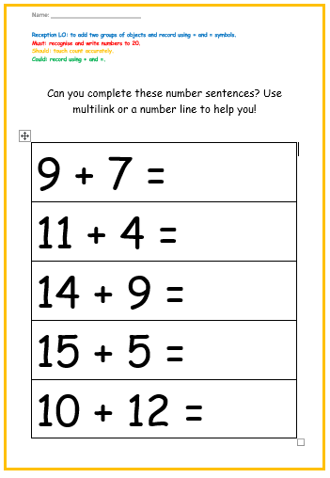
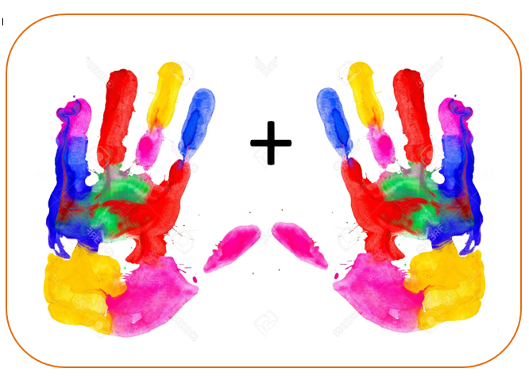
Your Task:
Reception: grab two handfuls of objects and place them on your grab mat. Can you record the number sentence that your objects are showing?
Reception Challenge: try the reception ‘something harder’ sheet. Can you read the symbols in the number sentences and record the totals?

Slide 9
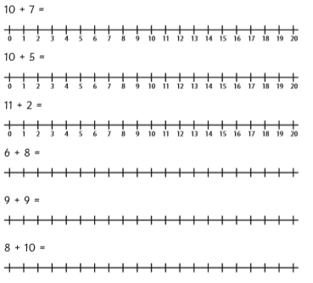
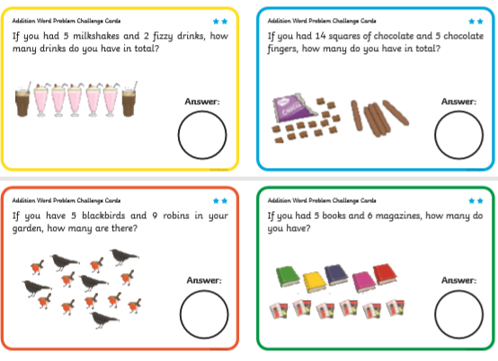
Your Task: year 1
Something easier: grab 2 handfuls of objects and place them on your grab mat. Find the total by counting all the objects. Can you record this as a number sentence using + and =?
Something harder: Complete some of the addition word problems. Read the question carefully and use a number line to help you find the total.
Year 1: Use a number line to solve the addition number problems. Check your answers carefully. There are 2 levels of challenge here.

