Slide 1


Year 1 LO: to represent multiplication using arrays.
Must: use concrete resources.
Should: use pictorial representations.
Could: problem solve and reason using arrays.

Slide 2


Let’s talk about arrays!
No Tiny, not rays from the sun… arrays… let me show you!

Slide 3


Arrays have columns.
Arrays have rows.
Arrays are when we build rows and columns.

Slide 4

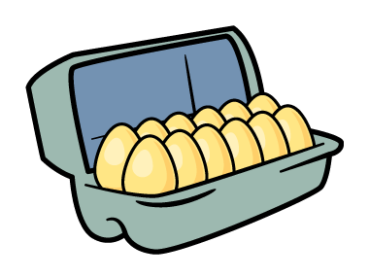
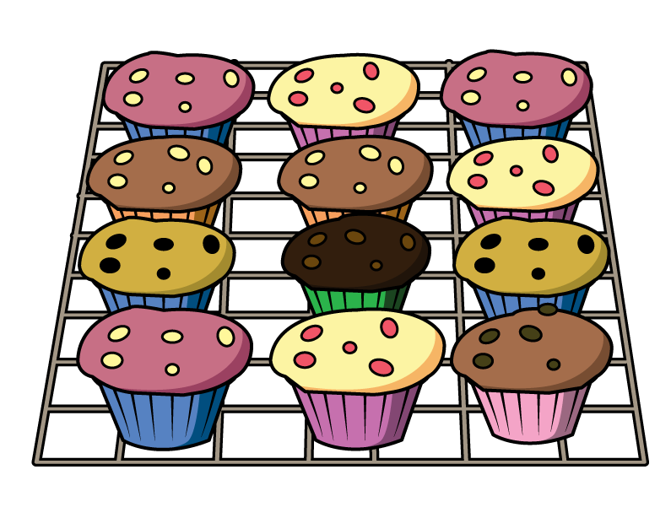



Where have you seen arrays?
Have a think

Slide 5
Can you find any arrays?

Slide 6
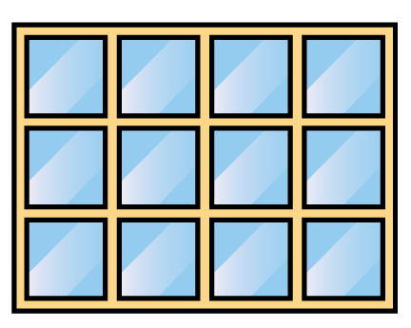
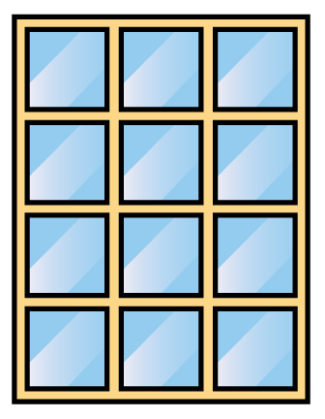
Let’s look at arrays!
Have a think
1
1
2
2
3
3
4
This window has rows.
3
This window has rows.
4

Slide 7
Let’s look at arrays!
Have a think
1
2
3
4
1
2
3
This window has rows.
3
It has columns.
4
This window has rows.
4
It has columns.
3

Slide 8
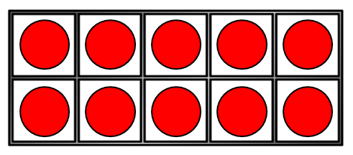
Is a ten frame an array?
1
2
1
2
3
4
5
1
1
2
2
3
4
This has rows.
2
5
It has columns.
5
This has rows.
5
It has columns.
2

Slide 9
Make arrays
How many rows?
4
How many are in each row?
3

Slide 10
Make arrays
How many columns?
3
How many are in each column?
4

Slide 11

Make arrays
Have a think
How many rows?
2
How many columns?
3
How many are there altogether?
6

Slide 12
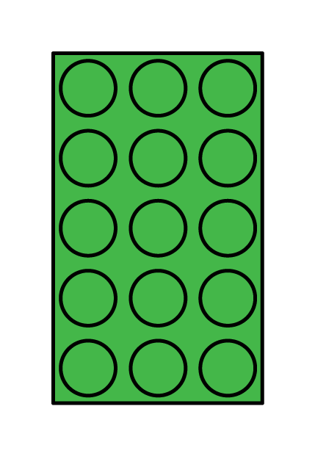
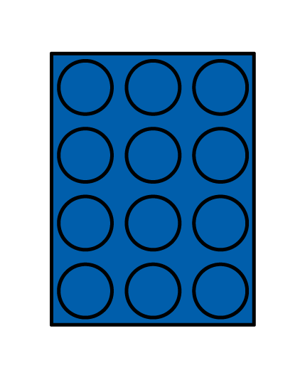
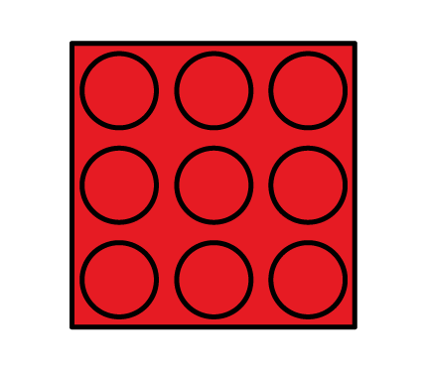
Have a think
3 columns
3 columns
3 columns
3 rows
4 rows
5 rows
What is the same?
columns
rows
What is different?

Slide 13
Can you make an array with
5 rows and 3 columns?
Have a think
There are ___ rows.
5
There are __ counters in each row.
3
There are ___ counters altogether.
15

Slide 14
Can you make an array with
3 rows and 3 columns?
Have a think

Slide 15
This array has
3 rows and 3 columns.
Have a think
There are ___ columns.
3
There are ___ counters in each column.
3
There are ___ counters altogether.
9

Slide 16
Your Task:
Choose your challenge!
Choose the activity according to how confident you are feeling working with arrays.

