Slide 1
English
28.02.2022

Slide 2
What are the features of instructions?
Title
Ingredients/materials list
Method
Bullet points
Numbers
Imperative verbs

Slide 3
Spot the imperative verb in my sentence:
Pour in the milk.

Slide 4
Spot the imperative verb in my sentence.
First, screw the legs in place.

Slide 5
LO: To recognise time connectives in an instruction text. Must: Identify common time connectives. Should: Use time connectives to sequence events. Could: Use time connectives when giving verbal instructions.

Slide 6

This is called a time a time connective.
What does it do?
First, screw the legs in place.

Slide 7
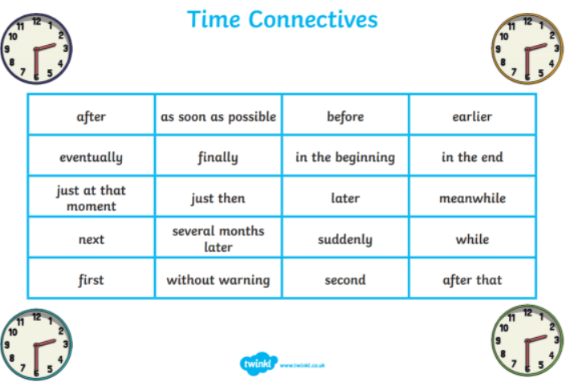
Can you think of any other time connectives?

Slide 8
First, touch your nose.
Next, touch your knees.
Finally, put your hands in the air.

Slide 9
Finally, sit down.
First, stand up.
Next, touch your toes.

Slide 10
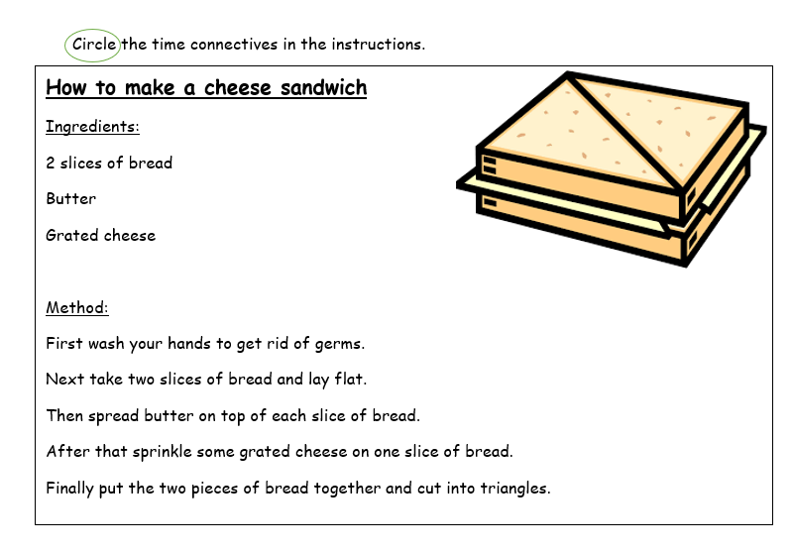
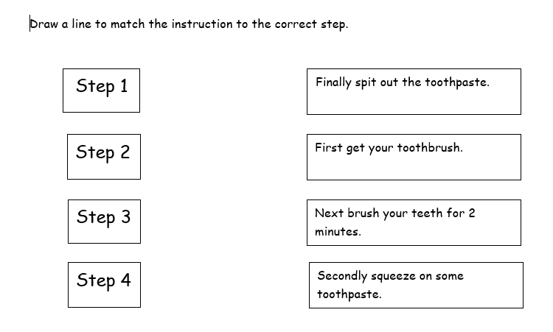

Slide 11
Plenary
Follow your partners instructions to draw a picture

