Slide 1
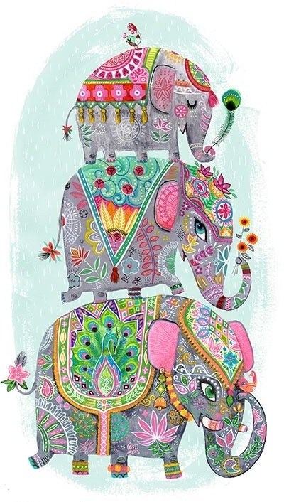
Painted elephants
Lesson 1 - design
Notes:
Find out if the chn know anything about painted elephants. When or why they are used? Anything about what colours and patterns are used. bright with paint, bangles, and drapes

Slide 2
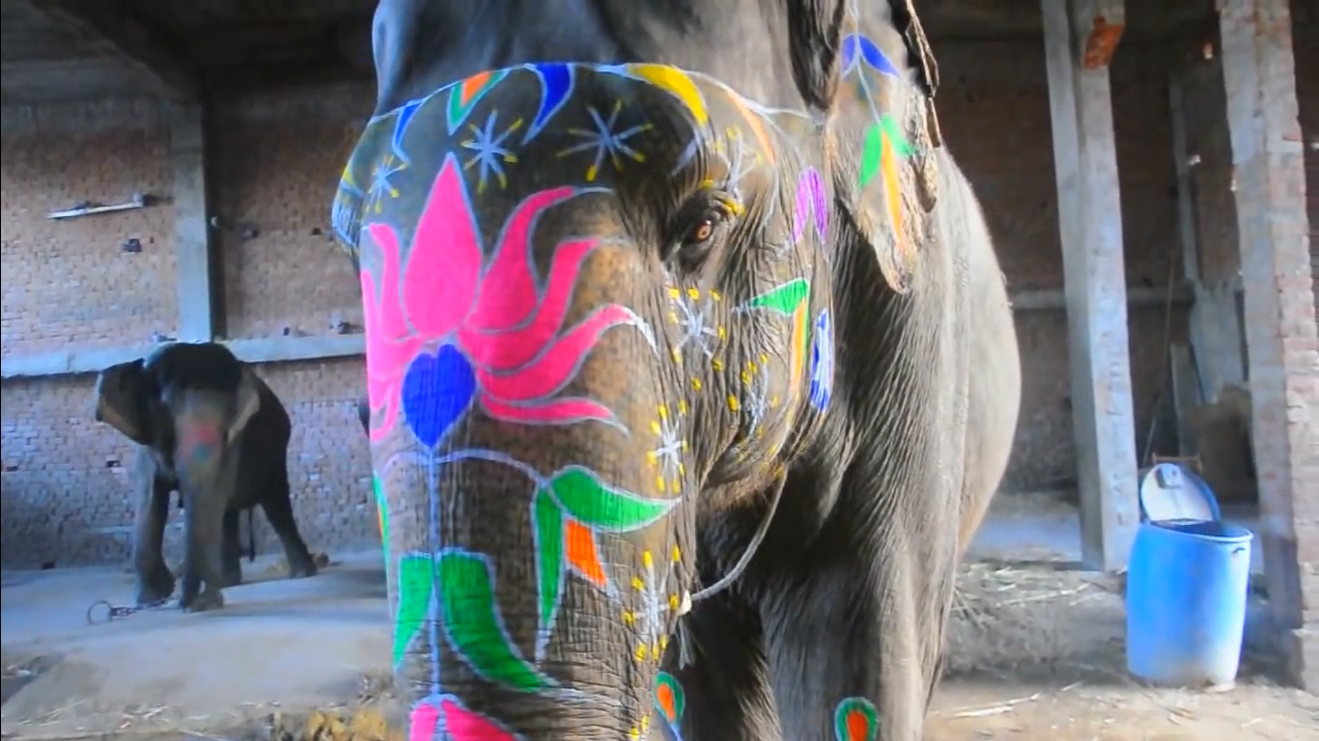
https://www.youtube.com/watch?v=Y6Eaiv4SREI
Notes:
Show chn the video of an elephant being painted. What do we notice about the patterns? Let’s look at some more examples of painted elephants.

Slide 3

Elephants and royalty
The royalty of India, mainly Kings, used to appear before their dazzled subjects on elephants whose ivory tusks glittered with gold and silver and whose bodies shimmered in silk and velvet. It was a symbol of their power. Some kings and Maharajas also rode into war on elephants.

Slide 4
Elephants and royalty
“An elephant mounted by a king is radiant; a king mounted on an elephant is resplendent,” proclaims one historical manuscript.
Notes:
Radiant; happy, glowing, joyful etc
Resplendent; magnificent, splendid, dazzling etc

Slide 5
Elephants in religion
In Hinduism, the elephant-headed god Ganesh, the remover of obstacles, is prayed to before every new journey or challenge. Elephants add to the atmosphere of temples and give blessings on the faithful. Hindus regard elephants as sacred animals.

Slide 6
Elephants in religion
It is believed that worshipping elephants and feeding them is a great way to win the favour of Ganesh.
The elephant head symbolizes great intellect and wisdom. The God of Gods Indra is believed to have a white elephant named Airavata as his vehicle.

Slide 7
When are painted elephants used?
The city of Jaipur in Rajasthan celebrates the Elephant festival every year.
Decorated elephants are also used at some Indian weddings as a symbol of wealth and luck for the marriage.

Slide 8
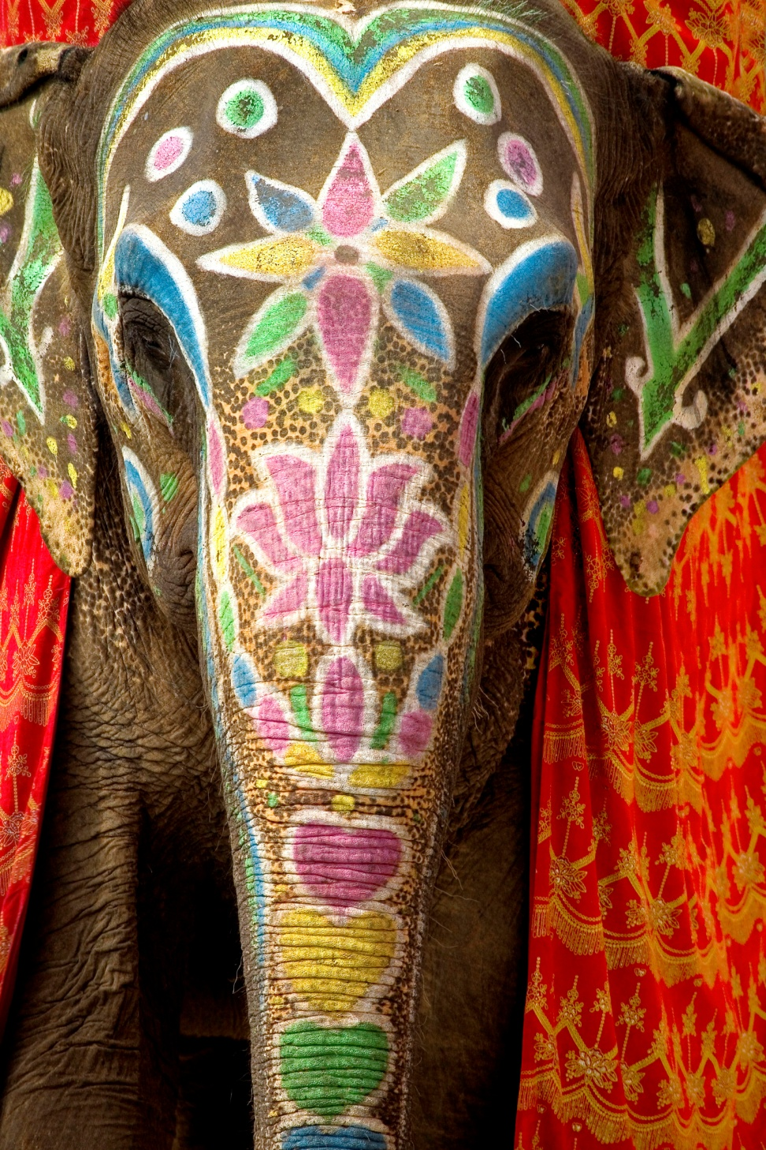
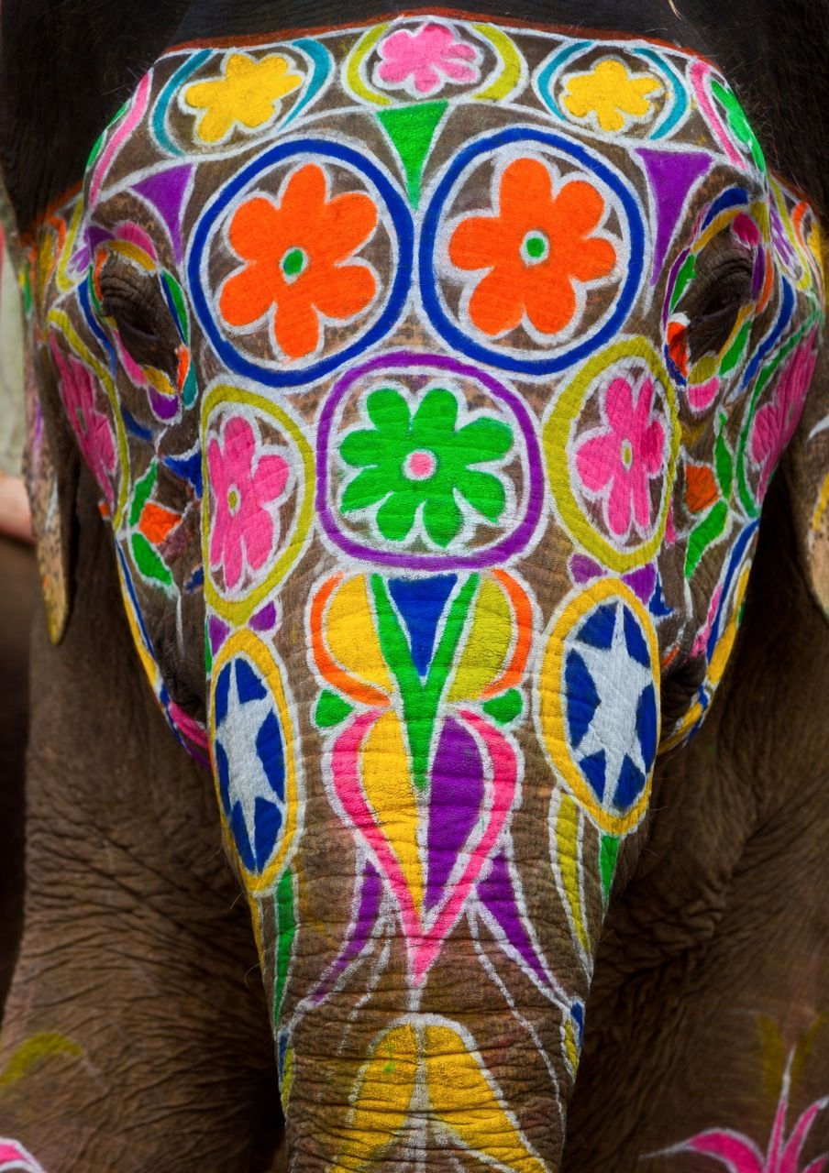

Slide 9
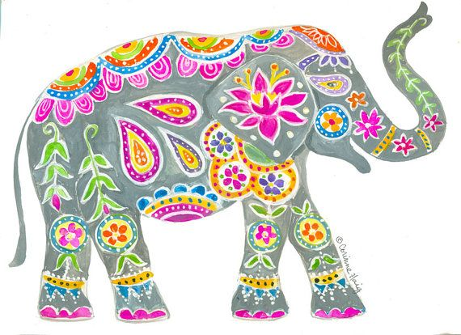

Slide 10
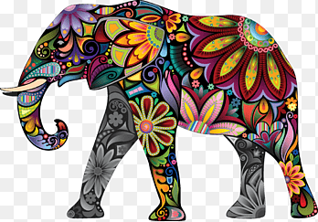

Slide 11
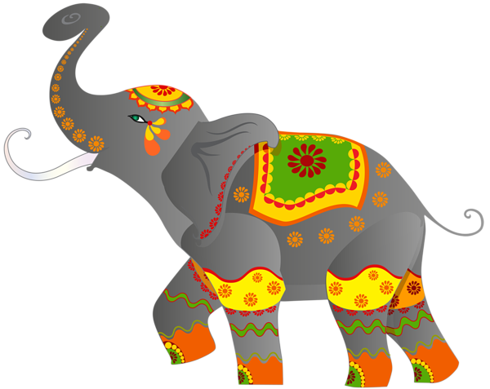

Slide 12
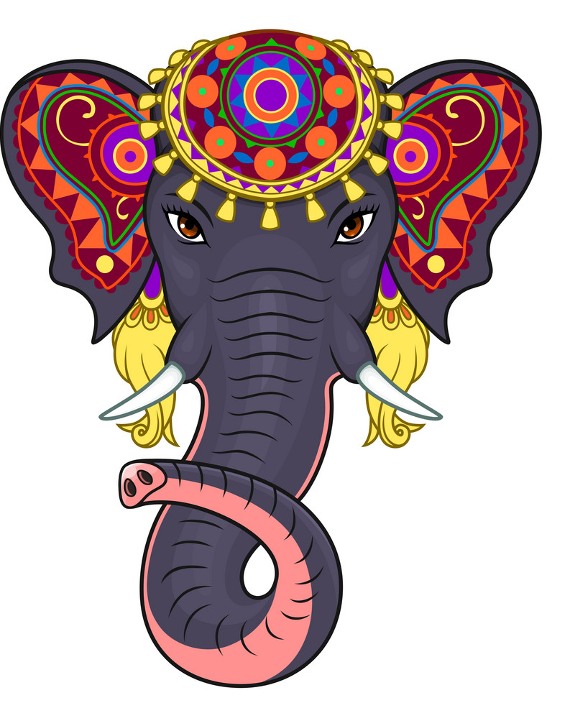


Slide 13
What do we notice?
Colours?
Patterns?
Size of design?
Areas covered?

Slide 14
Your turn!
It is now your job to design a painted elephant using careful designs.
Make sure to annotate your design to say what colours you would use or what materials e.g. Paint, crayon, charcoal

Slide 15
Painted elephants
Lesson 2 - create

Slide 16
Let’s share!
With the person next to you, discuss your design and think about if you want to change anything before we start creating our elephants!

Slide 17
Choose your materials
Charcoal
Crayons
Pencil
Coloured pencil
Paint – how will you make the lines thin?

Slide 18

How to draw an elephant
Notes:
https://www.twinkl.co.uk/go/resource/tg-a-94-how-to-draw-an-elephant-animation
HA children to draw their elephant using animation.

Slide 19
Painted elephants
Lesson 3 - evaluate

Slide 20
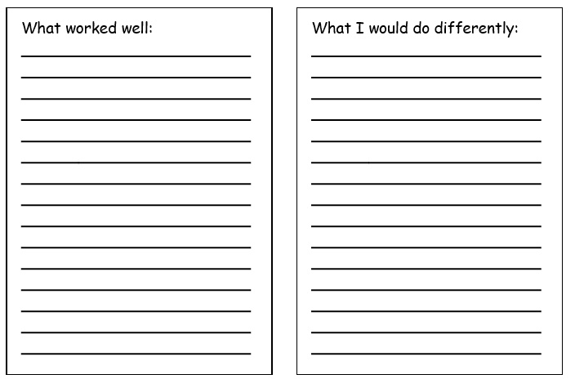

Slide 21
