Slide 1
L.O. To use map skills to locate significant cities in India.
Must: Be able to locate India on a globe.
Should: Discuss the similarities and differences between urban and rural India.
Could: mark the location of some of the main cities on a map.

Slide 2
What is a continent?
A continent is a large, solid landmass.
There are seven continents. These are:
Australasia
North America
Asia
Africa
South America
Antarctica
Europe
Notes:
https://www.echalk.co.uk/Science/physics/solarSystem/InteractiveEarth/interactiveEarth.html- use this link to show interactive globe if you don’t have a globe. Also have atlas out on tables so children can explore themselves.

Slide 3
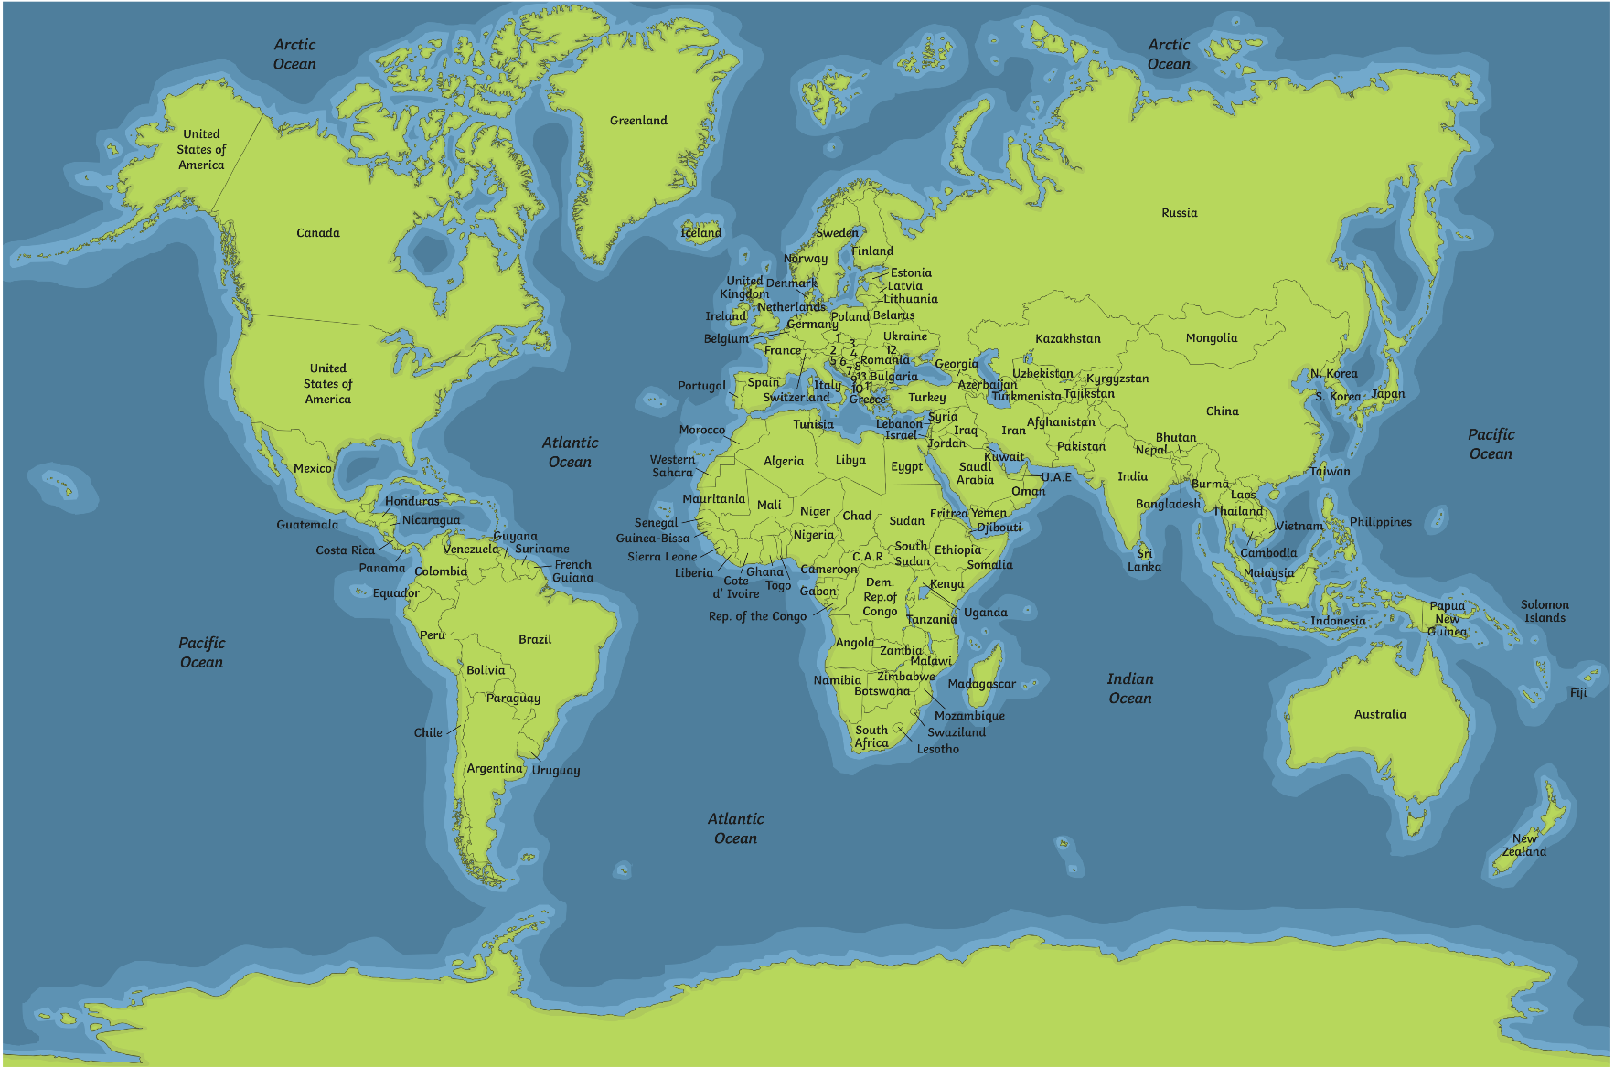
Many countries can exist in one continent.
Notes:
Could quickly circle the continents to show how many countries within a continent

Slide 4
Think of where you live as a map of concentric ovals.
Continent
Country
State/Region
City
Notes:
Do our school as a basis for an example
Then India

Slide 5
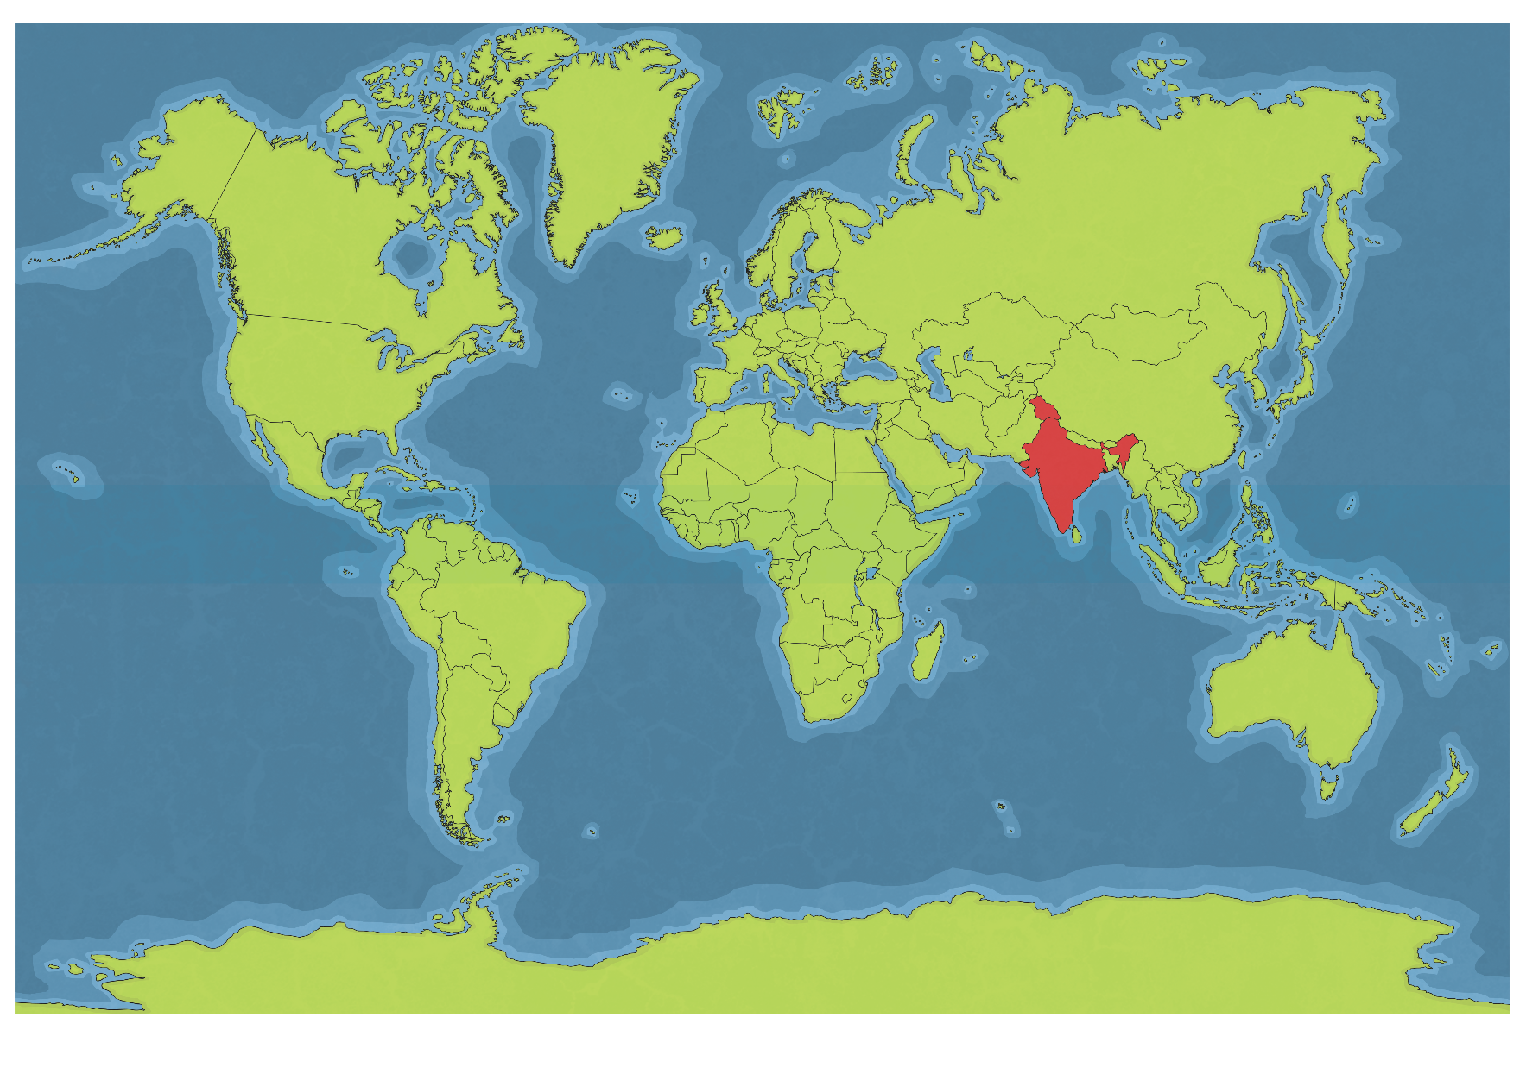
Where is India?

Slide 6
India
India is located in the continent Asia.
India is the 7th largest country in the world.
It borders with 7 other countries. They are: Afghanistan, Bangladesh, Bhutan, Burma, China, Nepal, Pakistan and Sri Lanka.
India has the second largest population in the world.
India also borders the Himalayan mountain range, the highest mountain range in the world.
Like the United States, India is divided into states. India has 29 states. It also has seven union territories.

Slide 7
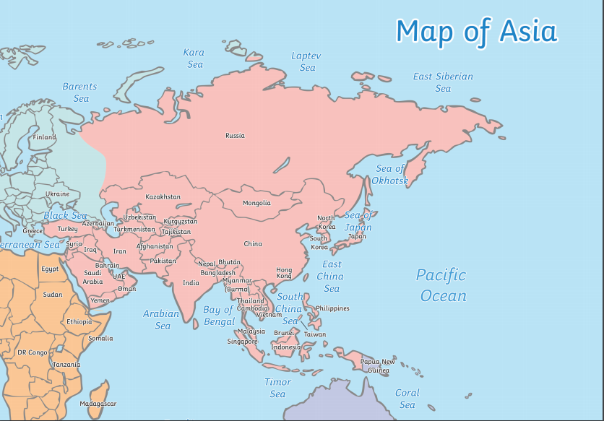
Notes:
Look at India- then the bordering countries

Slide 8
Cities in India
The 5 largest cities in India are:
Mumbai
New Delhi
Kolkata
Chennai
Bangalore

Slide 9
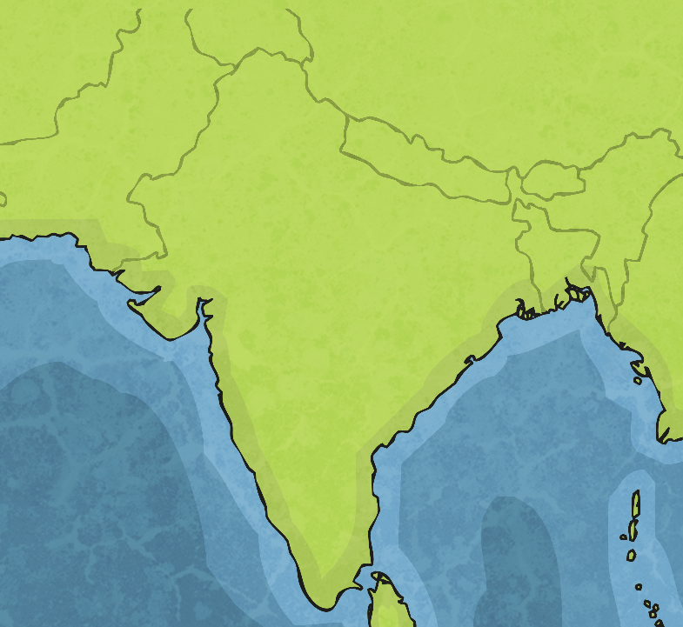
Mumbai
Mumbai is India’s largest city in terms of population.
Mumbai was formerly named Bombay.
It is named after a temple and had the first train in India.
Mumbai is also known as Bollywood (after Hollywood) because it produces a great deal of Indian movies.
Mumbai

Slide 10
New Delhi
Delhi has over 11 million people. It is the second-largest city in India
in terms of population.
Delhi is the largest city of India in terms of area.
Delhi is home to the largest spice market in Asia.
New Delhi is India’s capital and is in the south of Delhi.
Delhi

Slide 11
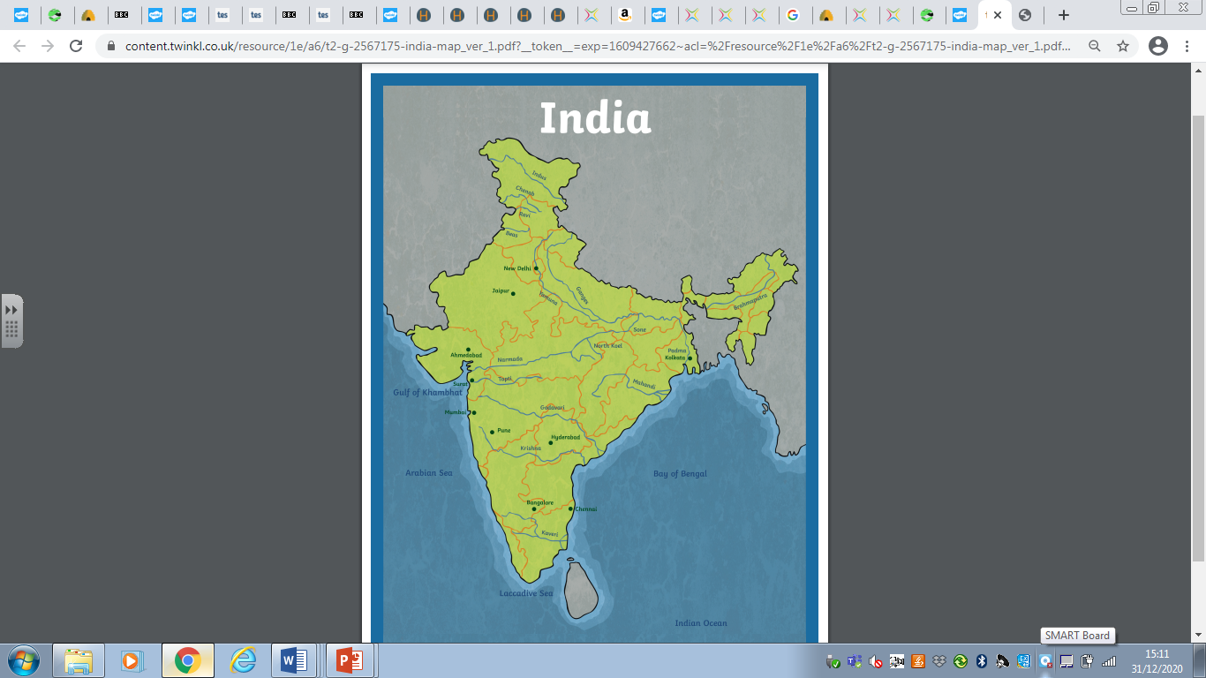
Kolkata
The population is 14.85 million.
Until 2001 the cities official name was Calcutta.
Kolkata is the capital of the Indian state of West Bengal.
The Port of Kolkata is India's oldest operating port and its sole major riverbank port.
The city is widely regarded as the "cultural capital" of India, and is also nicknamed the "City of Joy".

Slide 12
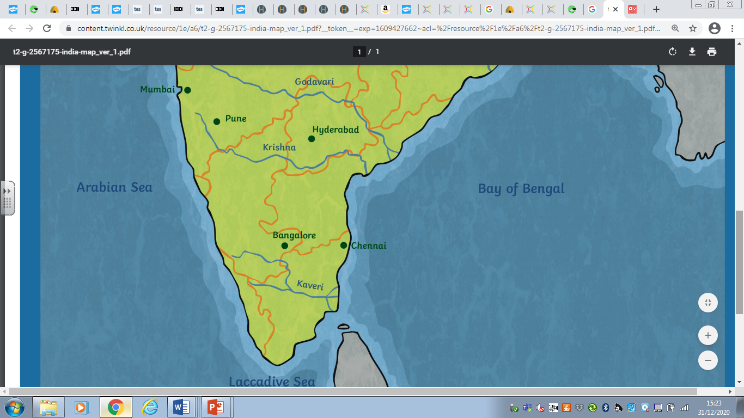
Chennai
Chennai was previously called Madras.
The population is 7 million.
Chennai is the capital city of the Indian state of Tamil Nadu.
Almost 10% of all people in the state live in Chennai.
The city is the fourth largest city of India.
The 12km (7 mile) long Marina Beach in Chennai, is one of the longest beaches in the world.

Slide 13
Bangalore
Bangalore is the capital city of the Indian state of Karnataka.
It is famous for its information technology industry.
Today as a large and growing city, Bangalore has many of the most well-recognised colleges and research institutions in India.
Bangalore is more famous for its climatic conditions. The temperature is usually low compared to the other cities in Karnataka.
This city was also known as the garden city because of the greenery it had.

Slide 14
Notes:
Table task worksheets.
Place the five cities on the map of India.
Write a fact about each city.

Slide 15
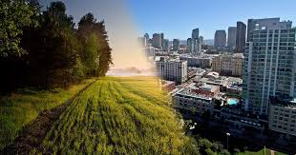
Urban and Rural
When we say Urban we mean the city and town areas.
When we say Rural we mean the countryside/ land.
Can we think of the similarities and differences?
Notes:
Ask them to discuss- then write on whiteboard. Then show next slide to show answers.

Slide 16
Urban | Rural
It has a high population. | It has small populations.
The population has higher incomes. | The population has lower incomes.
There is a wide range of different races and religions. | There is a smaller range of different races and religions.
It is associated with the city and localities that have large buildings and an environmental organisation created by humans. | It is associated with field or natural space.
There are government centres. | There is little or no government presence.
Social relationships are shorter and less personal. | Social relationships are more intimate and last longer.
Notes:
Show after

Slide 17
Urban India
Many rural areas in India became urban after they declared independence.
An example of urbanisation is Bangalore. This used to be a rural area, however it has become urban due to the amount of people who have come to live here and the buildings that have been built.
It has become much more built up to provide homes for all who have come here. The population has increased by half in the last decade as IT and other business areas have grown.
It may seem confusing as a landscape in an urban area can still seem rural due to the land.
The Indian economy is booming, which means it has created opportunities for many but not everyone.

Slide 18
Urban India
However just because there are many urban areas, it does not mean everyone within them is rich. Although before we said urban areas have higher incomes due to the higher amount of job opportunities; the volume of people living in India means this isn’t the case.
Many people believe going to an urban area promises more money, better jobs and better education. However when this isn’t available or possible this is when they move to the slums.
Within all urban areas of India there are places called slums.
Slums are over crowed areas with poor facilities and limited access to education and healthcare.
This shows the extreme difference between rich and poor within India.

Slide 19
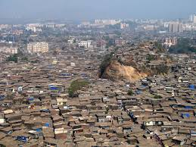
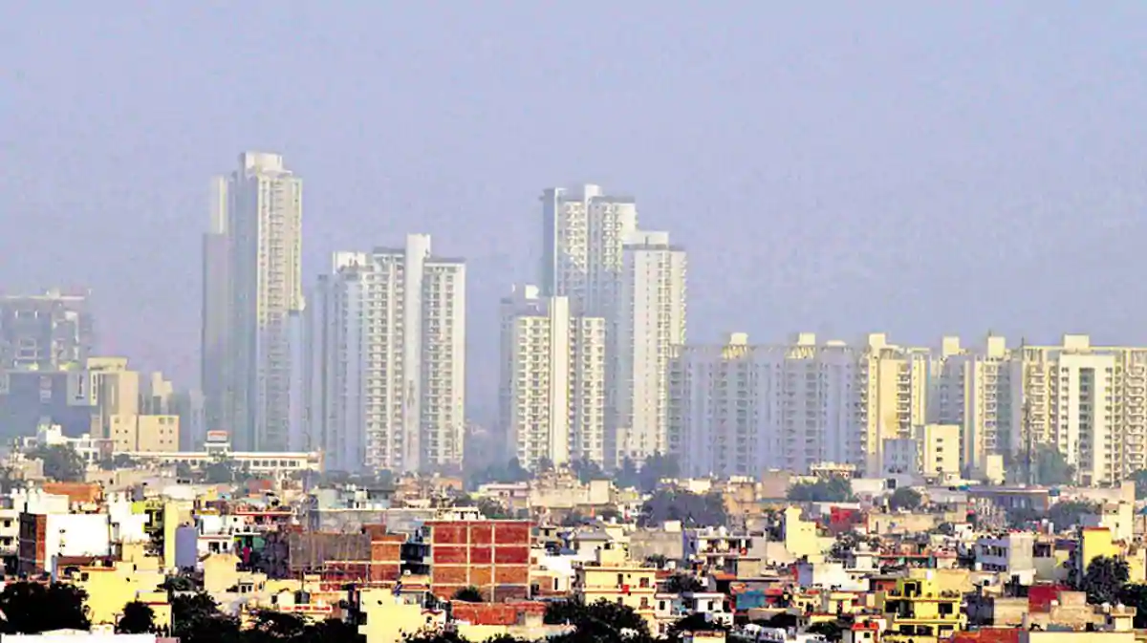
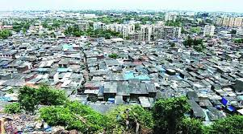

Slide 20
Rural India
Most people in India live in the countryside so the rural economy is central to Indian life.
Although most people in India live in rural areas, the areas they live in still have low population compared to urban India.
This is very different from the UK where only one in six people lives in a rural area.
The main job for people living in rural India is farming. However unlike farming in England where you can earn a lot of money selling, here due to the size of the land, they make enough products to feed their own family. This is called subsistence farming.
The rural areas in India are often effected by flooding from the Ganges.
Due to the flooding, millions of people are forced to travel from the rural areas to urban areas to look for work to earn money and survive.
This then becomes one of the reasons for urbanisation.

Slide 21
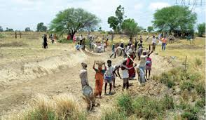
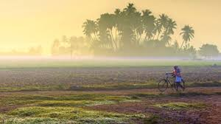
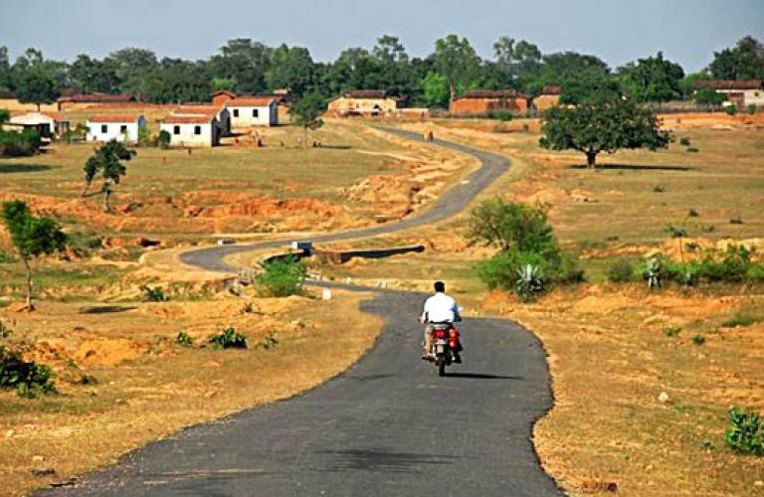
Notes:
Send to tables to do rural or urban worksheets.

