Slide 1

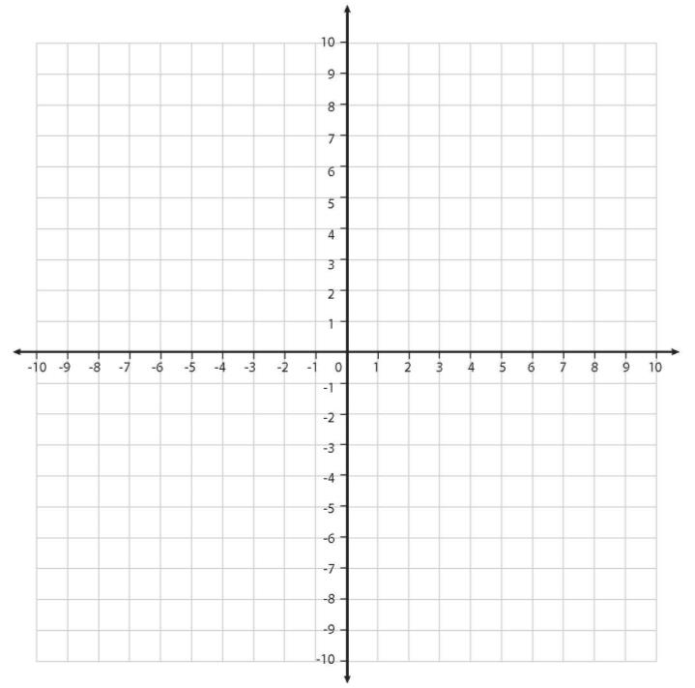


Describe new co-ordinates after a translation.
What shape is this?
y
A parallelogram
Now, let’s use our paper, pencils and rulers to sketch the shape (not the grid) and label the co-ordinates…
Don’t rub off the co-ordinates when we finish!
(-4, 3)
(3, 3)
+
+
x
+
+
(-6, -3)
(1, -3)
This parallelogram moves
3 squares to the right.
What are the co-ordinates of its new position?

Slide 2
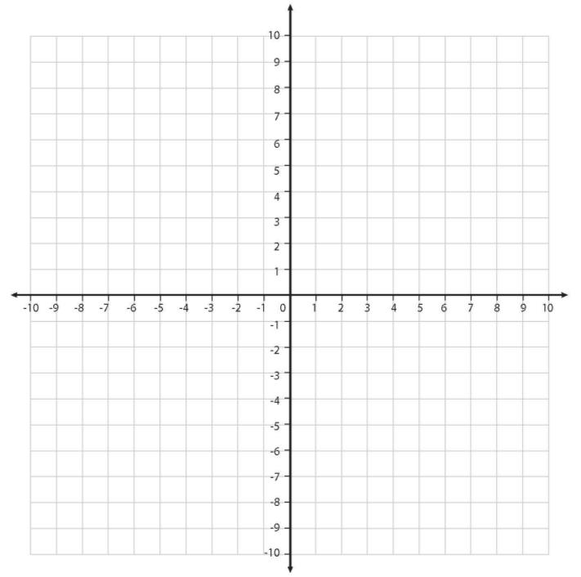

Describe new co-ordinates after a translation.
This shape has been translated.
This means that it has moved but kept its original shape and orientation.
y
(-1, 3)
(6, 3)
+
+
x
Look at the new co-ordinates.
What is the same; what is different?
+
+
(-3, -3)
(4, -3)

Slide 3
Describe new co-ordinates after a translation.
y
This time, move the parallelogram up four squares…
Sketch the shape, labelling the new co-ordinates.
(-4, 3)
(3, 3)
+
+
x
+
+
(-6, -3)
(1, -3)

Slide 4
Describe new co-ordinates after a translation.
y
Look at the new co-ordinates.
What is the same;
what is different this time?
(3, 7)
(-4, 7)
+
+
(-6, 1)
(1, 1)
x
+
+

Slide 5

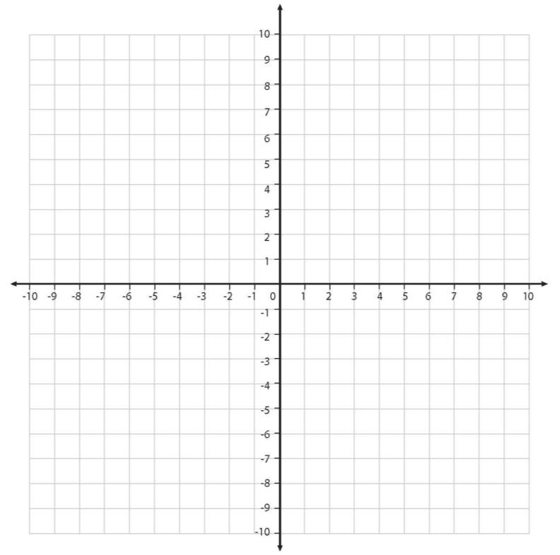
Describe new co-ordinates after a translation.
y
Watch carefully…
Then think how to describe this translation….
FINISH
x
The rectangle has moved ___ squares up and ___ squares to the right.
START
The rectangle has moved 12 squares up and 8 squares to the right.

