Slide 1

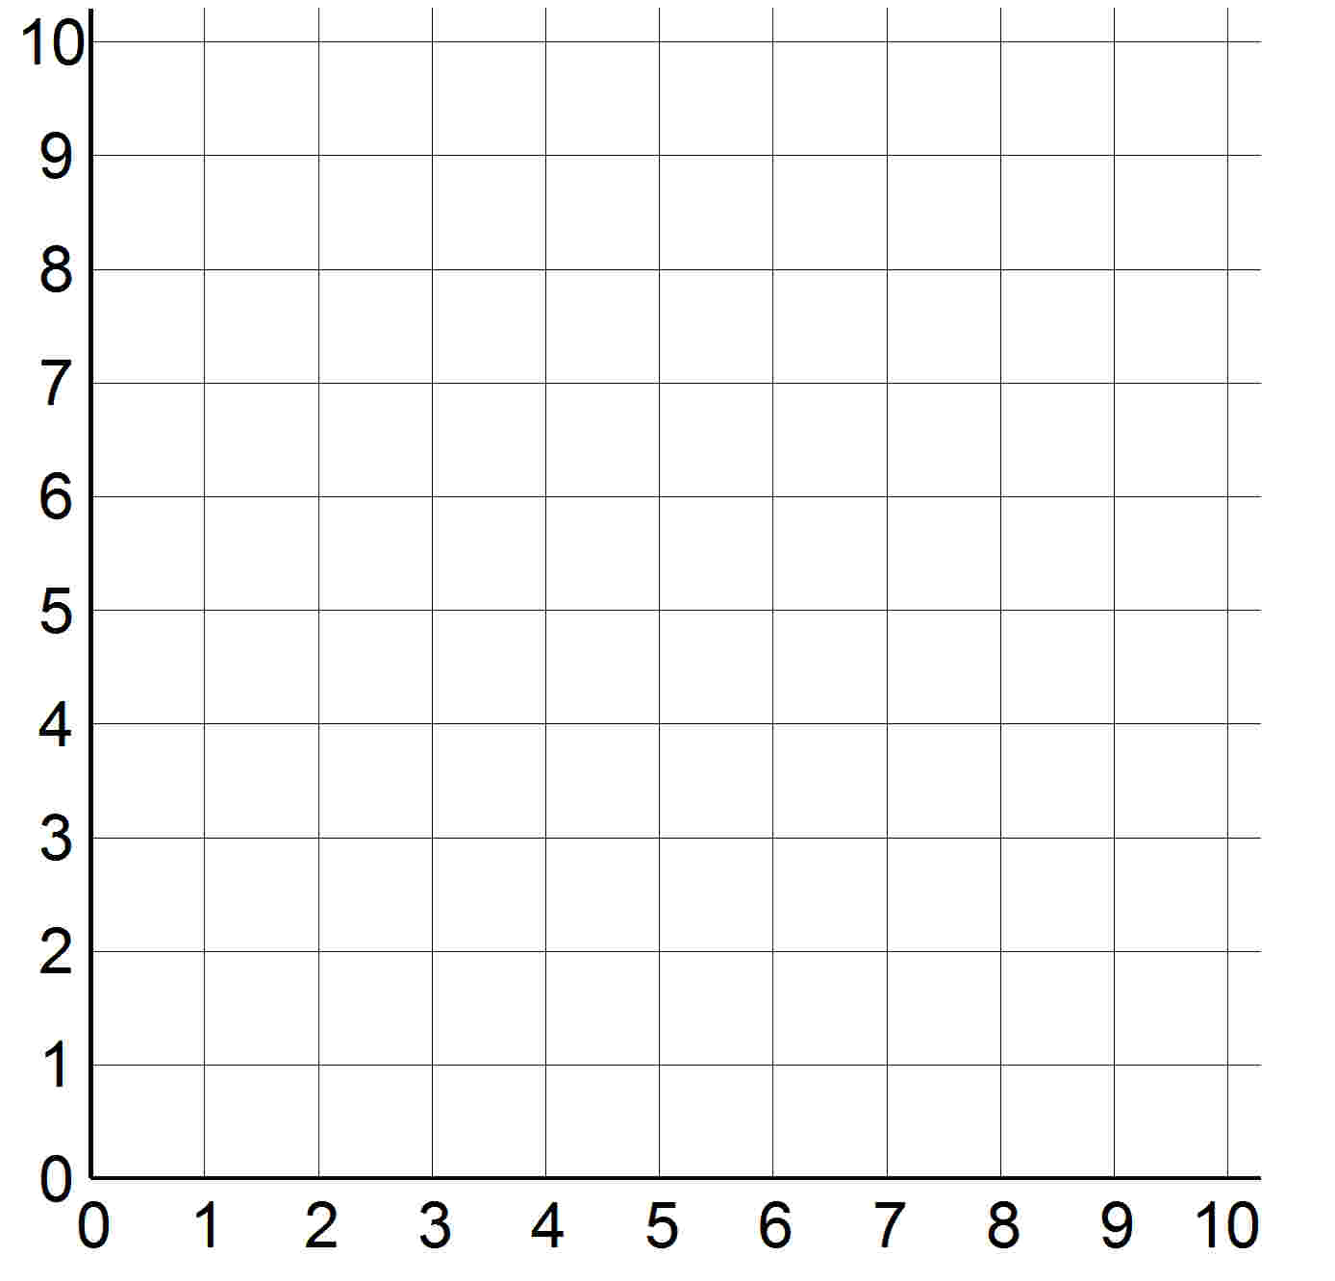
Plot co-ordinates and draw polygons in two quadrants.
This is called a
co-ordinate grid. We can use it to plot points, like a map.
This is the point (2, 5). We always give the x position first, then a comma, then the y position. Walk before you fly!
y-axis
This line is the y-axis.
It goes up the grid, marking the
vertical position.
This line is the x-axis.
It goes across the grid, marking the horizontal position.
The origin is the point where the x and y-axes cross.
x-axis

Slide 2
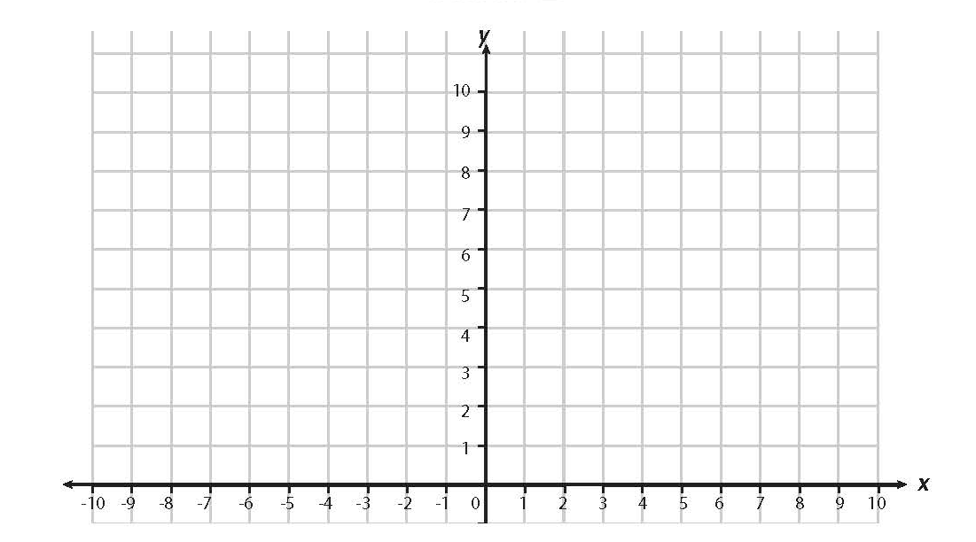

Plot co-ordinates and draw polygons in two quadrants.
We can extend the grid into a second quadrant. Look how the numbers on the x-axis to the left of the origin are negative numbers, counting back from zero.
(-3, 8)
(2, 8)
+
+
How do we write these as co-ordinates?
How do we write the co-ordinates for this point?
+
+
(-3, 5)
(2, 5)
These are three of the four vertices of a rectangle.
What the co-ordinates of the missing vertex?

Slide 3

Plot co-ordinates and draw polygons in two quadrants.
(-1, 9)
+
What shape is this?
+
+
(-5, 6)
(3, 6)
It is a pentagon
+
+
(-5, 1)
(3, 1)
Write down the co-ordinates of its vertices.

