Slide 1



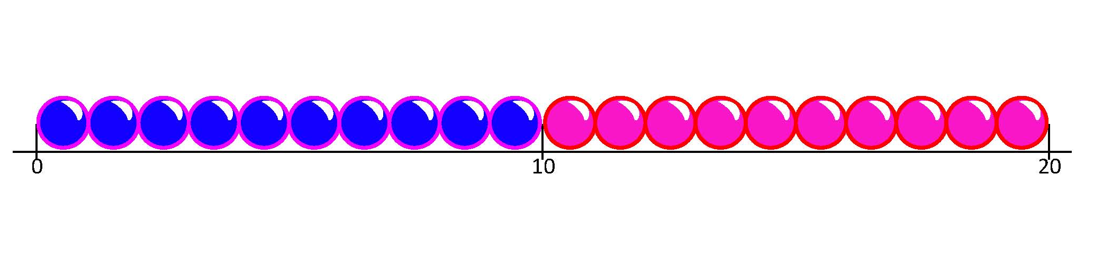

Count up to find a difference between two amounts of money.
Matthew had £17 birthday money.
He spent £15 on an art set.
How could we calculate how much money he has left?
Let’s mark 15 and 17 on a beaded line.
We could count back 15 to find how much he had left, but that would take a long time and we might make a mistake.
Matthew had £17 and spent £15. How much is left? What number sentence can we write?
Instead we count up from 15 to 17 to find the difference between these amounts.
It is quicker and easier.
Next draw the jump from 15 to 17.
£17 - £15 = £2
2
15
17

Slide 2
Count up to find a difference between two amounts of money.
What if Matthew had spent £14? That would be a lot to count back. How could we work it out?
Matthew had £17 and spent £14. How much is left? What number sentence can we write?
Mark 14 and 17 on a beaded line.
Next, draw the jump from 14 to 17.
Counting back 14 would take too long. Let’s use the beaded line to count up from 14 to 17.
£17 - £14 = £3
3
14
17

