Slide 1
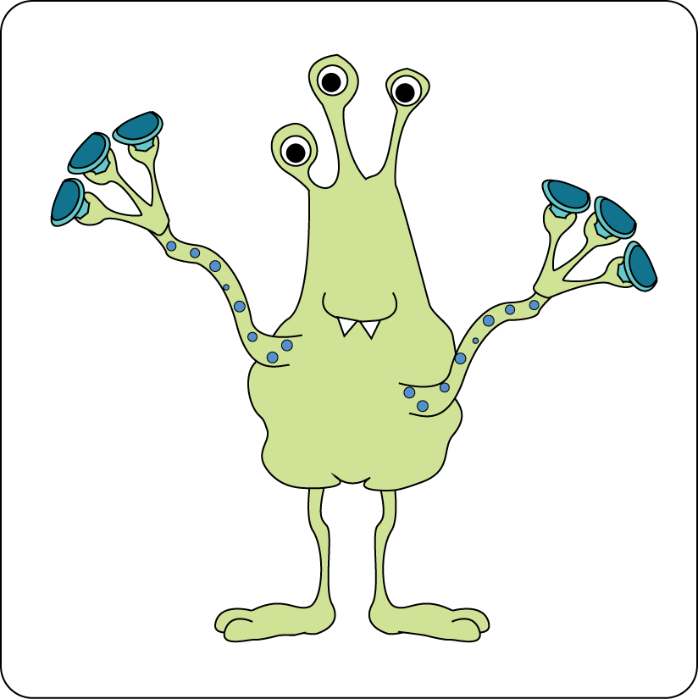
A l i e n s
Nouns and adjectives
Scary
Wild
Slimy
Interesting

Slide 2
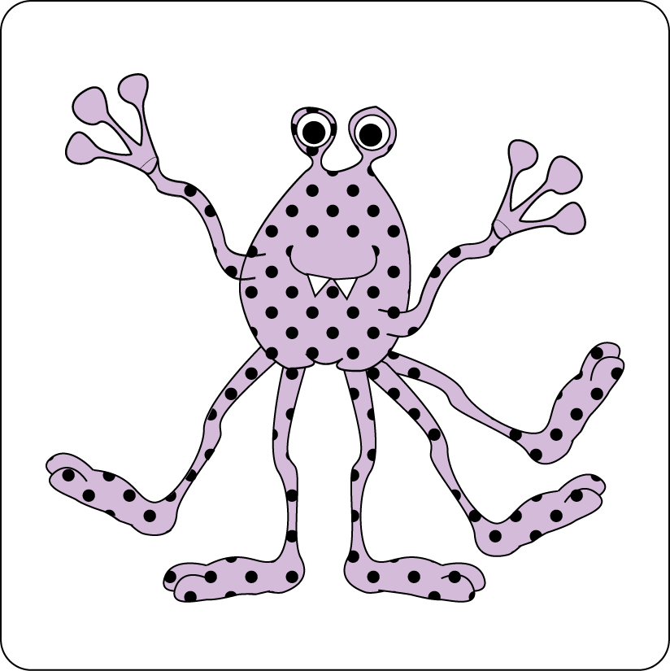
Nouns
A noun names a person, place, idea, thing or feeling.
In front of a noun, we often have one of ...
a
an
the
A UFO flew over a garden.
An alien heard the sound of the mower.
Parvati had a feeling of terror.

Slide 3

Identify the nouns
Hint!
Try putting ‘the’, ‘a’ or ‘an’ in front of the word. Does it make sense?
Write the nouns on this page.
described
sense
alien
garden
space-ship
they
really
scary
Hint!
There are five.
Have you found them all?
tentacles

Slide 4
Identify the nouns
Hint!
Try putting ‘the’, ‘a’ or ‘an’ in front of the word. Does it make sense?
Write the nouns on this page.
described
sense
alien
garden
space-ship
they
really
scary
Hint!
There are five.
Have you found them all?
tentacles

Slide 5
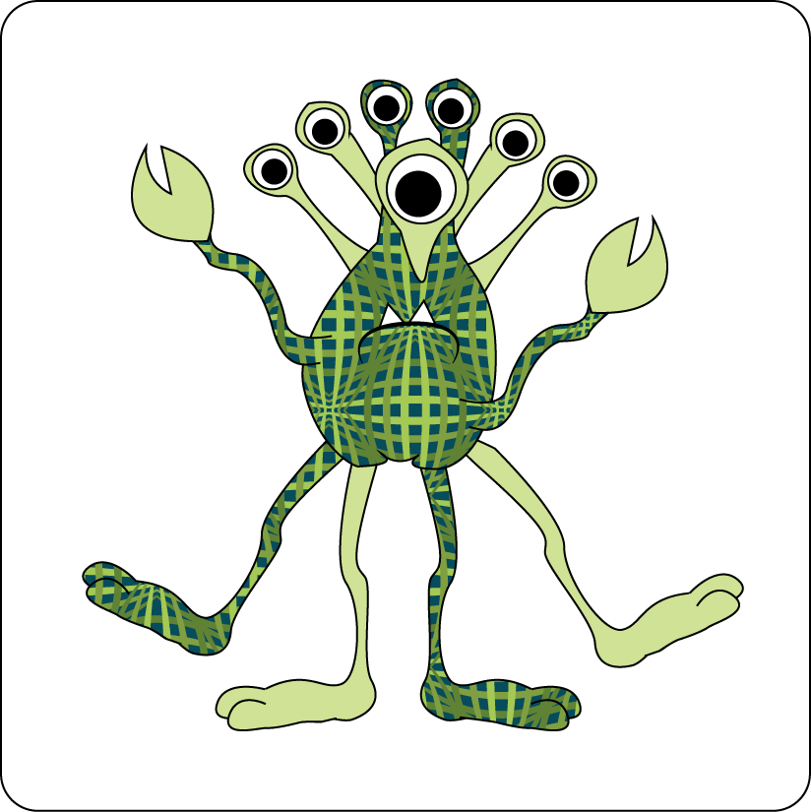
Adjectives
An adjective describes a noun.
Adjectives can come beside the noun
or they can complete a sentence.
The
small, green
alien
waved its
tentacles.
The
creature
seemed
intelligent but scared.
You can have several adjectives together…
But then you need a comma.
The small, green alien…

Slide 6
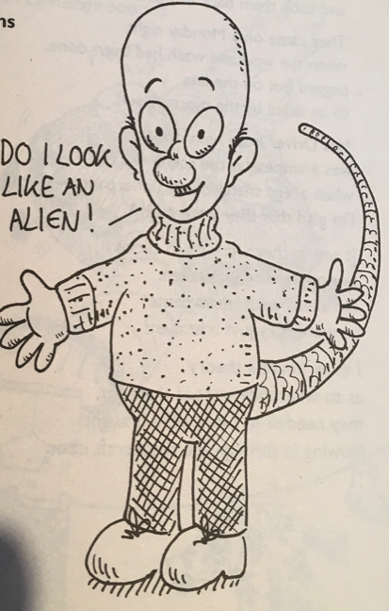
Nouns
My Step-Dad is an Alien
Adjectives
I’d suspected for some time.
I finally got up the courage
to talk to him about it.
I think you’re an alien, I told him.
Nonsense, he said. Why do you think that?
You’re bald. You don’t have any hair anywhere.
That’s not unusual, he said.
Well, you’ve got one green eye and one blue one.
That doesn’t make me an alien, he replied.
You can make the toaster work without turning it on.
That’s just a trick, he smiled.
Sometimes I hear you talking to Mum in a weird alien-language.
I’m learning Greek…
What about your scaly, blue tail?

Slide 7

Nouns
Describing
Adverbs
Explore more Hamilton Trust Learning Materials at https://wrht.org.uk/hamilton/ .
Being specific
Imagining
Adjectives
Creating a picture

