Slide 1
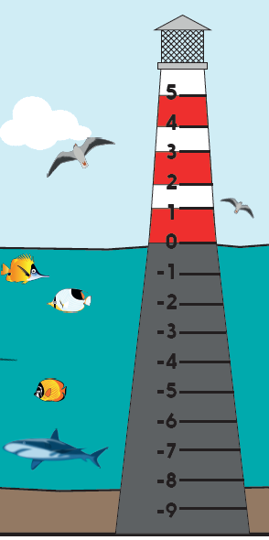
Count on and back in steps through zero.
Work on today’s learning with a grown-up. Talk through the slides together. (there’s no voice-over to listen to)

Slide 2

Count on and back in steps through zero.
Numbers less than zero are called negative numbers.
We usually refer to them as minus numbers, for example with temperature.
-10
-8
-6
-4
-2
0
2
4
6
8
10
Together, use the number line to count on in 2s from minus 10 (-10) to 10.
Now let’s count back again…
Notes:
Count on in 2s, speeding up as you pass 0, then count back again.

Slide 3
Count on and back in steps through zero.
-40
-35
-30
-25
-20
-15
-10
-5
0
5
10
Now we are going to count on in 5s from -40.
Where do you think we will get to?
Now let’s count back again…
Notes:
Count on in 5s, speeding up as you pass 0, then count back again.

Slide 4
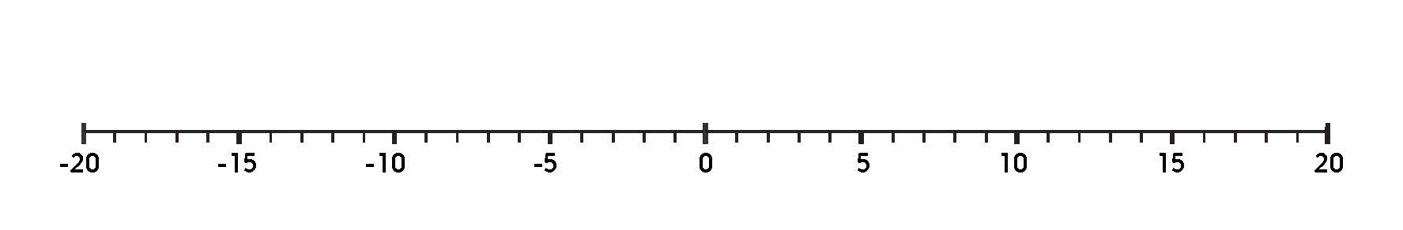
Count on and back in steps through zero.
This time we are going to count back from 20 in 3s.
-19
-16
-13
-7
-4
-1
2
8
11
14
17
We need to take particular care when counting back and crossing zero.
2 - 3 = -1
Count back 2 to 0 then 1 more to -1.

Slide 5
Count on and back in steps through zero.
This time we are going to count back from 20 in 6s.
-16
-4
2
8
14
2 - 6 = - 4
Count back 2 to 0 then 4 more to -4.

Slide 6
Count on and back in steps through zero.
Now have a go at one of today’s Practice sheets...

