Slide 1


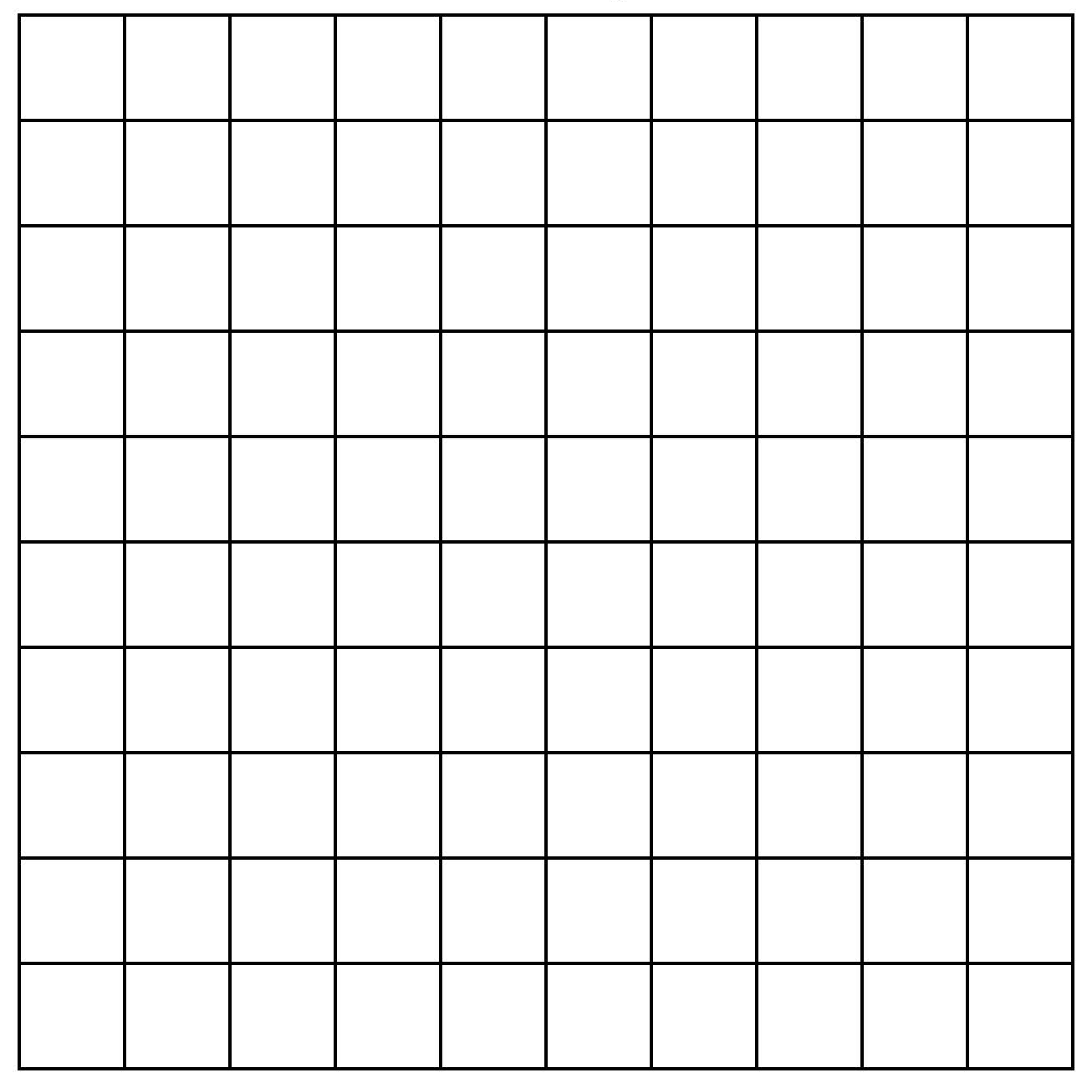

Introduction to percentages.
%
Where have you seen this symbol?
What does it stand for?
Per cent means per 100, or out of 100.
Each small square is one hundredth of the whole square.
1 out of a 100 is the same as 1 percent. We write this as 1%.
What fraction is now shaded? In tenths? In hundredths?
This is 10% of the whole square, as 10 out of 100 small squares are shaded.
¹/₁₀₀ = 1%
¹/₁₀ ≡ ¹⁰/₁₀₀ ≡ 10% ≡ 0.1
Notes:
Children may have seen ‘20% off’ in sales for example…

Slide 2
Introduction to percentages.
¹/₁₀ ≡ ¹⁰/₁₀₀ ≡ 10% ≡ 0.1
Per cent means per 100, or out of 100.
Each small square is one hundredth of the whole square.
1 out of a 100 is the same as 1 percent. We write this as 1%.
What percentage do you think is shaded now?
What fractions are equivalent to 50%?
¹/₁₀₀ = 1%
50% ≡ ⁵⁰/₁₀₀ ≡ ⁵/₁₀ ≡ ¹/₂ ≡ 0.5
What a lot of ways to write the same amount!
Notes:
Explain that ≡ means equivalent.

Slide 3

Introduction to percentages.
¹/₁₀ ≡ ¹⁰/₁₀₀ ≡ 10% ≡ 0.1
Per cent means per 100, or out of 100.
¹/₁₀₀ = 1%
What percentage do you think is shaded now?
What are the percentage, fraction and decimal equivalents for this amount?
75% ≡ ⁷⁵/₁₀₀ ≡ ³/₄ ≡ 0.75

Slide 4
Introduction to percentages.
¹/₁₀ ≡ ¹⁰/₁₀₀ ≡ 10% ≡ 0.1
Per cent means per 100, or out of 100.
¹/₁₀₀ = 1%
What percentage is equivalent to ⁹/₁₀?
90% ≡ ⁹⁰/₁₀₀ ≡ ⁹/₁₀ ≡ 0.9

