Slide 1

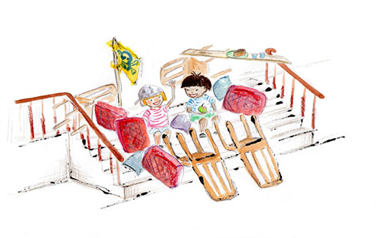
Tense Past, Progressive Past and Perfect Form

Slide 2
Verbs
Verbs indicate that someone or something is
doing, feeling or being.
They built a ship.
Tom fell.
I played and played.
The stairs were a mess!
Usually verbs have the name of a person or thing or a pronoun in front of them.

Slide 3
Verbs have a tense.
They tell us when the action happened.
In the past,
In the present,
or, in the future.
Tom played.
We have such fun.
We will play again tomorrow.

Slide 4
Verbs have a tense.
They tell us when the action happened.
Present tense | Past tense
The boys play.
The boys played.
Tom falls on the stairs.
Tom fell on the stairs.
I am a bit sad.
I was a bit sad.
You tell me not to worry.
You told me not to worry.

Slide 5
Progressive form of verbs

Slide 6
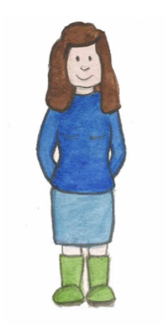
The progressive form is continuous.
It suggests that the action continues,
for a period of time,
Mum was waiting for me to finish playing.
or continues at the time something else happens or happened.
We were playing when Tom fell over.

Slide 7
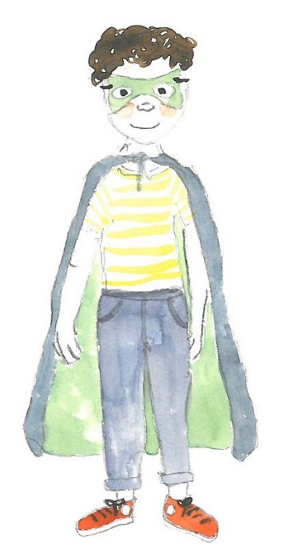
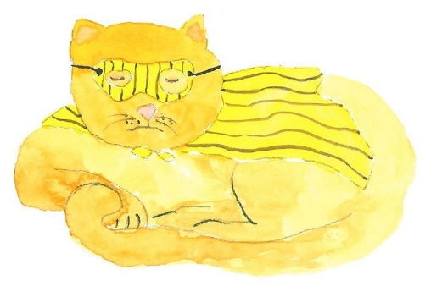
Simple past and past-progressive
Simple- Past |  | Past-Progressive
I played superheroes.
I was playing superheroes.
The cat sat patiently.
The cat was sitting patiently.
Tom came back.
Tom was coming back.
Dad read.
Dad was reading.

Slide 8
Perfect form

Slide 9
Perfect form
The perfect form of the past tense suggests that
a past action is still affecting the present.
still affecting the present.
We built the ship in the past and it is still there.
Simple past | Perfect form
We built a ship.
We have built a ship.
I found a saw in the past and it is still with me.
I found a saw.
I have found a saw.
Tom ate the cake.
Tom has eaten the cake.
Tom ate the cake in the past and it is still eaten.

Slide 10
Perfect Form
The perfect form is created by using the present or past tense of ‘have’ with the past participle of the verb.
We have played.
She has asked to play too.
My sister has joined the ship.

Slide 11
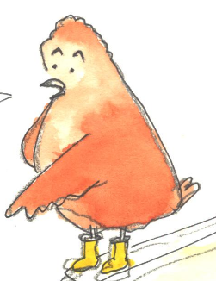
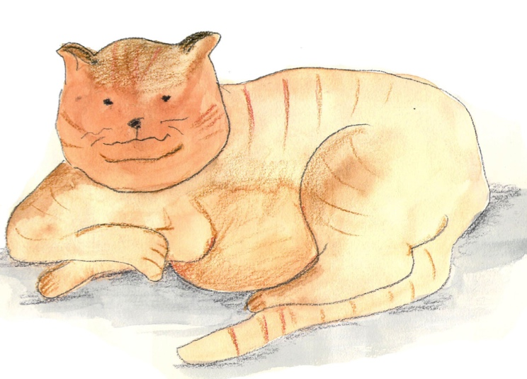
Perfect form
Change these sentences into the simple past,
Perfect Form
has/have + verb
and then the perfect form.
Tom loves the birds.
The fat cat eats a lot of birds.
We try to stop the cat!
Simple past | Perfect form
Tom loved the birds.
Tom has loved birds (since he was two).
The fat cat ate a lot of birds.
The fat cat has eaten a lot of birds.
We tried to stop the cat!
We have tried to stop the cat!

Slide 12

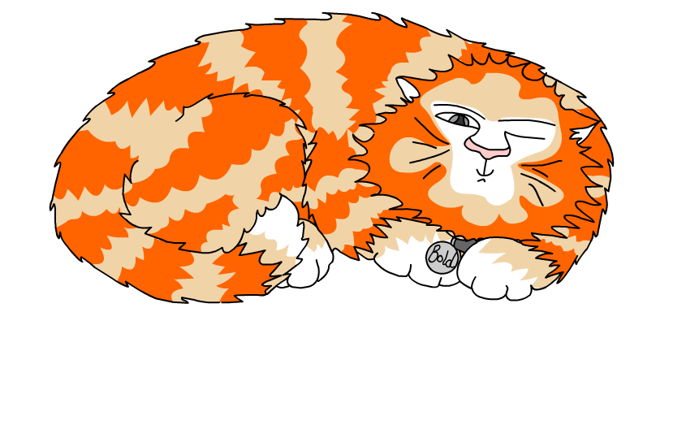
Explore more Hamilton Trust Learning Materials at https://wrht.org.uk/hamilton/ .

