Slide 1

Halves and quarters.
Now fold your paper into four equal parts.
Each part is a quarter.
Fold a sheet of paper in half. What can you say about each piece?
¹/₂
¹/₄
¹/₄
¹/₂
¹/₄
¹/₄
Two quarters are the same size as one half!

Slide 2
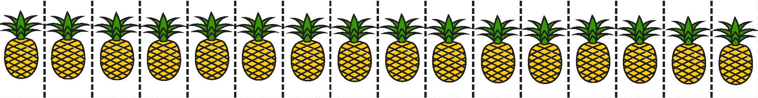
Find fractions of amounts (quarters and eighths).
How many pineapples on this strip?
How many are in each half?
How many are in
each quarter?
How many in
two quarters?
What do you notice?
How many pineapples are in each eighth?

Slide 3
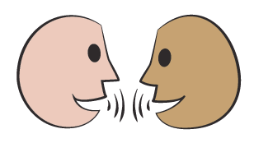
Find fractions of amounts (quarters and eighths).
We can use our strip to answer questions about fractions of 16.
What is ¹/₂ of 16?
What is ¹/₄ of 16?
What is ²/₄ of 16?
Suppose you had a strip of 24 objects.
How many would half be? And ¹/₄? And ¹/₈?
What is ¹/₈ of 16?
What is ³/₈ of 16?

