Slide 1


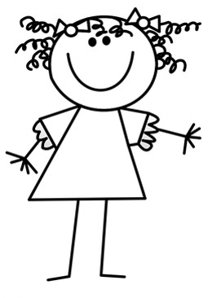
Word Classes: Nouns, adjective, verbs, adverbs Video Games
I love seeing the fun characters in Mario games, whizzing fast in their vehicles or jumping high in the air.
I think some of the characters are rather scary when they shout loudly.

Slide 2

Nouns
A noun names a person, place, idea, thing or feeling.
a plumber
the rescue
a race
a mushroom
In front of a noun, we often have
a an the
determiners

Slide 3

Nouns
A noun names a person, place, idea, thing or feeling.
Proper nouns are shown using capital letters.
Mario
Mushroom Town
Yoshi the dinosaur
When a noun is a particular name it is called a
proper noun.

Slide 4

Verbs
Verbs indicate what someone or something is
doing, feeling or being.
Mario gasped.
The kart hurtled.
He has Princess Peach.
I win!
Usually verbs have the name of a person or thing or a pronoun in front of them.

Slide 5

Adjectives
An adjective is a describing word.
It tells you more about a noun.
those funny clothes
some exciting news
a nice, normal day
his clenched fist
The clothes were funny.
Adjectives sometimes come next to ‘their’ nouns…
but sometimes they do not.

Slide 6

Adverbs
An adverb tells you more about a verb.
It helps us express
manner,
time
and place.
gently
quickly
earlier
daily
here
away
kindly
hard
soon
there
around
often
How?
When?
Where?
then
inside
wildly
first
back
loudly
next
daily
fast
last
everywhere
carefully
yesterday
nearby
spoke quickly
arrived last
ran away

Slide 7
Adverbs
immediately
first
kindly
there
behind
An adverb can come before or after a verb.
“Stop!” she said immediately.
He spoke as kindly as he could.
He spoke as kindly as he could.
His kart moved behind.
“Stop!” she said immediately.
His kart moved behind.
Which verbs are being modified by the adverbs?

Slide 8


Multiple word classes
Look at how Mario and Luigi are using the word ‘click’.
verb
I will click my fingers loudly.
I heard a loud click.
Are they the same word class?
noun
No! One is a verb and the other is a noun.

Slide 9
Multiple word classes
What about the word ‘hard’.
I find swimming very hard to do.
adverb
This is a super hard piece of cheese!
Are they the same word class?
No! One is an adverb and the other is an adjective.
adjective

Slide 10
Multiple word classes
Can you think of two word classes that these can belong to?
This design is great!
noun
I am going to design a new house.
verb
This is a really dirty kart!
Wario is always playing dirty.
adjective
adverb

Slide 11

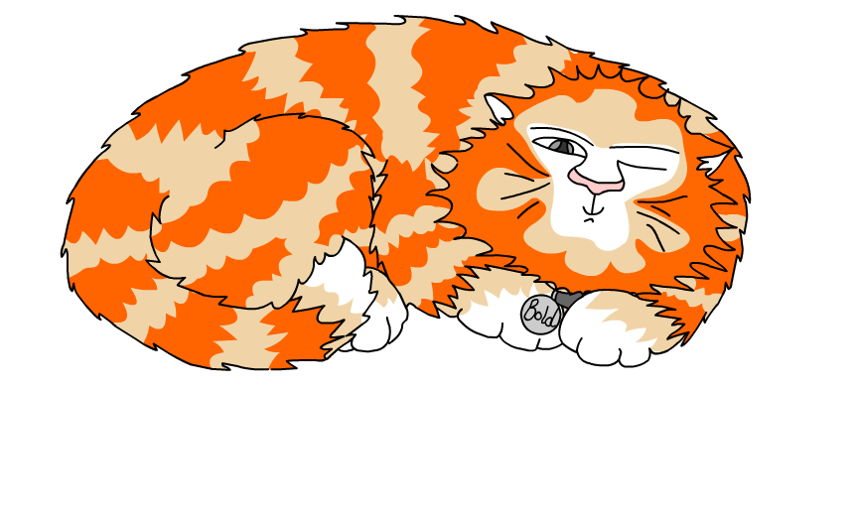
Explore more Hamilton Trust Learning Materials at https://wrht.org.uk/hamilton/ .

