Slide 1
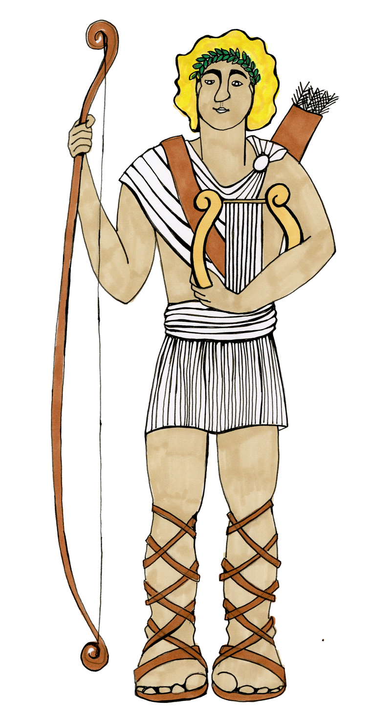
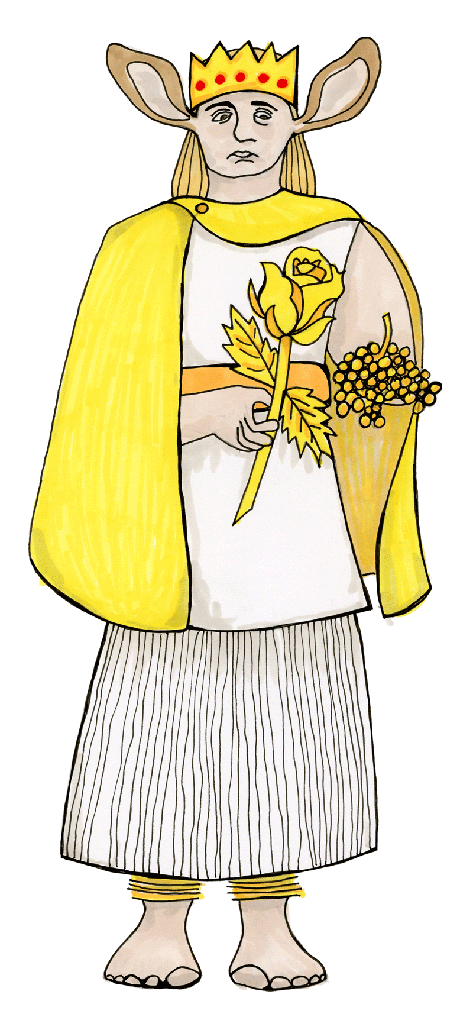

Punctuating Direct Speech
Greek Myths
What do you remember about writing speech?
I am too busy listening to Pan’s amazing music for that!

Slide 2
Spotting Direct Speech
Look at this example from the story of King Midas.
“There is something wrong with your ears if you think Pan’s music is better than mine.”
“Nothing wrong with my ears,” said foolish king Midas.
“Oh, no? Well we can soon change that!”
When he got home, Midas’s ears were itching… he had brown and pink donkey’s ears.
Which words are direct speech? How do you know?
Now read this excerpt out loud, using expression.

Slide 3
Punctuating Speech
Speech bubbles can show us what a character is saying.
Pan was better
The words actually spoken are called direct speech.
“Pan was better,”
confirmed King Midas.
Bubbles take up too much room so we use speech marks.
Speech marks work in pairs to hug the direct speech.
We report who is speaking using a reporting clause.
Speech marks are also called inverted commas.

Slide 4
Punctuating Speech – capital letters open direct speech
Direct speech begins with a capital letter, even if it is in the middle of a sentence.
King Midas said, “You just don’t play as well as Pan.”
Apollo replied, “What is wrong with you?”
It is the beginning of the speaker’s sentence so a capital letter is used.

Slide 5
Punctuating Speech – commas separate clauses
Direct speech and reporting clauses are usually separated by a comma.
“I am so much more musical than Pan,” he said.
King Midas sighed, “You are deluded, Apollo!”
The comma is placed at the end of the first clause.
The speech marks follow the comma.

Slide 6
Punctuating Speech – exclamations and questions
If the speech ends in a ! or ? we do not need a comma after the speech.
“Use your ears, Midas!” shouted Apollo.
“What did you say, Apollo?” King Midas teased.
The punctuation is placed inside the speech marks.
The punctuation belongs to the spoken words – they tell you how to say them.

Slide 7
Punctuating Speech – a new line shows a change of speaker
Those ears should help with your listening.
“Those ears should help with your hearing,” said Apollo.
My ears look hideous!
“My ears look hideous!” sobbed King Midas.
“I think they suit you,” chuckled Apollo.
I think they suit you.
We show each change of speaker by starting a new line.
This makes it clear when the speaker changes.

Slide 8

Punctuating Speech – What are the rules?
I look like a complete idiot
Hug the words spoken with speech marks
Start the speakers’ words with a capital letter
Separate the speech and reporting clause with a comma
Start a new line to show the speaker has changed
“I look like a complete idiot,” said King Midas.
I am going to need a bigger hat!
Try writing this as punctuated speech.

Slide 9

This is a Hamilton Trust Presentation. For more fantastic resources visit our website
https://www.hamilton-trust.org.uk/ .

