Slide 1

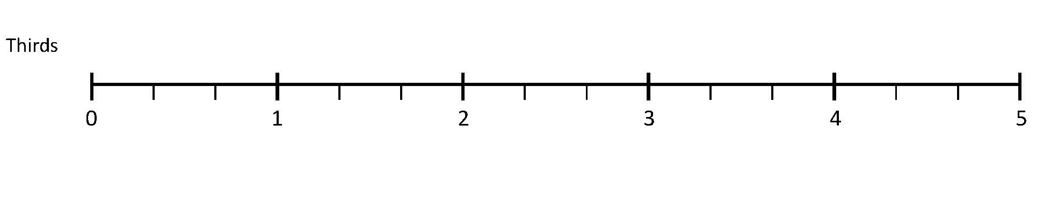

Count in ¹⁄₄s, ¹⁄₃s, ¹⁄₈s and ¹⁄₁₀s, saying equivalent fractions.
Let’s count along the line... one third, two thirds, ONE, one and one third, one and two thirds, TWO....
This number line goes up in thirds.
²/₃
1²/₃
2¹/₃
3²/₃
4¹/₃
Write the number the arrow points to.

Slide 2
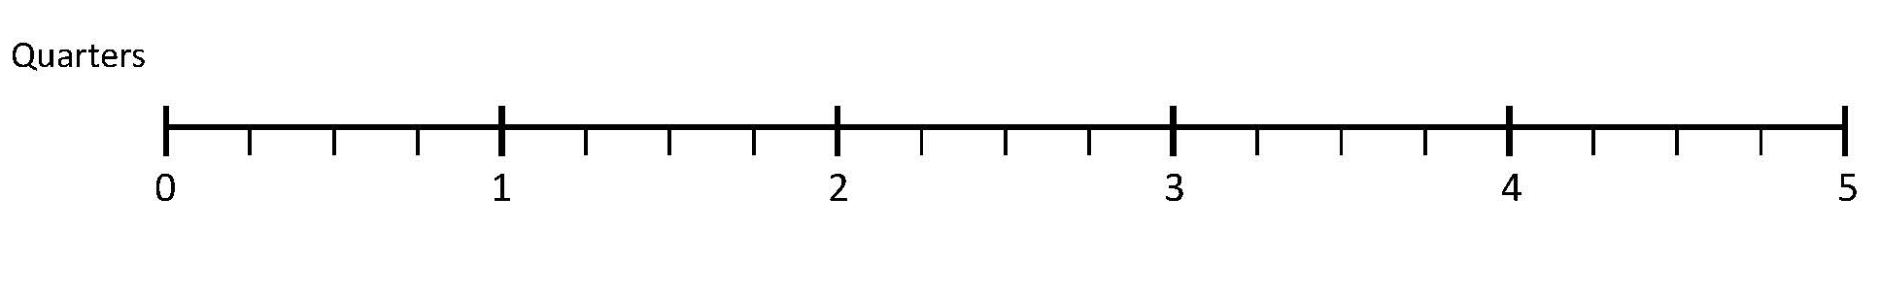
Count in ¹⁄₄s, ¹⁄₃s, ¹⁄₈s and ¹⁄₁₀s, saying equivalent fractions.
Let’s count along the
line from one quarter to five: One quarter, two quarters, three quarters, ONE, one and one quarter….
This number line goes up in quarters.
¹/₂
1¹/₂
2¹/₂
3¹/₂
4¹/₂
²/₄
1²/₄
Let’s count to five using quarters and halves:
One quarter, one half, three quarters, ONE, one and a quarter, one and a half, one and three quarters…
What’s another way of saying two quarters?
One and two quarters? Two and two quarters…

Slide 3
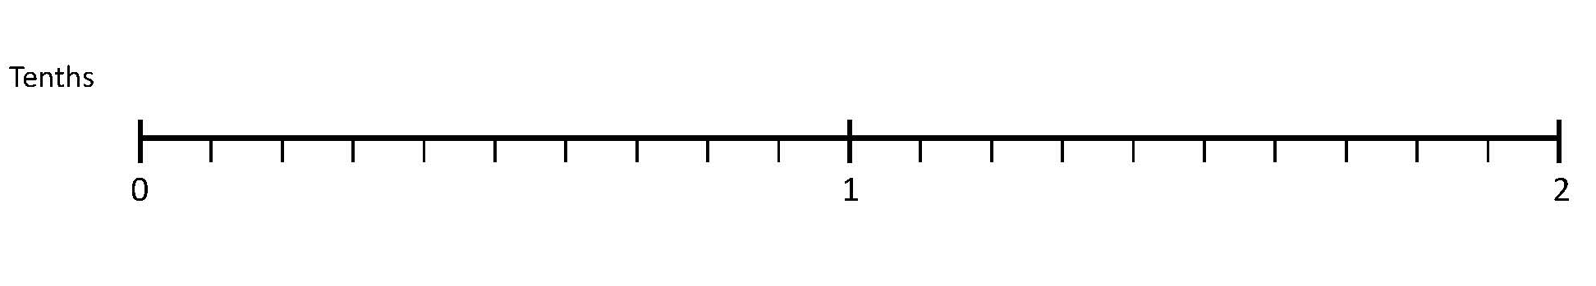
Count in ¹⁄₄s, ¹⁄₃s, ¹⁄₈s and ¹⁄₁₀s, saying equivalent fractions.
This number line goes up in tenths.
Let’s count along the
line to two: One tenth, two tenths, three tenths……ONE, one and a tenth….
¹/₅
²/₅
¹/₂
³/₅
⁴/₅
²/₁₀
⁴/₁₀
⁵/₁₀
⁶/₁₀
⁸/₁₀
Let’s mark on equivalent fractions.
Now from 1 to 2 – the pattern will be the same..
Let’s count along in tenths from 0 to 1 using the simplest equivalent fractions.

